Slide 1
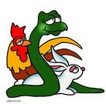
Characteristics of Living Things

Slide 2
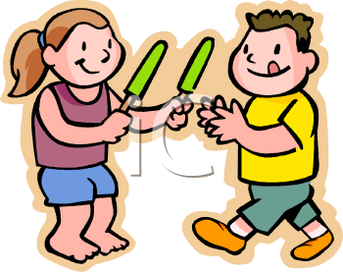
What is a living thing?
A living thing is something that has ALL seven of the following characteristics.
Growth and Development
Organization
Stimulus and Response
Homeostasis
Adapt and Evolve
Reproduce
Energy

Slide 3
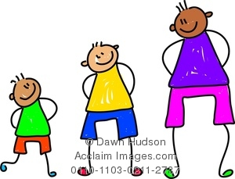
Growth
Growth is observed when a living things gets larger.
Living things have an increase in the number of cells when they grow.
Growth is an increase in the number of cells an organism has which causes the organism to get larger.

Slide 4
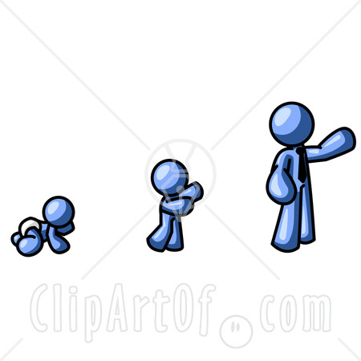
Development
All of the changes that occur in order for an organism to become an adult are known as development.

Slide 5
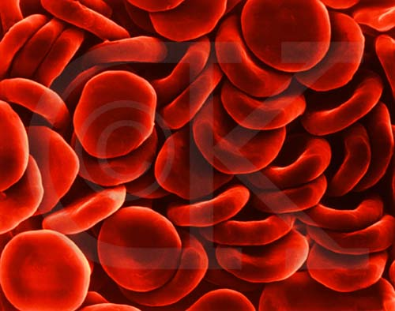
Organization
ALL living things are made up of cells.
The cell is the basic unit of structure and function in ALL living things.
ALL living things have certain parts that perform certain functions. This is known as organization.

Slide 6
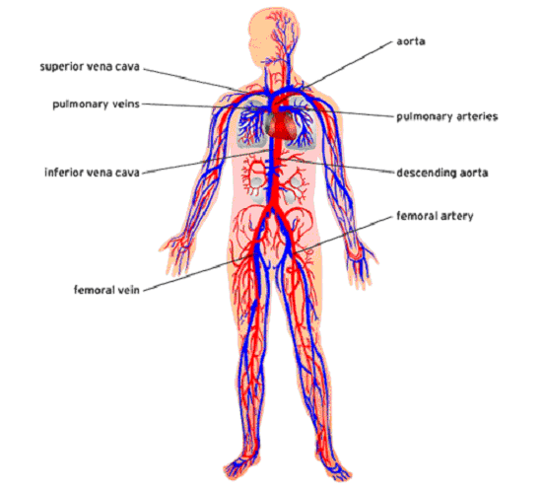
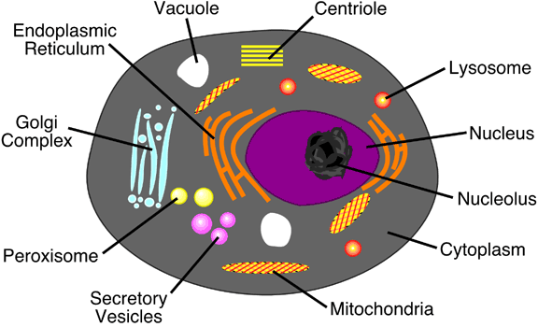
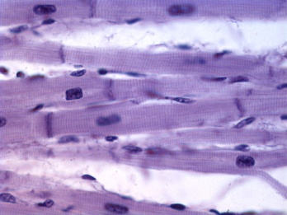
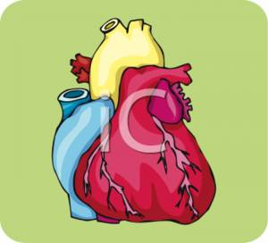
Organization
All cells have smaller parts that work together to perform functions needed by a particular type of cell.
Multi-cellular organisms have the following organization scheme:
Cell → Tissue → organ → organ system → organism

Slide 7
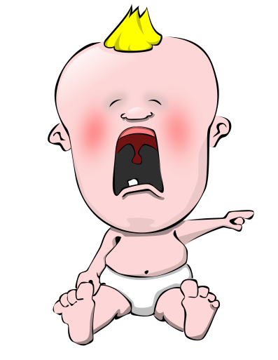
Stimulus and Response
A stimulus is anything in the environment that causes an organism to react.
Example – You take your baby brother’s lollipop!!
A response is the result or reaction to a stimulus.
Example - Your baby brother cries.

Slide 8
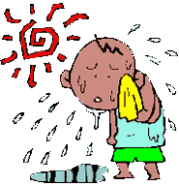
Homeostasis
Homeostasis is maintenance of a stable internal environment.
Living things die when they are not able to maintain homeostasis.
Examples
Excreting waste
Feeling thirsty
Sweating when you are hot
Shivering when you are cold

Slide 9
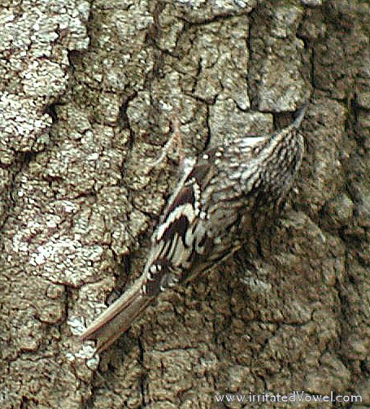
Adapt and Evolve
Adaptations are things that help you survive in a given environment.
Inherited from your parents.
Evolution is a change in the gene pool of a population over a long period of time.
Populations evolve!!! Individuals do NOT evolve!

Slide 10
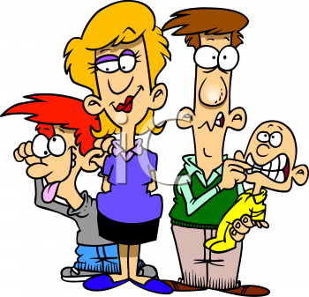
Reproduce
An organism reproduces to make more of the species.
A species is a group of organisms that can interbreed and produce fertile offspring.

Slide 11
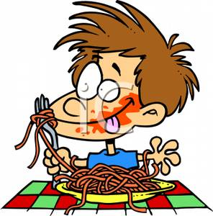
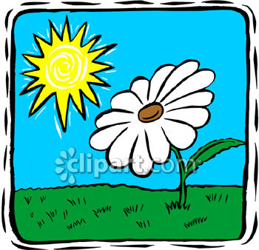
Energy
All living things need energy in order to survive.
Living things use one of two methods to obtain their energy: autotroph or heterotroph.
An autotroph is capable of making its own food. Autotrophs carry out photosynthesis.
A heterotroph must consume another organism for their energy needs.

