Slide 1
Enzymes
Objective 2.01
Functions of Enzymes
How Enzymes Work

Slide 2
Enzymes…
  A type of protein
  Responsible for speeding up the rate of a reaction.
  Very specific!! (Lock and Key)
  Found in different parts of your body
  5. Usually end in –ase
    Ex: Lactase, Amylase, Protease, Oxidase

Slide 3
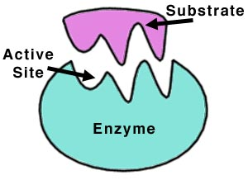
Examples in Body
Saliva: Amylase = breaks down sugars/starch
Digestive System:
  Protease = breaks down proteins
  Lipase = breaks down lipids
  Lactase = breaks down dairy
Tears: Lysozyme = breaks down bacterial walls
Detergents: Lipases, Proteases, Amylases

Slide 4
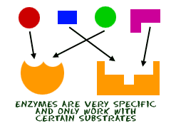
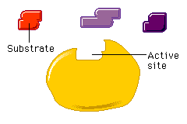
Enzyme Structure
Enzymes have different binding sites called active sites (Locks) that only work on a specific substrates (Keys).
Keys
Lactose
Sucrose
Fructose
Active Site→
Lactase
Lock
Lock

Slide 5
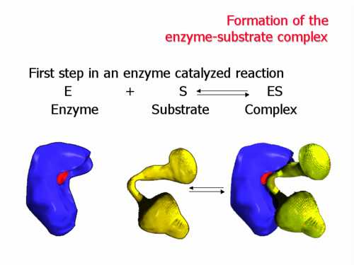
Enzymes lower the activation energy required for the reaction to take place.
Therefore enzymes are catalysts!
The reactants (ingredients) are called substrates.
The substrates bind to the active site of the enzyme

Slide 6
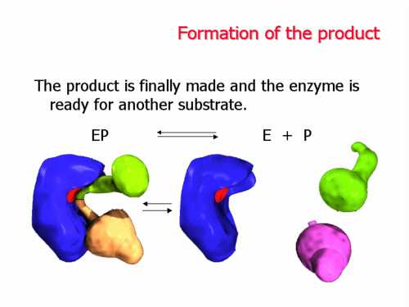
The enzyme either breaks apart the substrate or bonds the substrates together
The product is then released
The enzyme does not change and is free to catalyze another reaction

Slide 7

What affects Enzymes?
Enzymes are very specific!! They only function at certain temperatures or pH’s (acid/base)
If you raise/lower the temperature or pH of an enzyme, the active site shape changes
The enzyme will not be able to work with it’s substrate! ☹

Slide 8
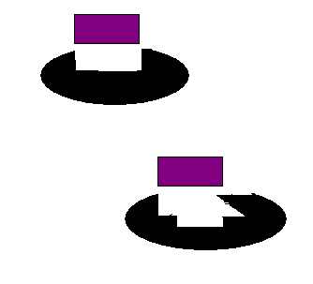
Active Site Shape Change
Enzyme at normal temperature and pH
Enzyme after raising or lowering temperature or pH = will not work!!
**The enzyme is DENATURED!! = “damaged”

Slide 9
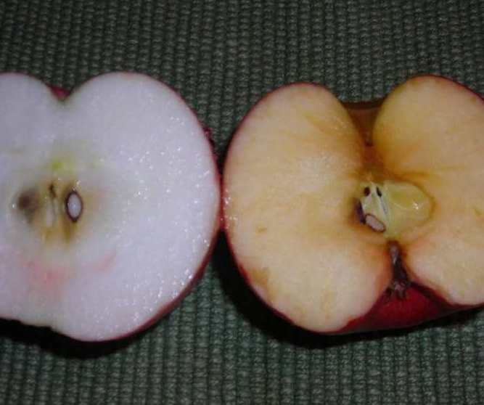
1. Oxidase is an enzyme found in fruits that react with oxygen in the air. When exposed to oxygen, the fruit turns brown.
If you add lemon juice to the apple, it LOWERS the pH (lemons are acidic)
The active site changes and cannot react with oxygen → apple does not turn brown!!

Slide 10
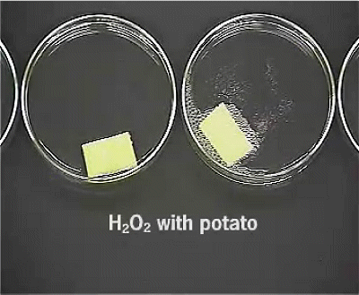
2. Catalase is an enzyme found in all living cells. It protects our cells against the chemical hydrogen peroxide (H₂O₂)
Hydrogen peroxide is very toxic to cells and can kill them..
Catalase breaks H₂O₂ →H₂O + O₂
A
B
-Dish A is a BOILED potato.. No reaction.. WHY?
-Dish B is a raw potato.. What are the bubbles??

Slide 11
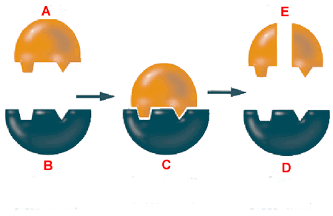
Review!!
A: Substrate
B: Enzyme
C: Enzyme-Substrate Complex
D: Enzyme
E: Products

