Slide 1
The Periodic table
Intro notes

Slide 2
Periodic table:
Table where elements are organized by increasing atomic number (number of protons)
In the late 1800s, Dmitri Mendeleev devised the first periodic table based on atomic mass.
This made some elements not be in the correct order
In 1913, Henry G. J. Moseley arranged elements by atomic number and is what is used today.

Slide 3
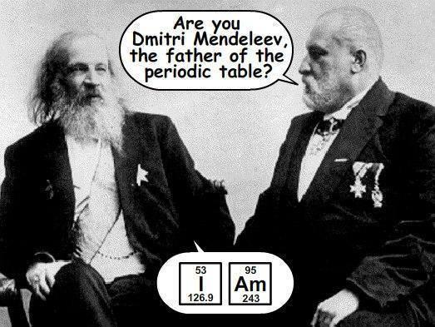
https://twitter.com/googlescifair/status/496890933846491136

Slide 4
Groups in the periodic table:
VERTICAL columns of elements with similar properties
Groups are numbered 1-18
Elements in the same group have the same number of electrons in their outer energy level

Slide 5
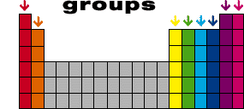
1 2 3 4 5 6 7 8
http://www.edcoogle.com/blog/2015/04/what-is-periodic-table-how-to-read-the-periodic-table-elements/

Slide 6
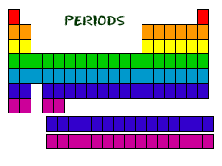
Periods in the periodic table:
HORIZONTAL rows of elements that contain increasing number of protons and electrons
Numbered 1-7
Each ROW in the periodic table ends when an outer energy level is filled

Slide 7
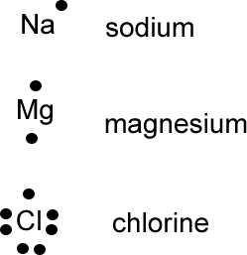
Electron dot (Lewis) diagrams:
American chemist G.N. Lewis
Use the element symbol and dots to represent the outer energy level electrons
Depends on the group in which the element is located:
number of valence e-
http://the3chemiteers.blogspot.com/2011/11/electron-dot-diagrams-nucleus-is.html?_sm_au_=iVVSTfZ5fJVZnLvH

Slide 8
https://www.youtube.com/watch?v=y6QZRBIO0-o

Slide 9
Practice:

Slide 10
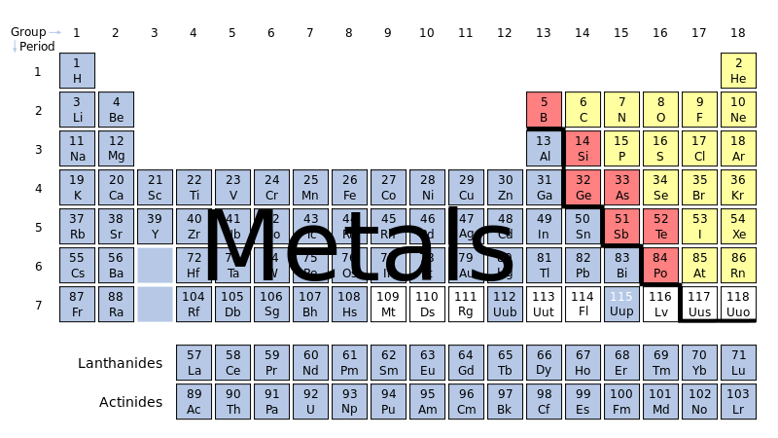
Metals:
Good conductors of heat & electricity
All but Mercury (Hg) are solid at room temperature
Metals are located to the left of the stair-step on the periodic table
https://commons.wikimedia.org/wiki/File:Periodic_table-metals.svg

Slide 11
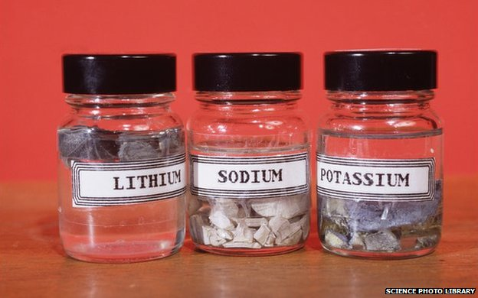
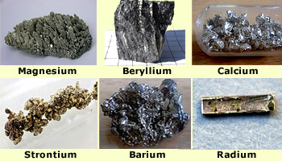
Metals:
Alkali Metals: group 1 on periodic table
Most reactive of all metals
Do not occur in nature in their element form
Alkaline Metals: group 2 on periodic table
Shiny, ductile & malleable
Combine easily with other elements
http://zunal.com/introduction.php?w=266222
www.emaze.com

Slide 12
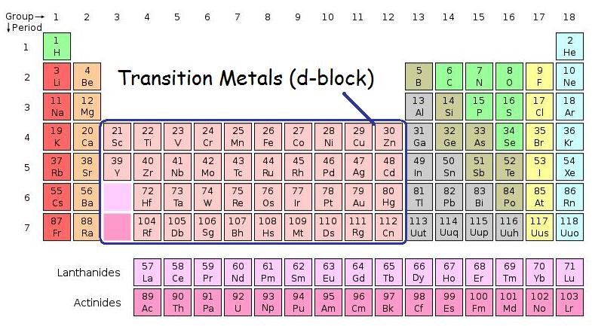
Transition elements
Groups 3-12 on periodic table
Most familiar metals since they often occur in nature uncombined
Includes the Lanthanide & Actinide series
http://chemwiki.ucdavis.edu/Inorganic_Chemistry/Descriptive_Chemistry/Elements_Organized_by_Block/3_d-Block_Elements/1b_Properties_of_Transition_Metals/Electron_Configuration_of_Transition_Metals/Oxidation_States_of_Transition_Metals

Slide 13
Non Metals:
Elements that are usually gases or brittle solids at room temperature
Most can form ionic and covalent compounds
Located to the right of the stair-step

Slide 14
https://commons.wikimedia.org/wiki/File:Periodic_table-metals.svg

Slide 15
Noble gases:
Group 18 on the periodic table
Exist as isolated atoms
They are all stable because their outer energy level is filled

Slide 16
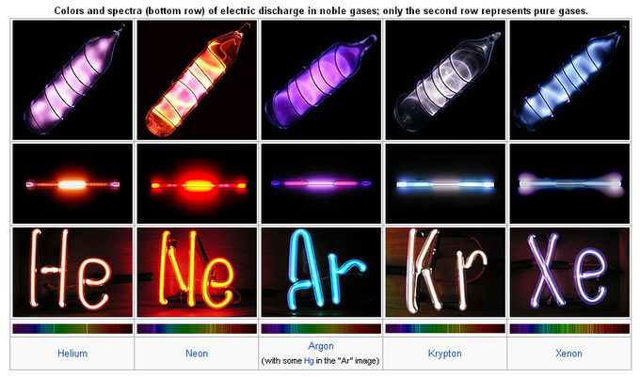
https://www.boundless.com/chemistry/textbooks/boundless-chemistry-textbook/periodic-properties-8/variation-in-chemical-properties-70/the-noble-gases-group-18-330-1854/

Slide 17
Metalloids:
Elements that make up stair-step on the periodic table
Have metallic and non-metallic properties
Part of the mixed-groups – which contain metals, non-metals and metalloids

