Slide 1
Properties of Matter

Slide 2
Physical Properties:
Characteristic of a material that you can observe without changing the identity of the substances that make up the material.
Examples: color, shape, size, density, melting point, boiling point

Slide 3
Physical Appearance:
How would you describe this object?
If you could hold this object, would it be
easier to describe the object? How?

Slide 4
Behavior:
Physical properties also describe the behavior of the object
Examples: attraction to magnets, metals turned into wire or jewelry
Think about the soda – how does spilling your cup of soda differ from spilling a jar of molasses?

Slide 5
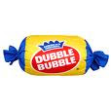
Physical Change:
A change in size, shape or state of matter.
Example: gum
Energy changes but the substance stays the same.

Slide 6
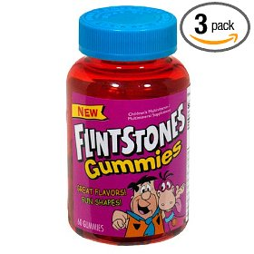
Chemical Properties:
Characteristic of a substance that indicates whether it can undergo a certain chemical change.
Examples: vitamins - stored in dark colored bottles – they may contain compounds that change when exposed to light.

Slide 7
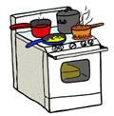
Chemical Change:
A change of one substance to another
Examples: smell in the air after a thunderstorm, pot of pasta burning on the stove.
Can be detected due to rapid releases of energy – heat, light & sound

Slide 8
Chemical Change:
The only sure way to know is a chemical reaction is taking place is a new substance is created:
Think of the dry wood in the fireplace. When we light the wood up, it burns gently and after a while it turns into ashes. As it burns, it produces heat, light and smoke which escapes through the chimney. The heat, light, fire and smoke are all good characteristics of a chemical reaction, which result in a completely new matter—ashes. Note that the ashes from the burning wood has an entirely new molecular composition. It can never be turned back into wood again.

Slide 9
Law of Conservation of Mass:
The mass of all substance that are present before a chemical change equals the mass of all the substances that remain after the change.
Matter is neither created or destroyed during a chemical change
Example: wood burning & producing a pile of ashes, smoke in the atmosphere.

