Slide 1
Muscular System
DISORDERS

Slide 2
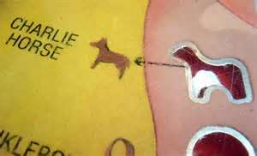
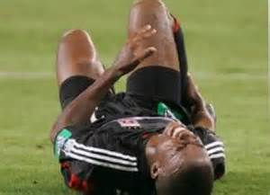
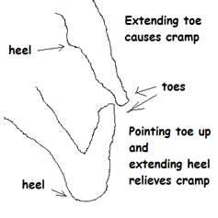
Charley Horse
Painful tear and contusion of a muscle

Slide 3
Why Charley Horse?

Slide 4
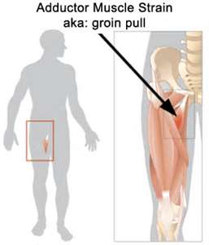
Pulled groin
Strain (tear, break in a muscle) affecting adductors of thigh

Slide 5
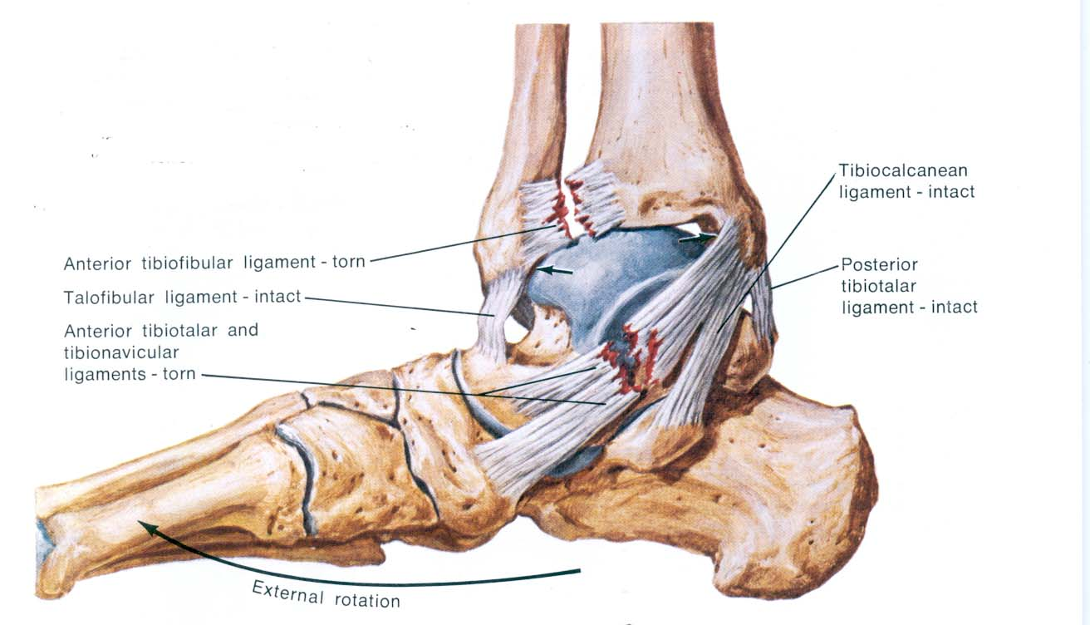
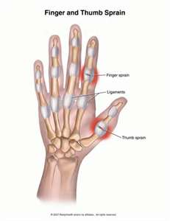
Sprain
Tear or break in ligament or tendons

Slide 6
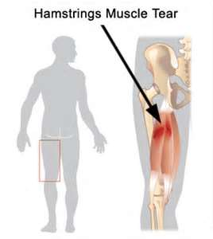
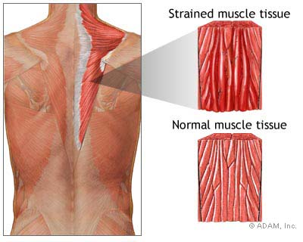
Strain
Tear or break in a muscle

Slide 7
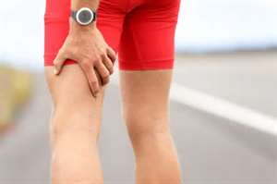
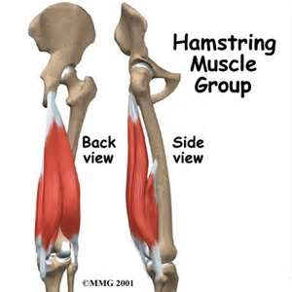
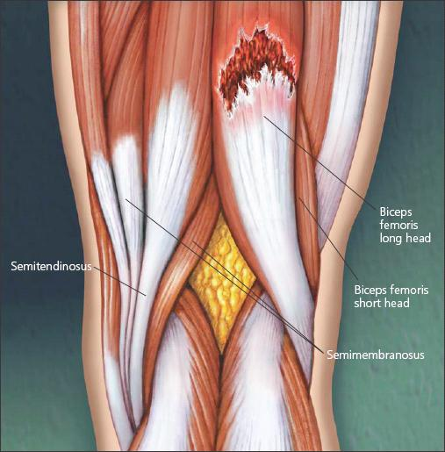
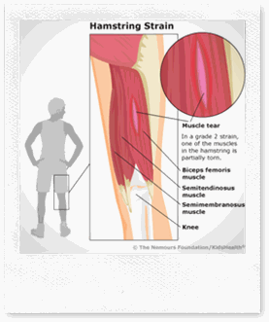
Pulled hamstrings
Strain of leg flexors (hamstrings)

Slide 8
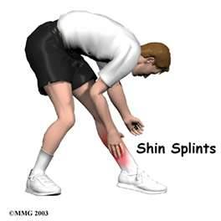
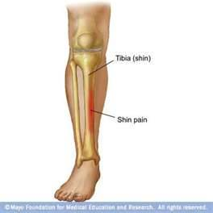
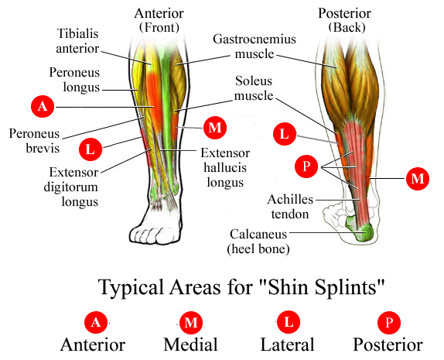
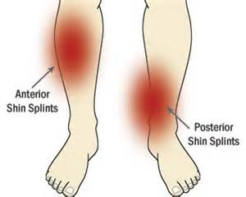
Shin splints
*inflammation of the dorsiflexors over anterior surface of lower leg

Slide 9
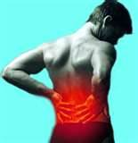
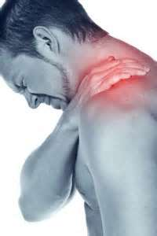
Spasm
Involuntary brief periods of complete tetanus (involuntary contractions)

Slide 10
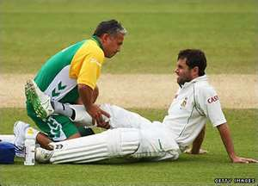
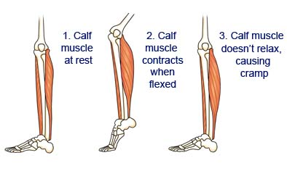
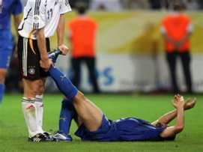
Cramp
Long spasm, by fatigue, chemical/physical sarcolemma damage; drugs

Slide 11
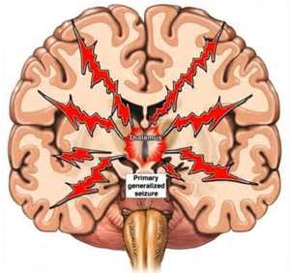
Convulsions
Involuntary contraction of entire muscle group; seizures

Slide 12
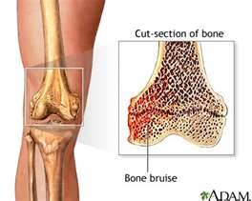
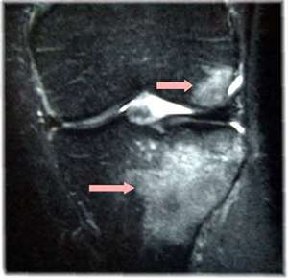
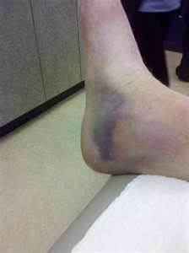
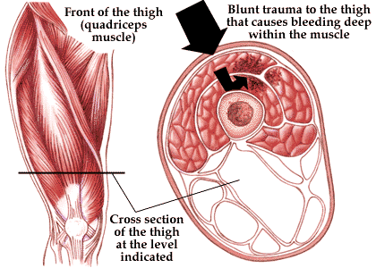
Bone bruise
Hematoma (filled with blood) within the periosteum

Slide 13
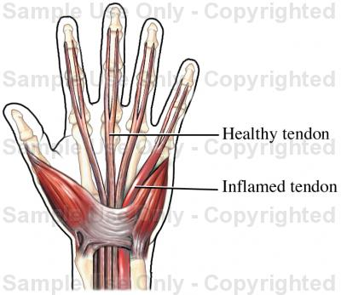
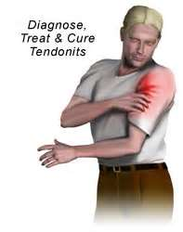
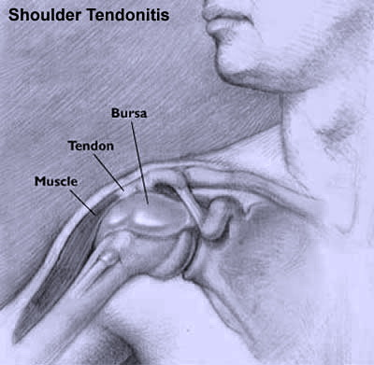
Tendonitis
Inflammation of connective tissue around tendon

Slide 14
Tetanus
Involuntary contraction of skeletal muscle groups throughout body; early symptoms=muscle stiffness, especially facial muscles; same as lockjaw; caused by bacteria Clostridium tetani

Slide 15
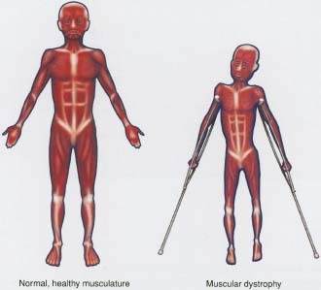
Muscular Dystrophy
Congenital (present at birth), produces progressive muscle weakness and deterioration, mostly in males; respiratory paralysis is usually the cause of death.

