Slide 1
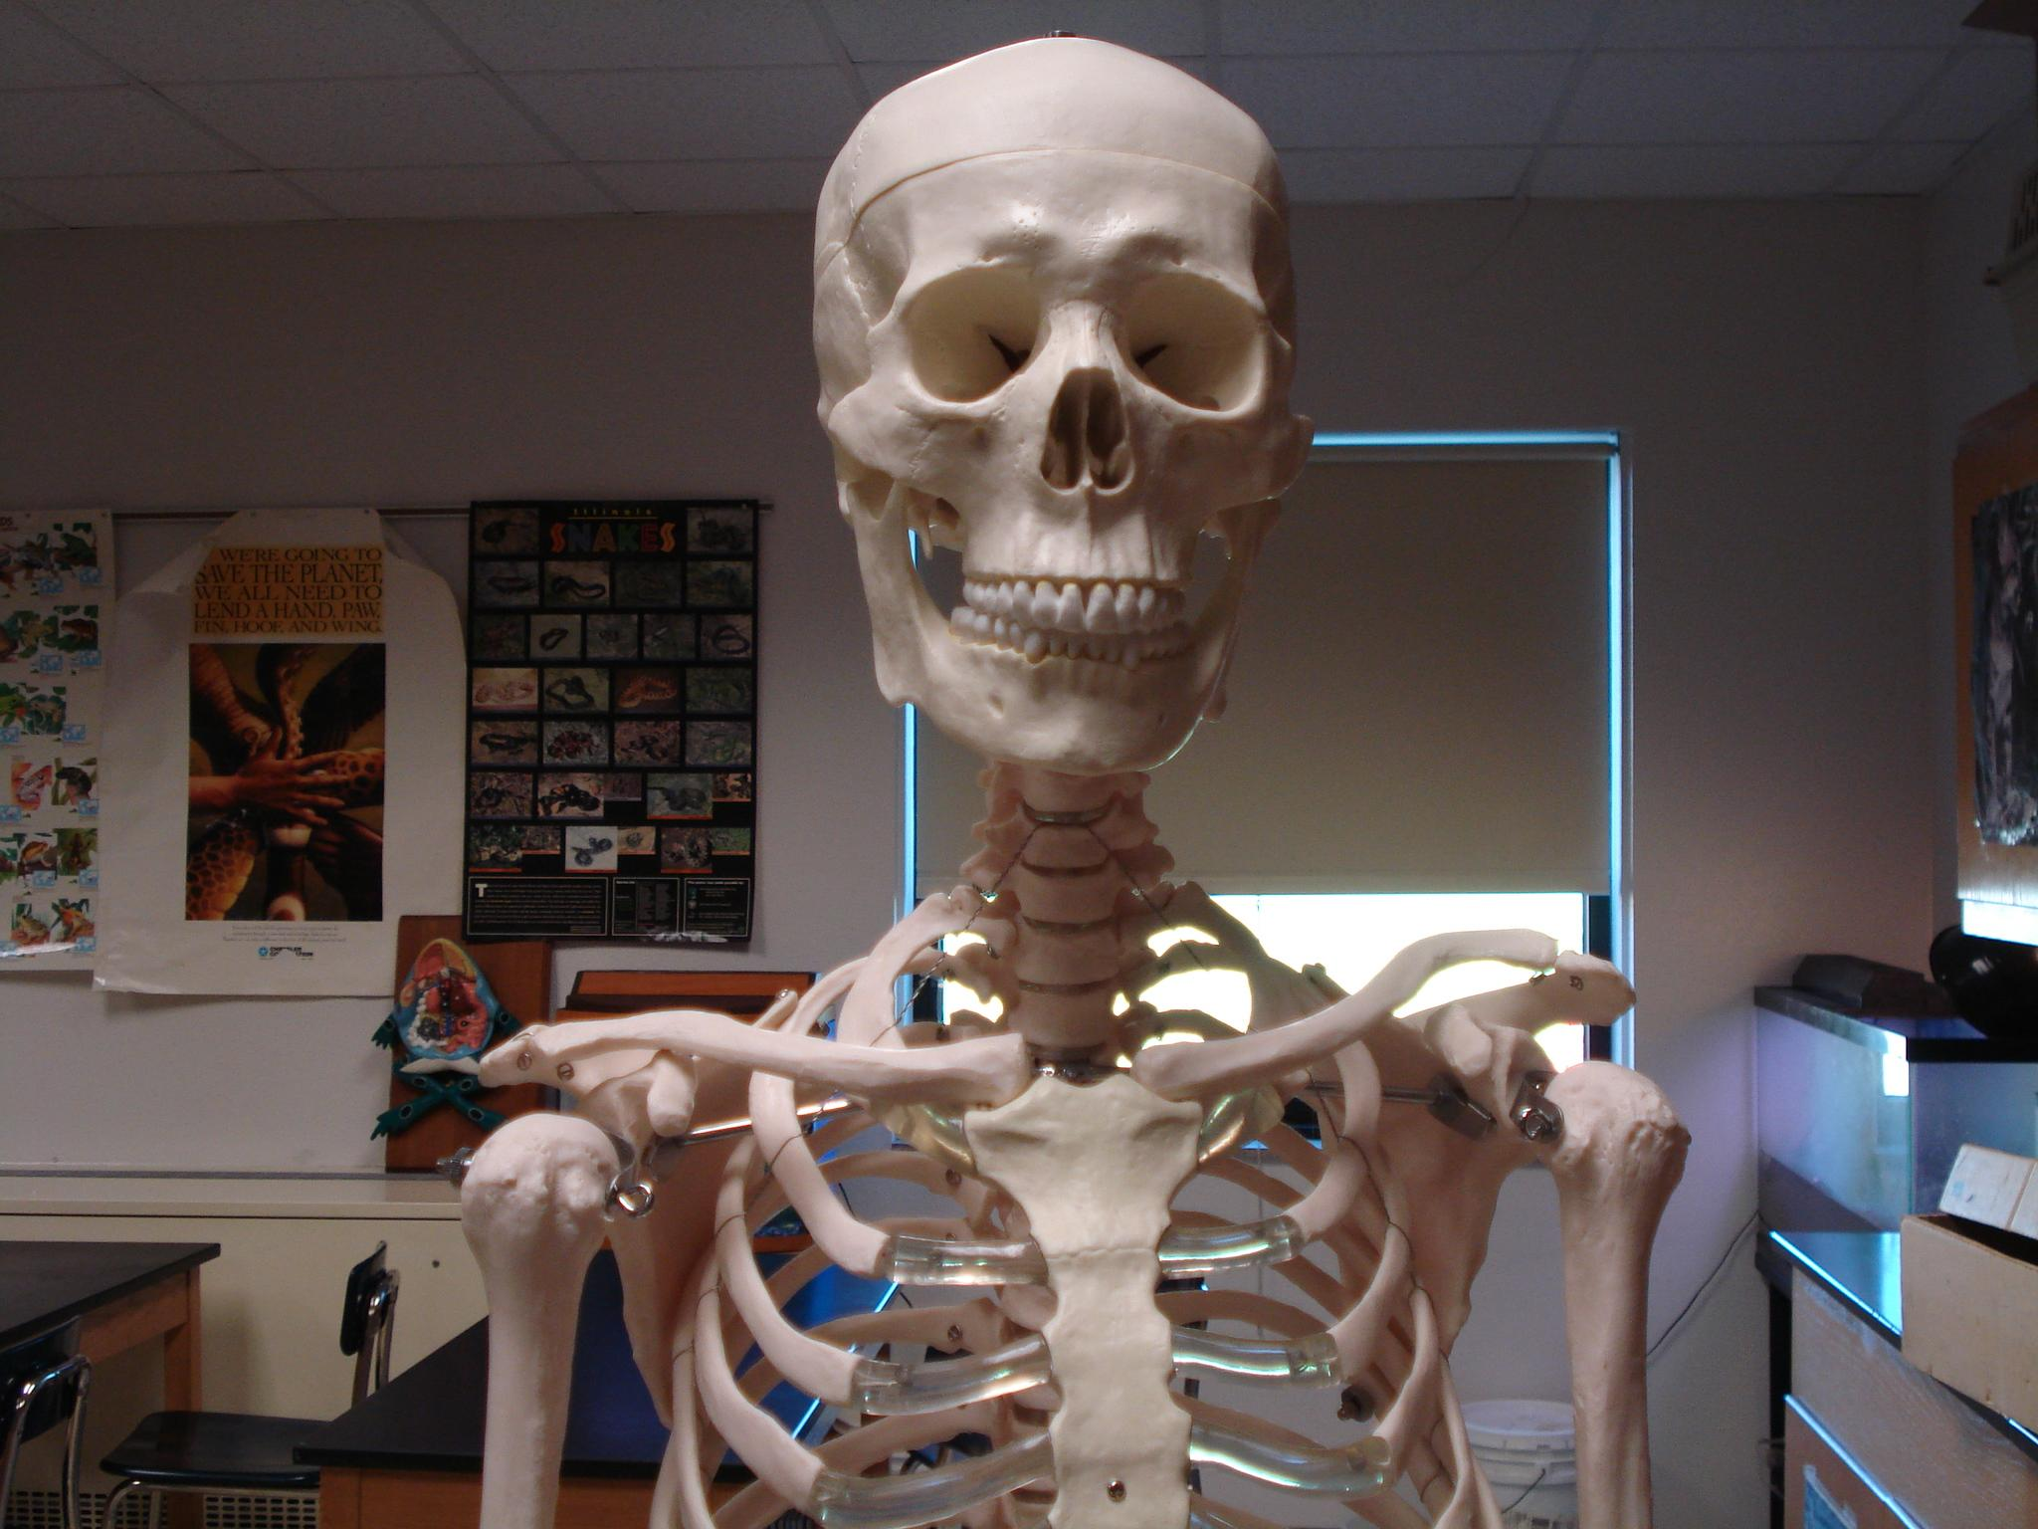
THE SKELETAL SYSTEM
Notes:
If you want to edit slides, go to "file" and make a copy for your own use.

Slide 2
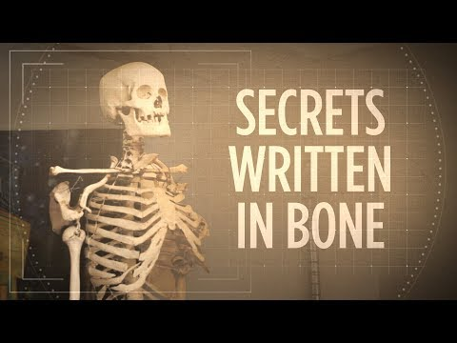

Slide 3
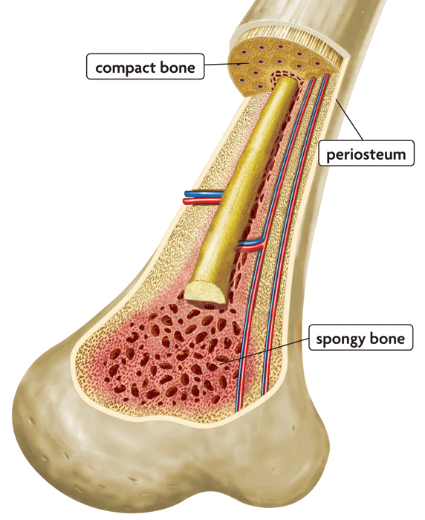
Functions of the Skeletal System
Support and protection
Body movement
Blood cell formation = hemopoiesis (occurs in bone marrow)
Storage of inorganic materials
(salt, calcium, potassium….)

Slide 4
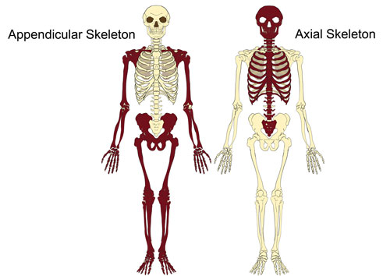
ORGANIZATION
About 206 bones
With 2 Main Divisions

Slide 5
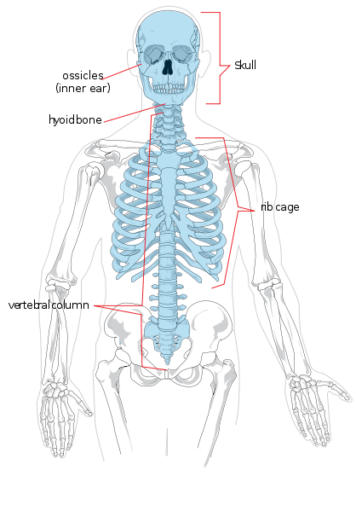
Axial Skeleton
Head, neck, trunk
Skull
Hyoid Bone
Vertebral Column
Thoracic Cage (ribs, 12 pairs)
Sternum

Slide 6
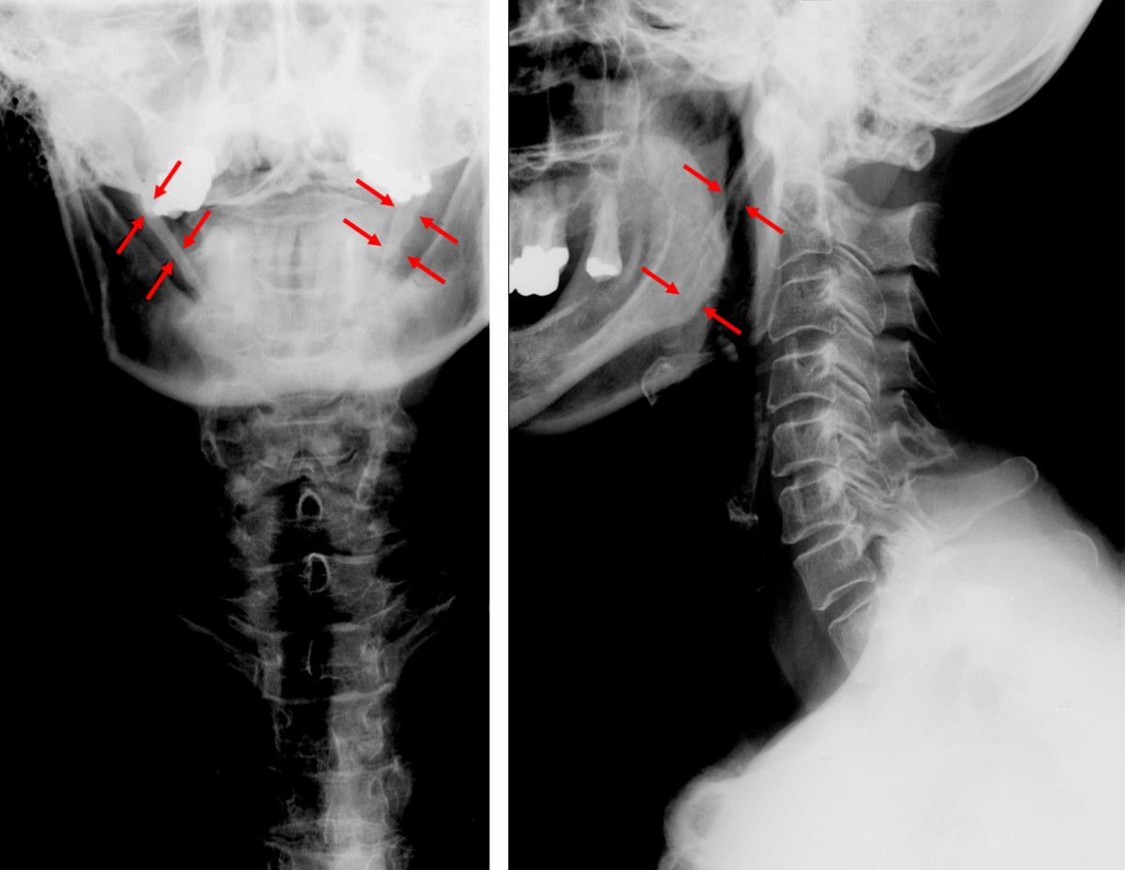
Hyoid Bone

Slide 7
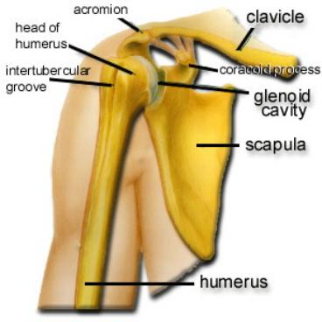
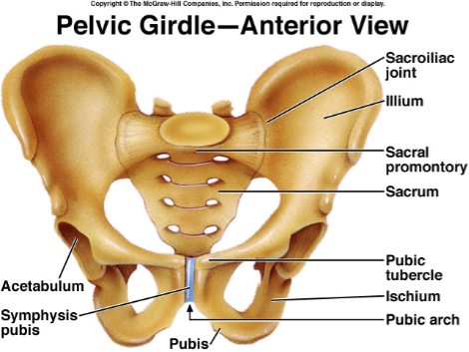
Appendicular Skeleton
Limbs & Bones that connect to the
Pectoral Girdle (scapula, clavicle, arms)
Pelvic Girdle (coxal bones, legs)

Slide 8
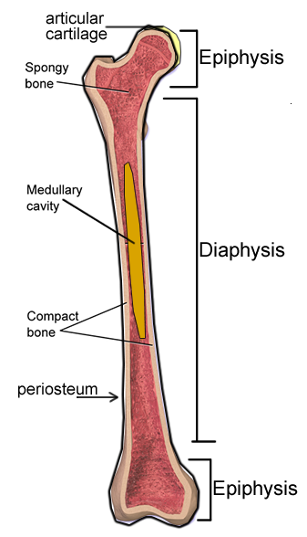
BONE STRUCTURE - Long Bone
1. Epiphysis (end)
2. Diaphysis (shaft)
3. Articular Cartilage
(hyaline cartilage, padding)
4. Periosteum
(membrane that covers entire bone)

Slide 9
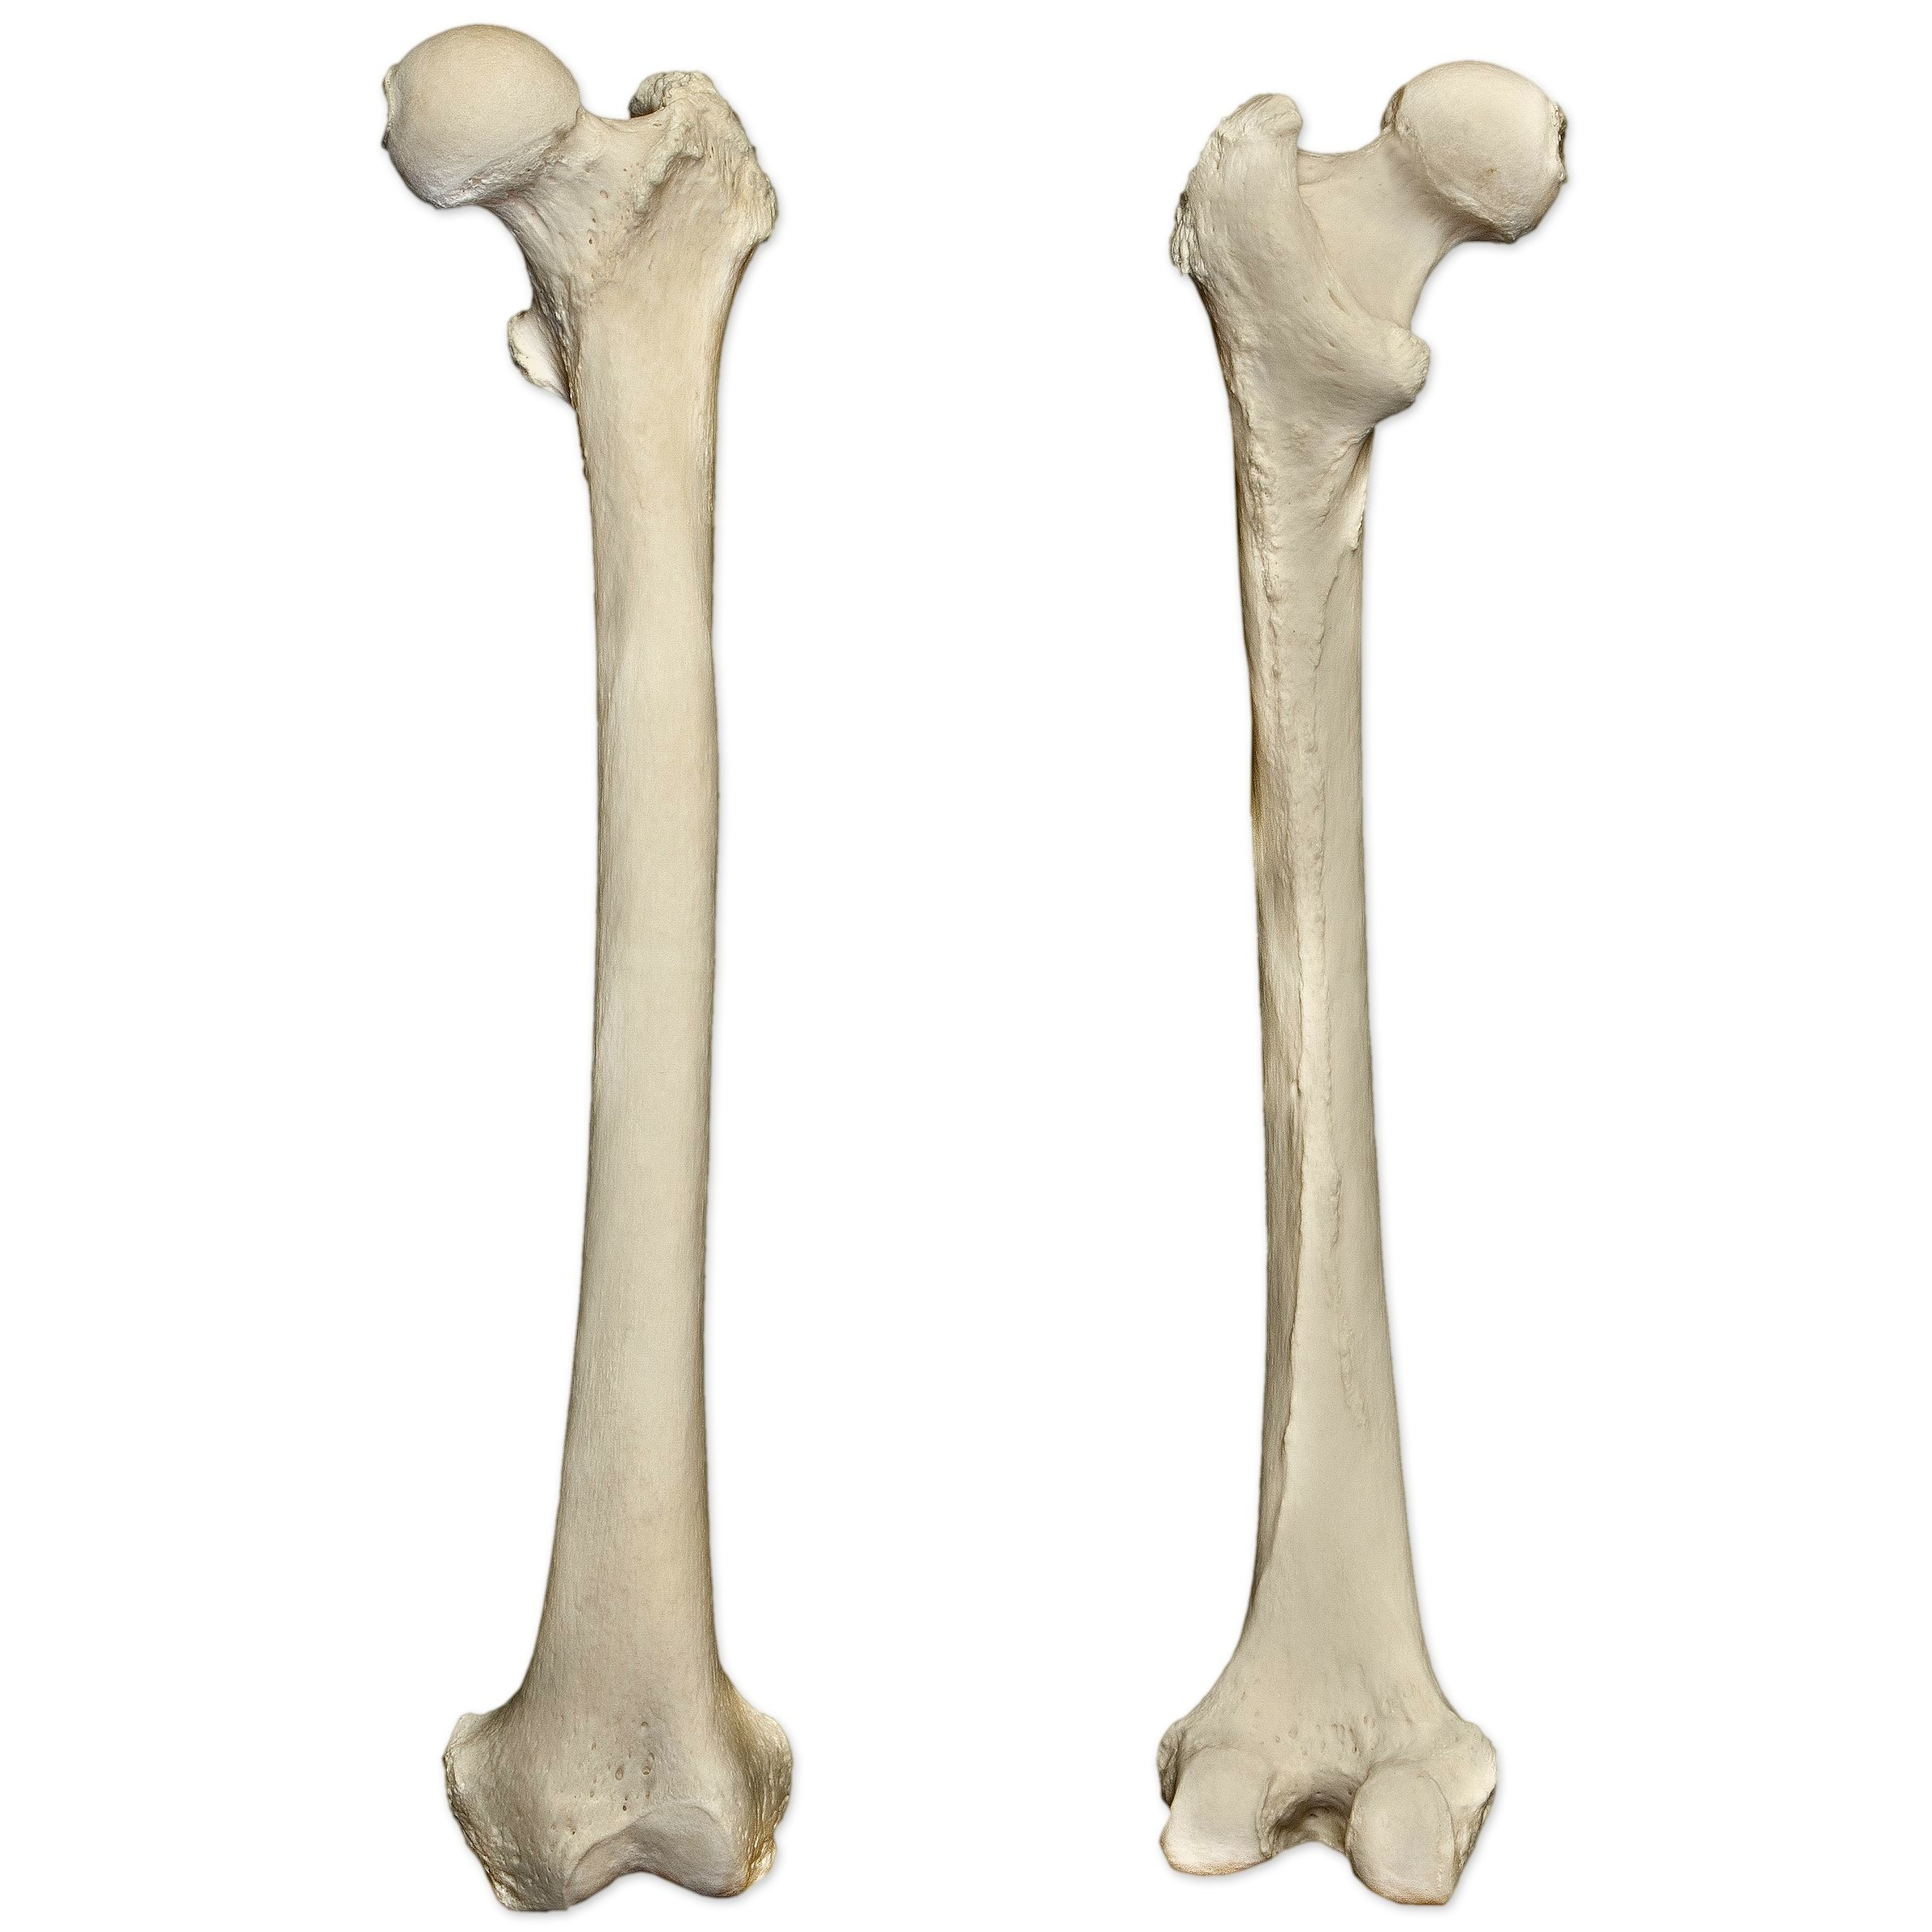
Proximal Epiphysis
The epiphyses are named according to their location.
The epiphysis closest to the body’s center is the PROXIMAL epiphysis.
The one that is farthest away is the DISTAL epiphysis.
Distal Epiphysis

Slide 10
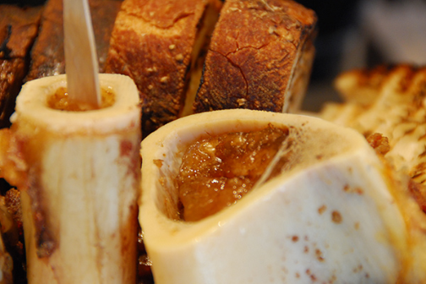
Inside the Long Bone
5. Medullary Cavity – hollow chamber filled with bone marrow
Red Marrow (blood)
Yellow Marrow (fat)
Endosteum
– lining of the medullary

Slide 11
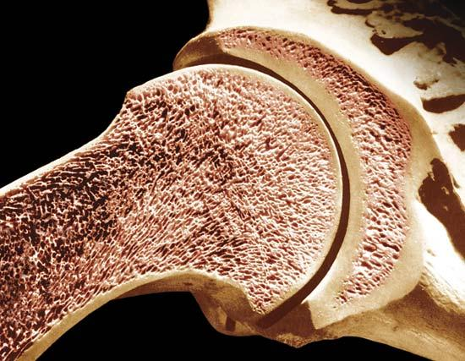
Types of Bone Tissue
Compact (wall of the diaphysis)
Spongy (cancellous, epiphysis) - red marrow

Slide 12
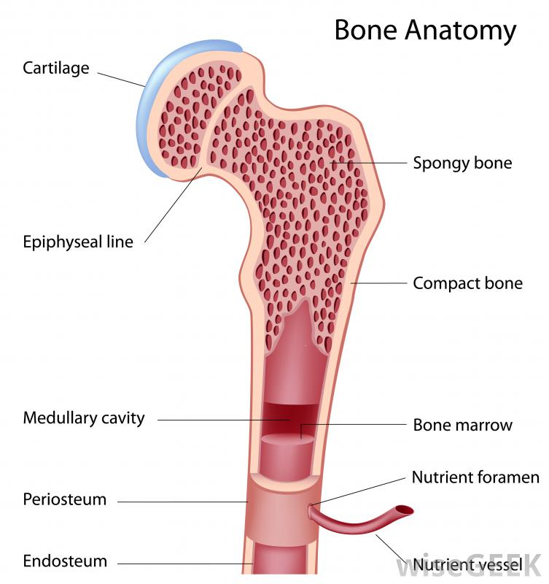

Slide 13
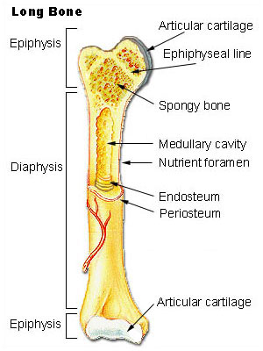
Review the Structure of a Long Bone
Matching quiz at http://www.mhhe.com/biosci/ap/holehaap/student/olc2/chap07matching01.html

Slide 14
Microscopic Structure
Bone tissue is called OSSEOUS tissue - the matrix is composed of collagen and inorganic salts
OSTEOCYTES - mature bone cells, enclosed in tiny chambers called LACUNAE
these form rings called lamella around a HAVERSIAN CANAL which houses blood vessels
CANALICULI - tiny canals that link osteocytes
Haversian and Volkmann canals provide passageways for blood vessels

Slide 15
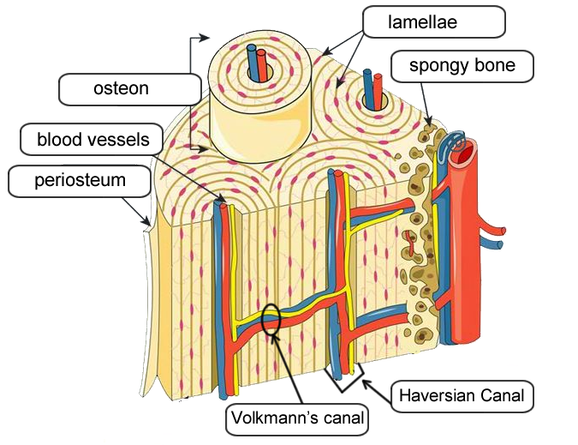
Osteocytes
Haversian Canal
Volkmann’s Canal

Slide 16
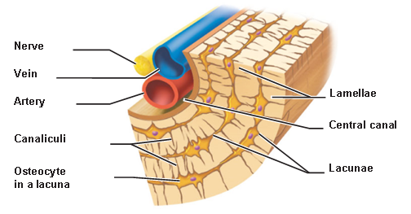

Slide 17
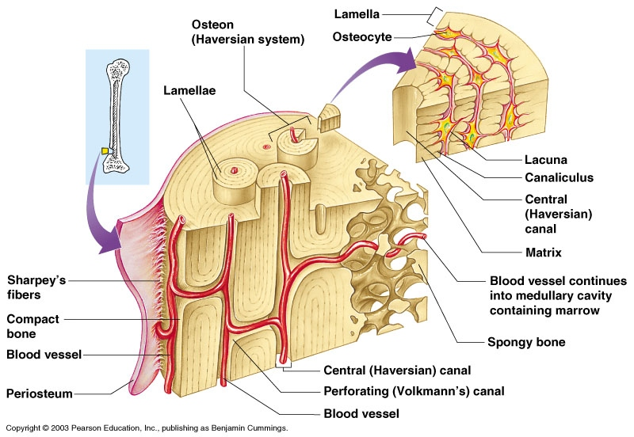
Notes:
https://www.biologycorner.com/worksheets/bone-matrix-color.html

Slide 18
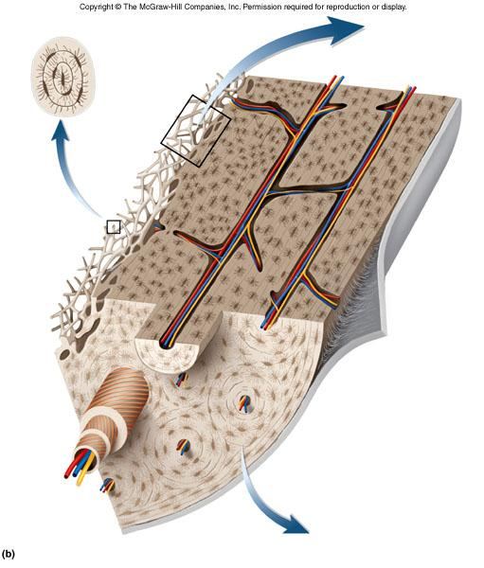
Test Yourself
Find the...
Haversian Canal
Volkman's Canal
Lamellae
Spongy Bone
Compact Bone

Slide 19
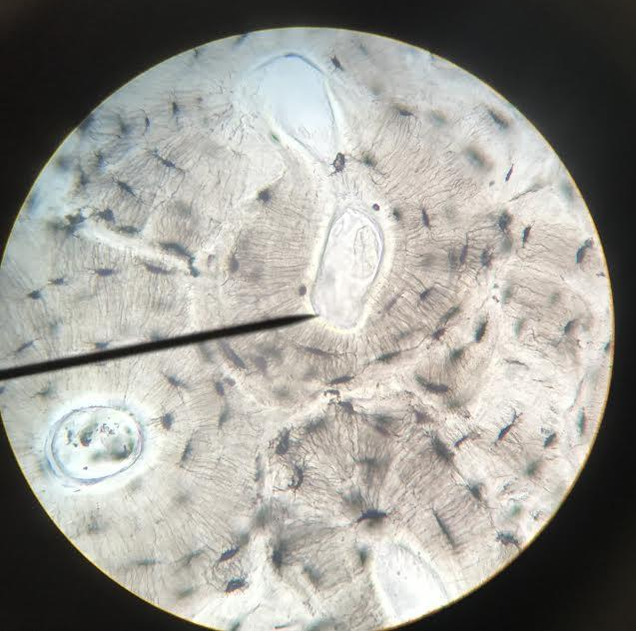
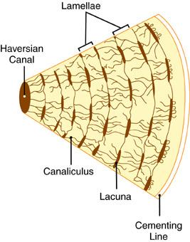
Photo by Gabby Wilkinson, 2018

Slide 20
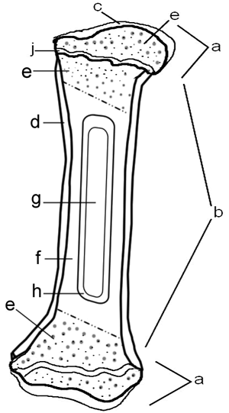
* Bone Matrix & Coloring of a Long Bone Assignment
Notes:
https://www.biologycorner.com/anatomy/skeletal/bone_coloring.html

Slide 21
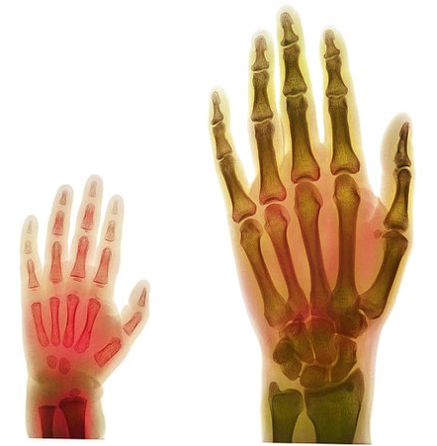
BONE DEVELOPMENT & GROWTH
Intramembranous bones – flat, skull
Endochondral bones – all other
Bones first form as hyaline cartilage. The cartilage then gradually changes into bone tissue - a process called OSSIFICATION
PRIMARY OSSIFICATION CENTER (shaft)
SECONDARY OSSIFICATION CENTER (ends)

Slide 22
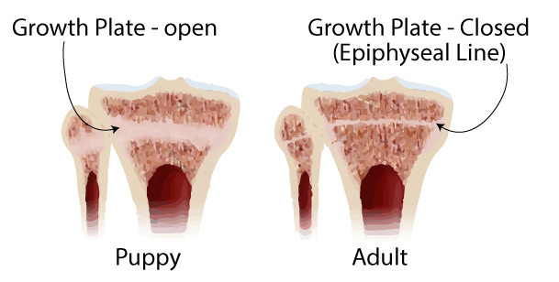
Bone Development & Growth
EPIPHYSEAL DISK (growth plate) is a band of cartilage between the epiphysis and diaphysis
These areas increase bone length as the cells ossify

Slide 23
OSTEOBLASTS produce cells called osteocytes.

Slide 24
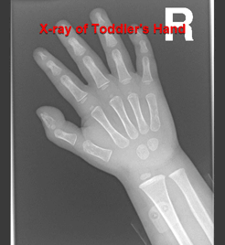
RESORPTION
OSTEOCLASTS - dissolve bone tissue to release minerals, process is called RESORPTION

Slide 25
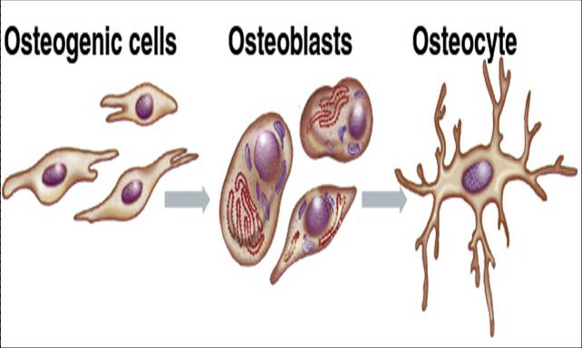
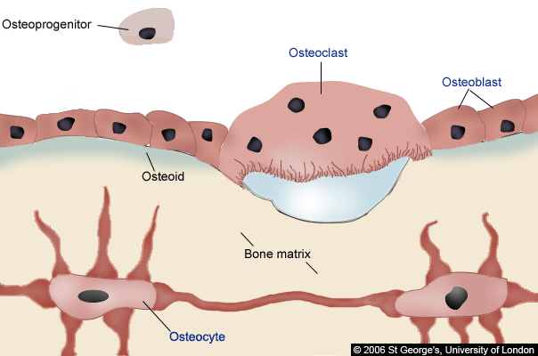

Slide 26
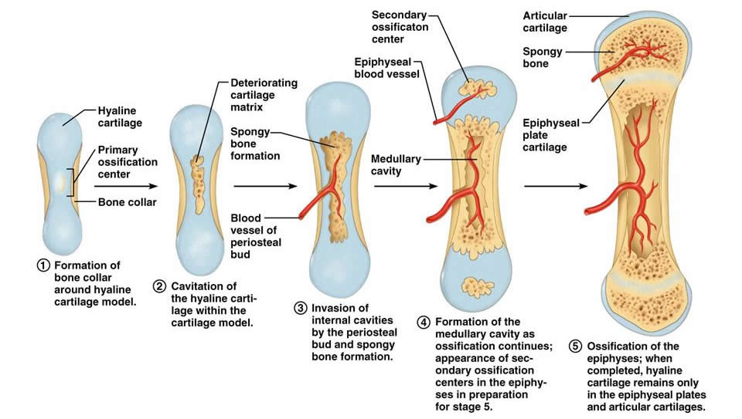
Bone Growth

Slide 27
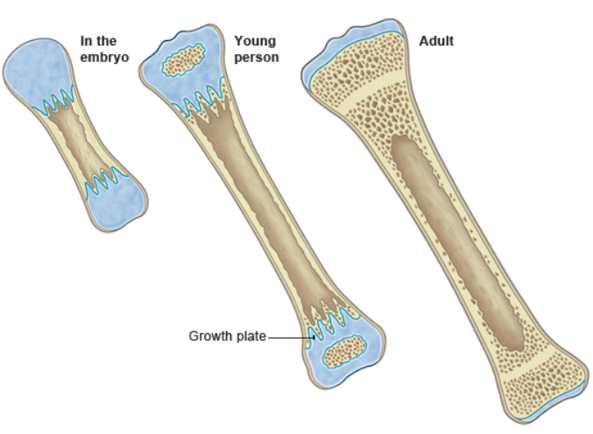
Bone Growth

Slide 28
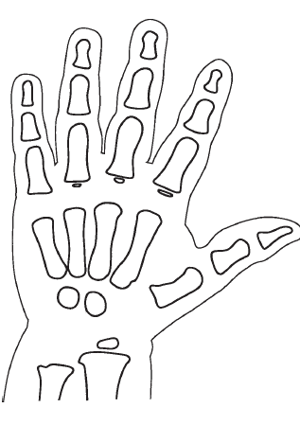
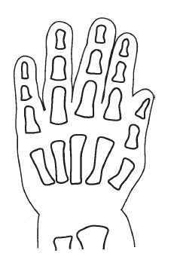
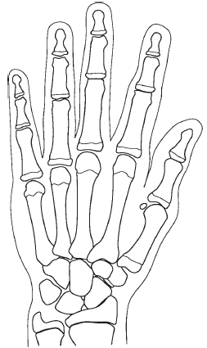
* Assignment - Coloring of the Aging Hand

Slide 29
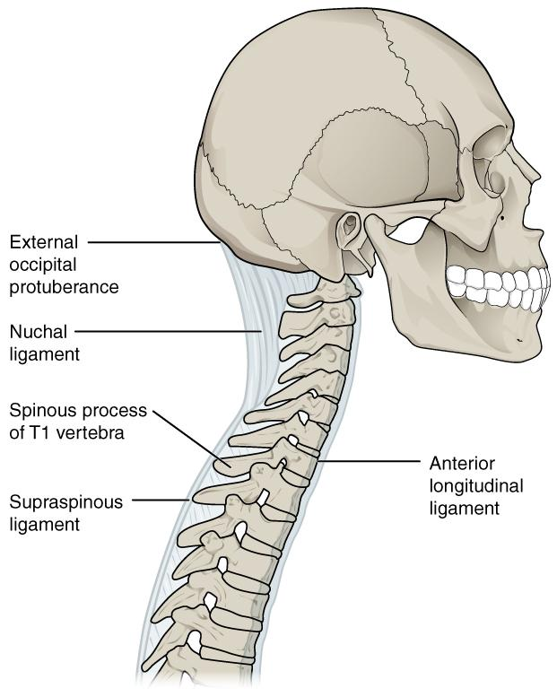
Types of Joints (articulations)
Synarthrotic (not moveable, aka sutures) -- Ex. skull
Amphiarthrotic (slightly movable)
-- vertebrae
Diarthrotic (moveable joint )
-- knees, elbows, wrist, shoulder..etc

Slide 30
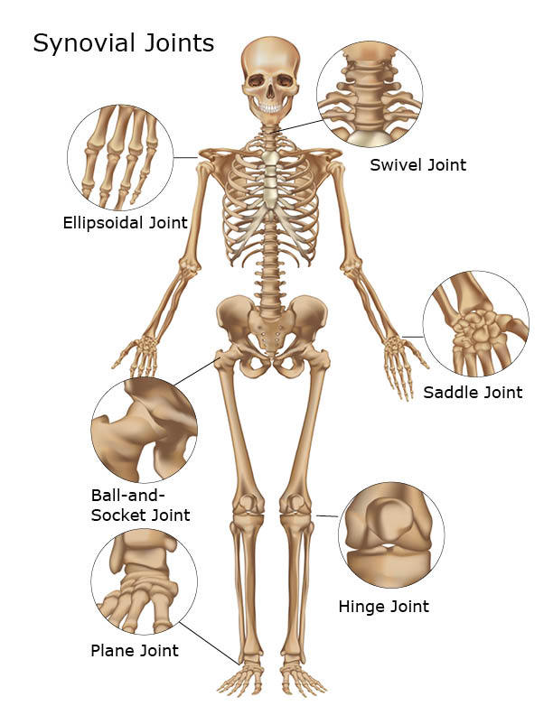
Types of Synovial Joints
1. Ball and Socket
(shoulder / hip)
2. Hinge (elbow, knee)
3. Pivot (lower arm)
4. Saddle (thumb)

Slide 31
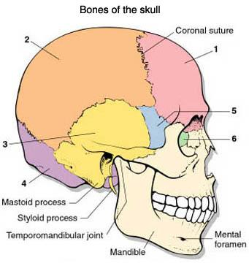
BONES OF THE SKULL
1. Frontal - 2. Parietal - 3. Temporal - 4. Occipital - 5. Sphenoid - 6. Ethmoid -
7. Maxilla -
8. Mandible -
9. Zygomatic -
7
9
8

Slide 32
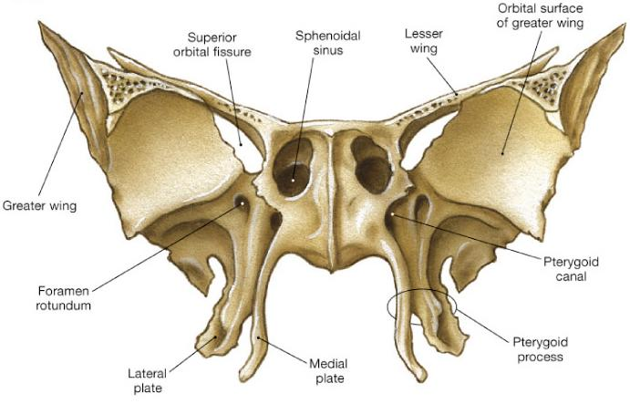
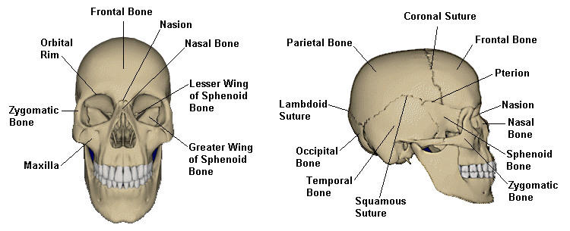
Sphenoid Bone
Names for its shape
a butterfly!

Slide 33
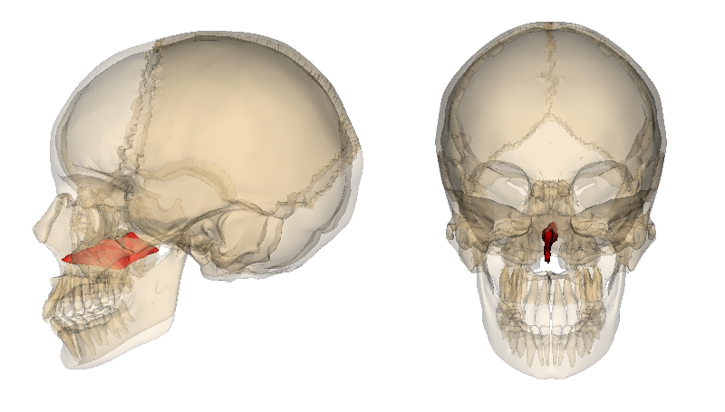
Vomer Bone

Slide 34
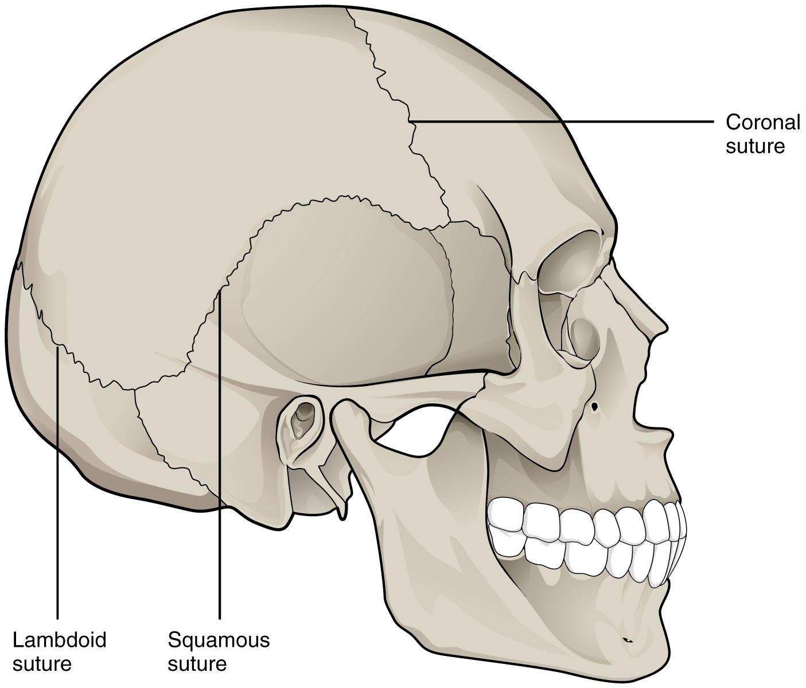
Sutures - connection points
Sagittal
1. Coronal - between frontal and parietal bones
2. Lambdoidal - between occipital and parietal bones
3. Squamosal - between temporal and parietal bones
4. Sagittal - between parietal bones

Slide 35
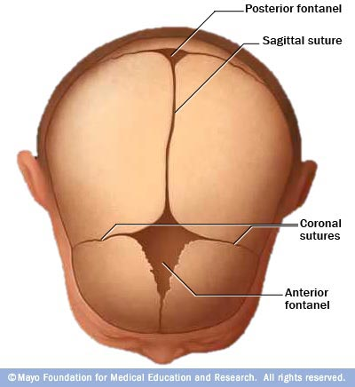
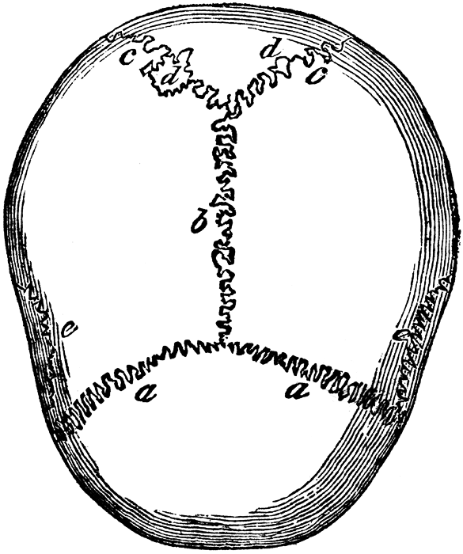
Suture - refers to any connection between large bones (in fetal skulls, these are called fontanels)
Fissure - any wide gap between bones

Slide 36
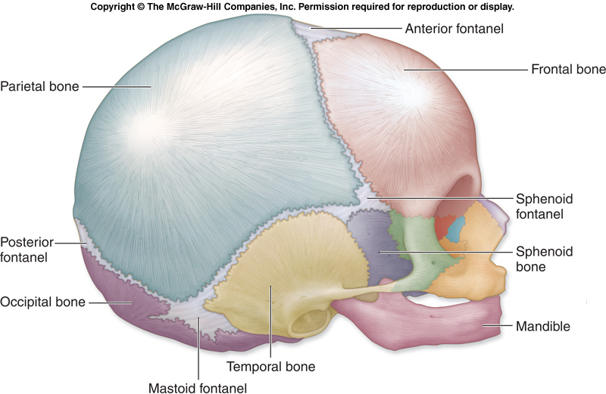
Fontanels are “soft spots” on an infant’s skull

Slide 37
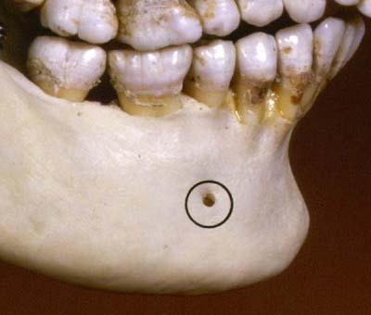
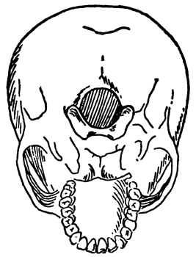
TOPOGRAPHY OF THE SKULL
Foramen - refers to any opening in the skull, nerves and blood vessels leave this opening to supply the face
Foramen Magnum
Mental Foramen

Slide 38
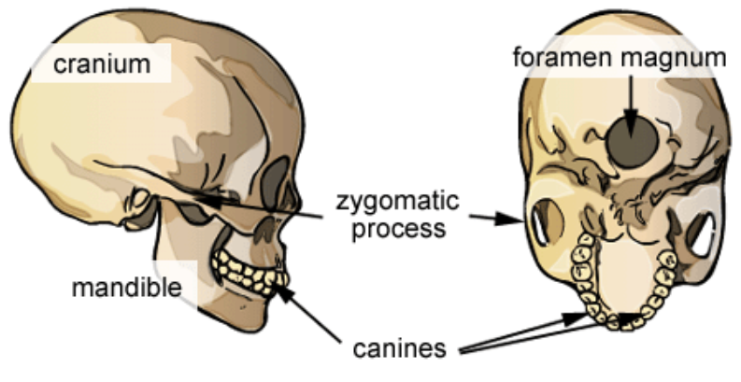
Foramen Magnum
* Assignment: Skull Labeling

Slide 39
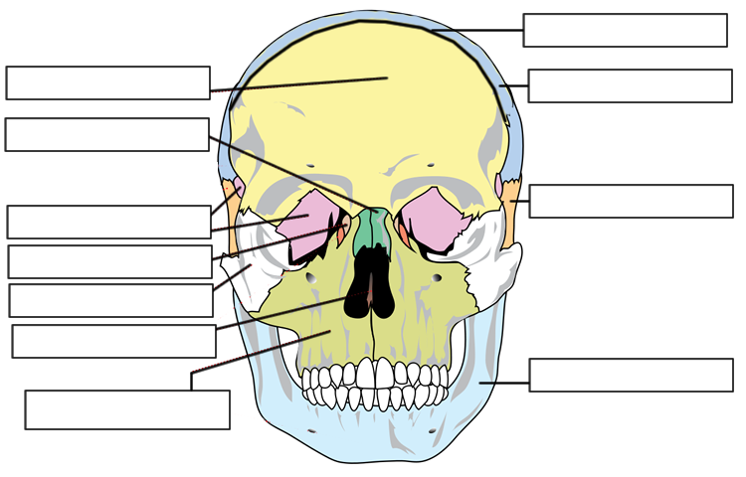
Coronal Suture
Frontal
Parietal
Nasal
Temporal
Sphenoid
Lacrimal
Zygomatic
Vomer
Mandible
Maxilla
Mental Foramen

Slide 40
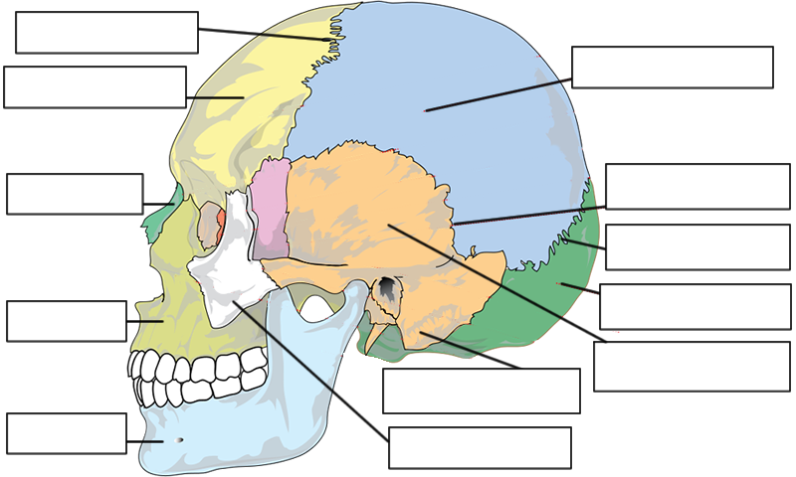
Coronal Suture
Parietal
Frontal
Nasal
Squamous Suture
Sphenoid
Lambdoid Suture
Occipital
Maxilla
Temporal
Mastoid Process
Mandible
Zygomatic

Slide 41
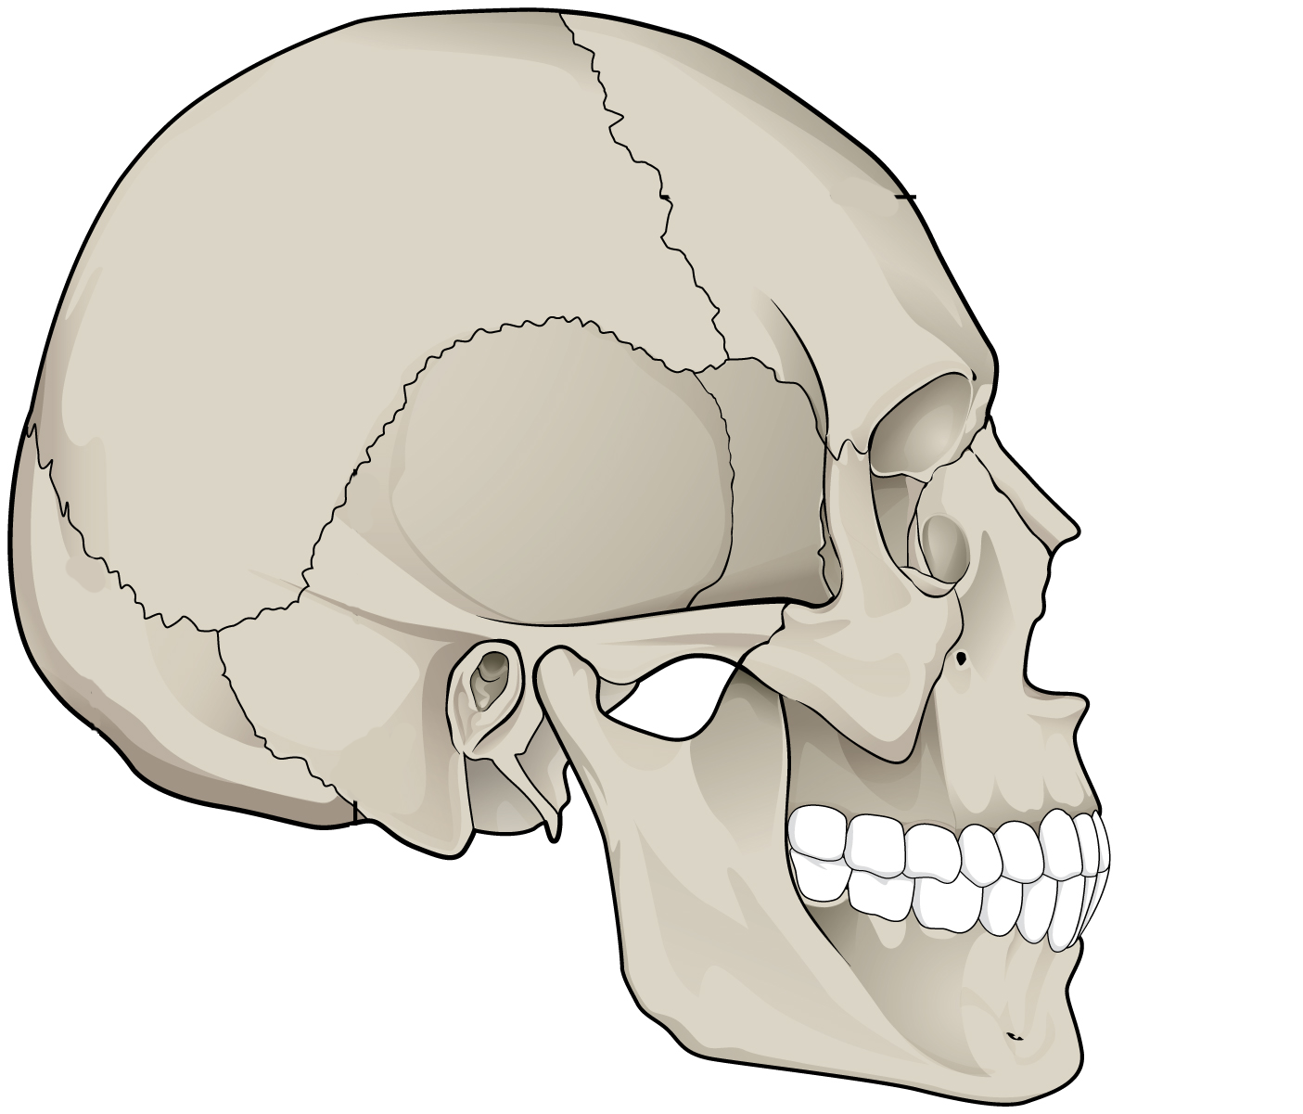
Name as many as you can.

Slide 42
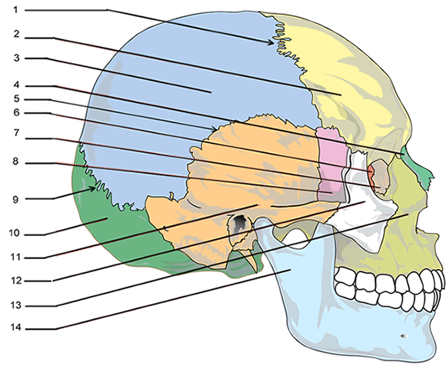
1. Coronal Suture
2. Frontal
3. Parietal
4. Nasal
5. Squamosal Suture
6. Ethmoid
7. Lacrimal
8. Sphenoid
9. Lambdoidal Suture
10. Occipital
11. Temporal
12. Zygomatic
13. Maxilla
14. Mandible

Slide 43
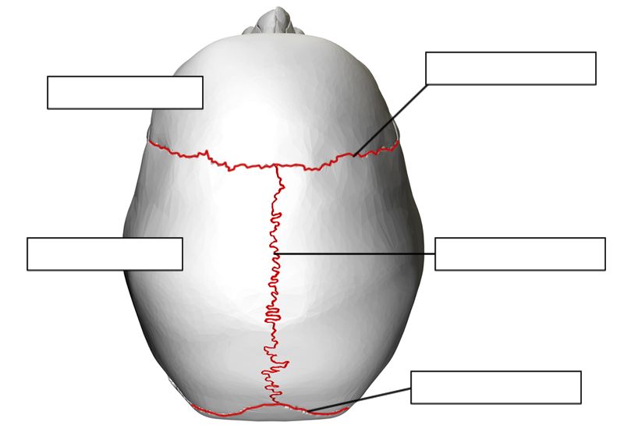
Coronal Suture
Frontal
Parietal
Sagittal Suture
Lambdoid Suture

Slide 44
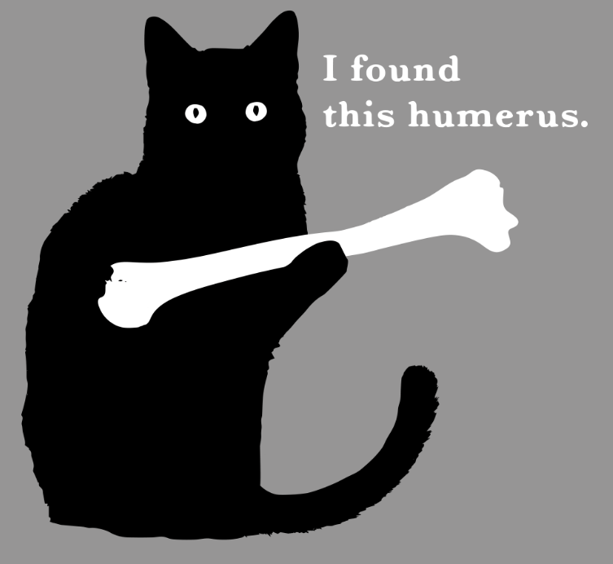

Slide 45
The Rest of the Bones

Slide 46
Vertebral Column
Cervical (C1-C7)
Thoracic (T1-T12)
Lumbar (L1-L5)
Sacrum and Coccyx

Slide 47
Thoracic Cage → 12 pairs of ribs
True Ribs = First seven
False Ribs = Next 3 pairs
Floating Ribs = Last two pairs

Slide 48
Pectoral Girdle
CLAVICLES
(collarbones)
HUMERUS (arm)
SCAPULAS
(shoulderblade

Slide 49
Bones of the Arm
Ulna goes to pinky (P-U)
Radius goes to thumb
HUMERUS
ULNA
RADIUS

Slide 50
Bones of the Wrist
Wrist - 8 small bones called carpals
Metacarpals (hand)
Fingers: Phalanges

Slide 51
Name the carpals

Slide 52
How to learn the carpals?
Some Lemurs Try Peanuts That They Can’t Handle
Notes:
Or: Some lovers try positions that they can’t handle.

Slide 53
ANSWERS...
Scaphoid
Lunate
Triquetrum
Pisiform
Trapezium
Trapezoid
Capitate
Hamate

Slide 54
Pelvic Girdle
two large COXAL BONES

Slide 55
Pelvic Girdle
COXAL
COXAL
The SACRUM is between coxal bones, COCCYX is the tailbone

Slide 56
Bones of the Leg
Upper Leg - FEMUR
Kneecap - PATELLA
Lower Leg - TIBIA & FIBULA

Slide 57
Bones of the Ankle
Ankle and Upper foot - 7 bones called Tarsals
Large heel bone is the calcaneus
Foot = metatarsals
Toes = phalanges

Slide 58
Assignment – Foot Coloring

Slide 59
Assignment – Skeleton Labeling

Slide 62
FUN FACT!
The baculum (also penis bone or penile bone) is a bone found in the penis of many placental mammals. It is absent in the human penis, but present in the penises of other primates, such as the gorilla and chimpanzee.
Raccoon baculum

Slide 63
Broken Bones

Slide 65
Warning: Next slide is graphic!

