Slide 1
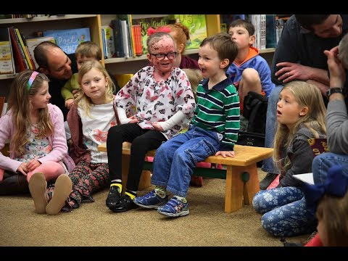
Pause at 2:50
What is wrong with Ella? What questions do you have?
Notes:
This is actually two questions posed for discussion (phenomenon). There’s the underlying genetic question (inheritance patterns) and then the physiological question about why the skin does that. Engage, Explore, Explain, Elaborate, and Evaluate (5Es). Develop driving questions. Information on this disease: https://www.washingtonpost.com/sf/style/2017/05/30/a-baby-girl-a-baffling-disease-and-the-only-way-to-help-her-is-to-hurt-her/

Slide 2
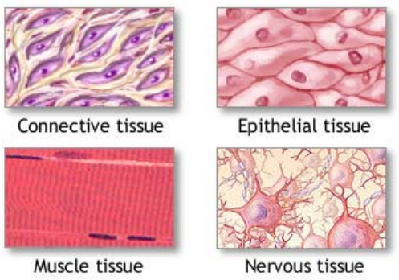
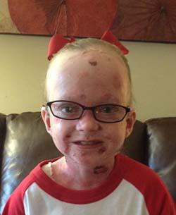
Skin is a type of tissue.
Four Types
1. Epithelial
2. Connective
3. Muscle
4. Nervous
Which type of tissue does Ella have a problem with?
Student Note Handout
Notes:
Guided Notes Handout Available :https://docs.google.com/document/d/1ogPzx7R2cDK4Q2SSX4tgKrPzFnZh6YF16zhWOOVXAwc/edit?usp=sharing
To edit this document, go to file and choose “make a copy.”

Slide 3
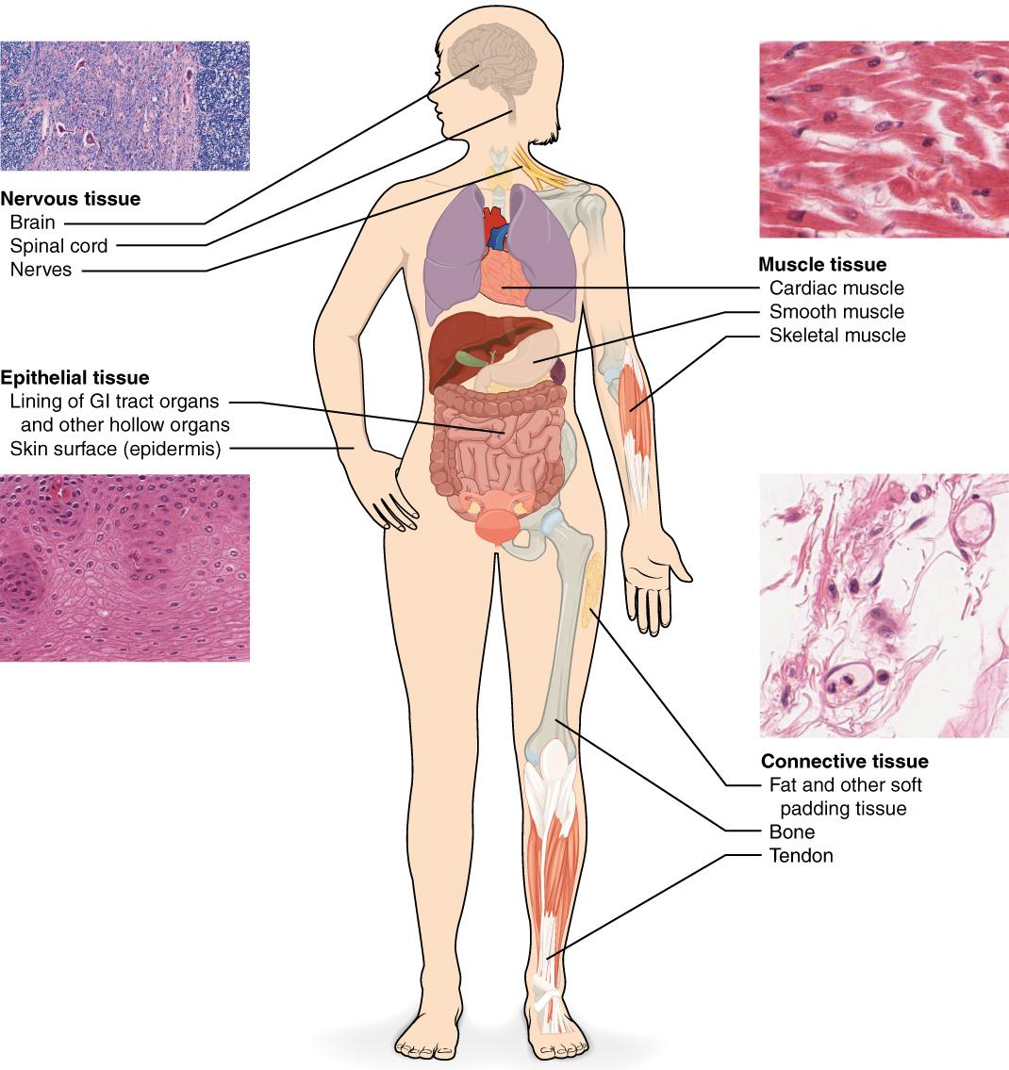
Tissue - a group or mass of similar cells working together to perform common functions.
If the cells within those tissues are abnormal, then that person may have a disease, like Ella.

Slide 4
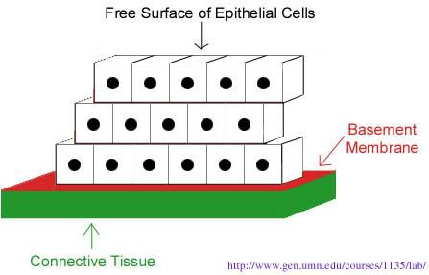
Epithelial Tissue
- Covers all body surfaces both inside and out. - Main glandular (glands) tissue. - Attached to underlying connective tissue at the basement membrane

Slide 5
- Usually has no vascular tissue - no blood supply - Cells reproduce rapidly, results in rapid healing (and scarring) - Cells tightly packed together
If a girl weighs 100 pounds. How much of her weight is skin?

Slide 6
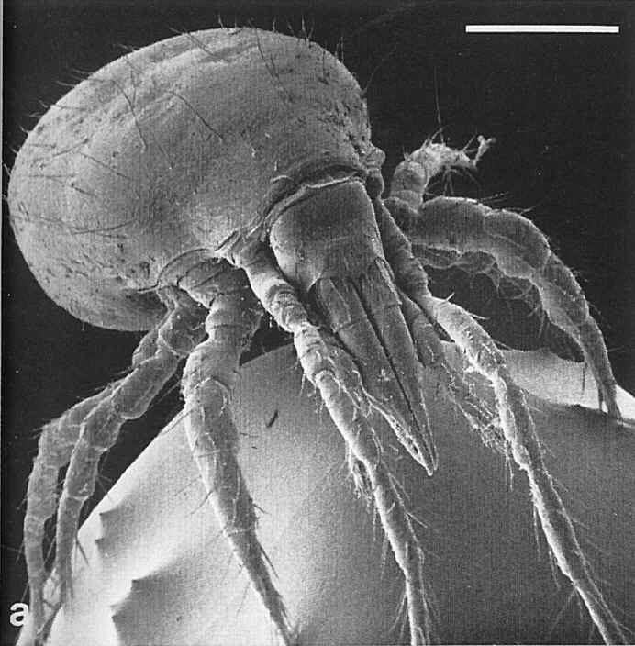
Where does all the dead skin you shed go?
It takes about 27 days for the outer layer of skin to shed and be replaced; that works out to 1.5 pounds of skin cells per year.

Slide 7
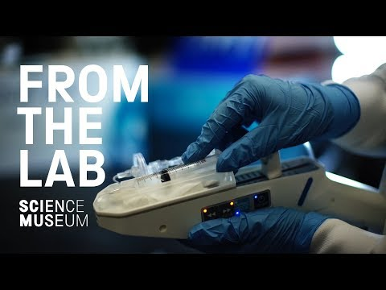
The skin is considered the largest organ of the body. Replacing it takes time, and burn victims are at risk of infection because they have no protection.
Do you think this type of treatment might work for Ella?

Slide 8
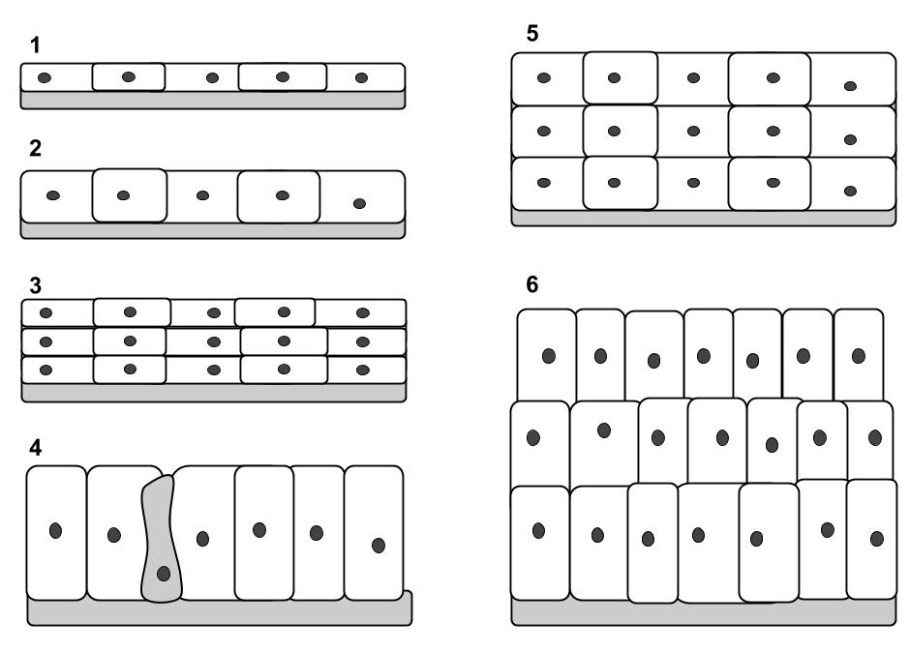
Functions of Epithelial Tissue
Protection
Secretion
Absorption
Excretion
Senses
Categorized based on the shape of the cells and the layers of cells.

Slide 9
Epithelial tissue
Naming is based on description
simple = single layer
stratified = multiple layers
squamous = flat
cuboidal = square
columnar = column (rectangle)
One type of tissue can be arranged in different forms, each form has a different function.

Slide 10
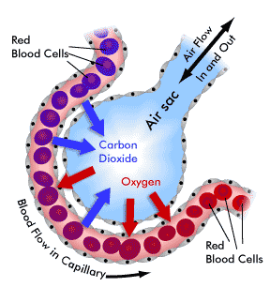
A. Simple Squamous
Simple Squamous Tissue
All epithelial tissue has a layer at the bottom called the:
BASEMENT MEMBRANE
Form: Single layer, Flat and thin
Function: diffusion and filtration. Air sacs in lungs, capillaries

Slide 11
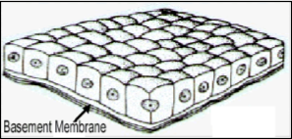
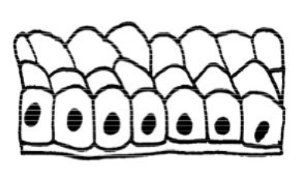
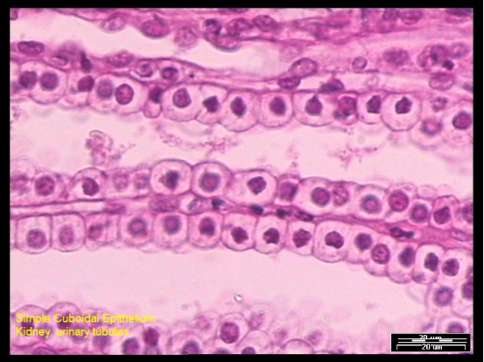
B. Simple Cuboidal
Function: Secretion and absorption
Found in kidneys tubules, ducts and covering the ovaries

Slide 12
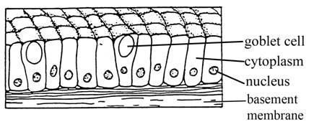
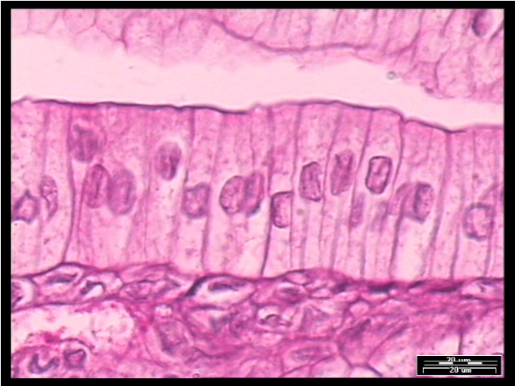
C. Simple Columnar
Function: Secretion and absorption
Found in digestive tract and uterus
*Contains scattered goblet cells to secrete mucus
*Can have microvilli to increase surface area

Slide 13
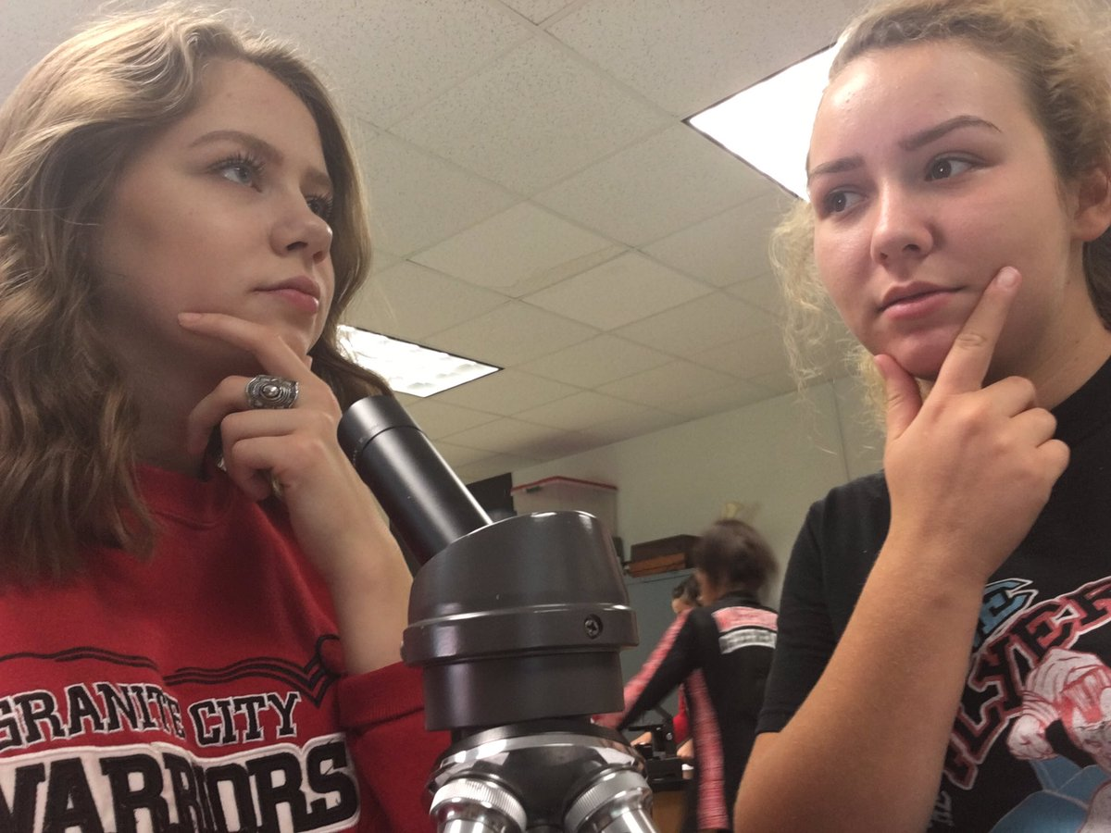
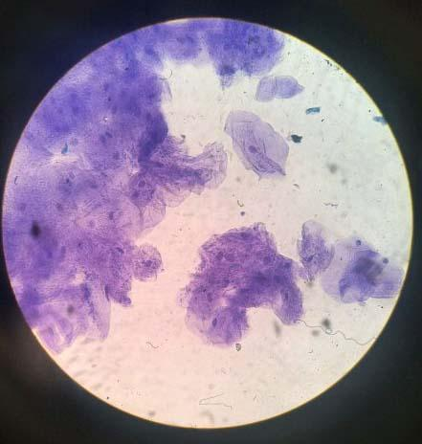
D. Stratified Squamous
Hmm..where have we seen these before?
Multi layer squamous, functions in protection
Found lining body cavities; skin and mouth
Notes:
These are the cheek cells that students viewed in the lab last chapter

Slide 14
The ink of tattoos must be injected below the basement membrane.

Slide 15
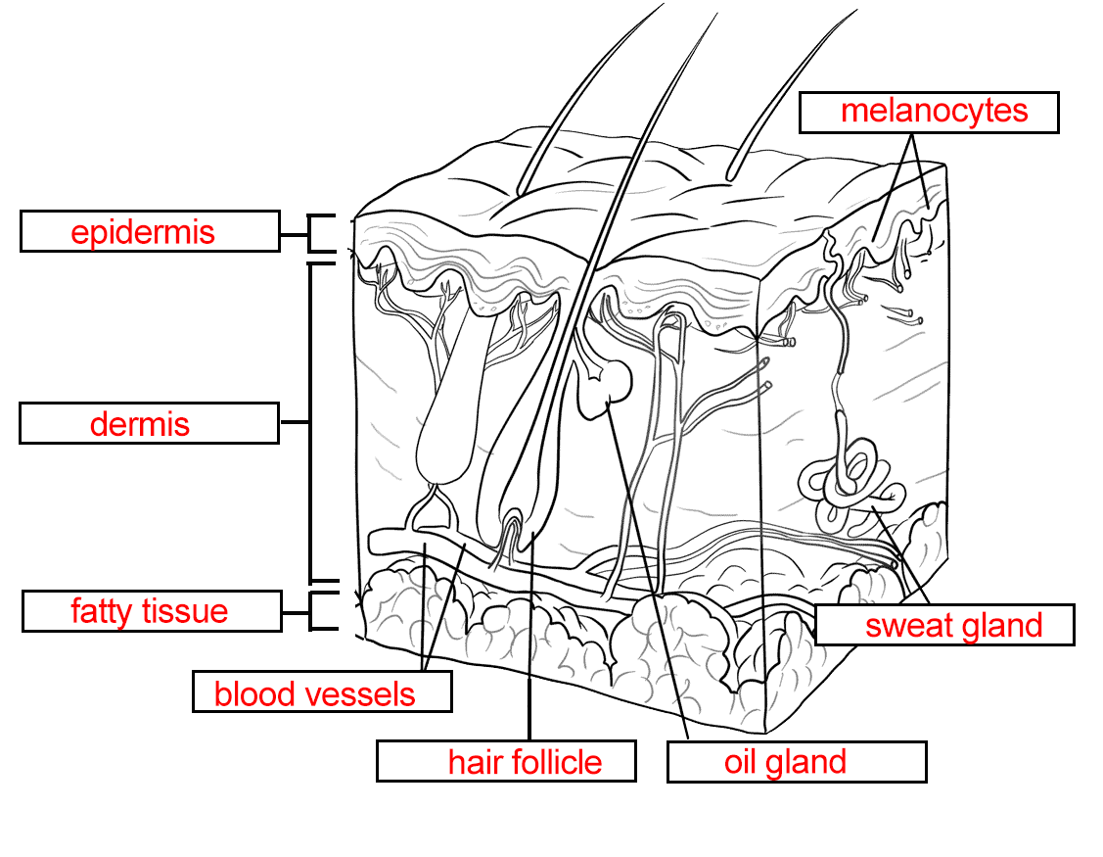
What’s wrong with Ella’s skin?
Mutations in the COL7A1 gene affects the protein, collagen.
Collagen is like the “glue” that holds tissues together. It anchors the epidermis to the dermis.
Highlight the area on the diagram that is affected by the mutation.
Notes:
Human skin image source: http://www.supercoloring.com/sites/default/files/styles/coloring_full/public/cif/2015/03/human-skin-coloring-pages.png

Slide 16
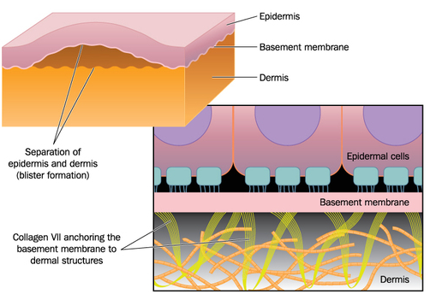
As the dermis pulls away from the epidermis, blisters form.
Any type of pressure can cause the skin to pull away.
These blisters and sores are very painful.
Notes:
Image source: https://ghr.nlm.nih.gov/condition/dystrophic-epidermolysis-bullosa#definition

Slide 17
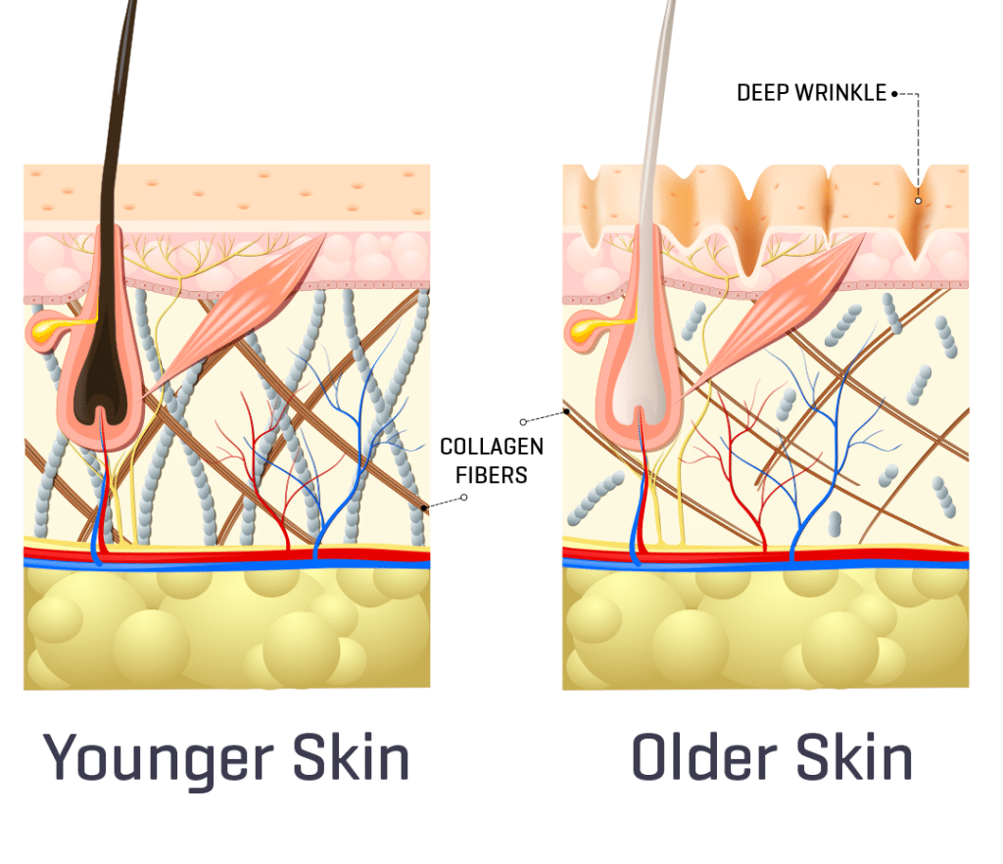
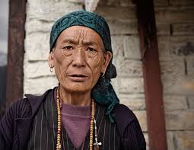
Collagen and elastin are proteins found in connective tissue.
Loss of these fibers are responsible for wrinkles as we age.
Notes:
Image source: https://en.wikipedia.org/wiki/Wrinkle

Slide 18
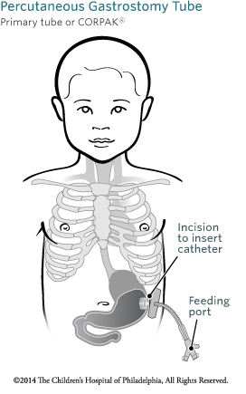
Did you notice that Ella was small for a 5th grader? Why does Ella’s skin condition also affect her nutrition?
Recall the epidermal tissue lines the mouth and esophagus.
The same blistering occurs there, making it difficult to swallow. Scar tissue can also narrow passageways for food.
Many will get gastric feeding tubes (G-tube).

Slide 19
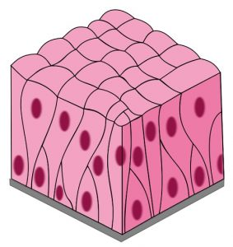
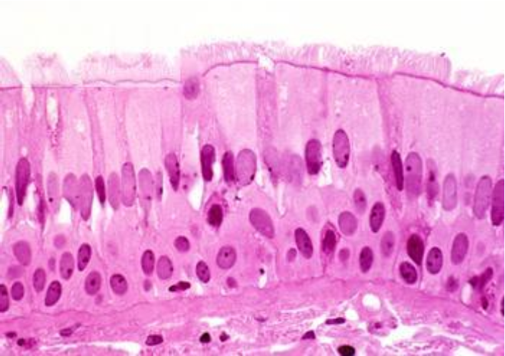
E. Pseudostratified Columnar
Appear stratified, but just a single layer of cells, nuclei at different levels
Can have cilia (hair-like projections)
And goblet cells, which secrete mucus
Function: Secretion and cilia-aided movement
Location: lining air passages and tubes of the reproductive system
What could happen if the cilia of this tissue doesn’t work properly?
Notes:
This is a reference to a case we studied in the cell chapter about a child with primary ciliary dyskinesia. Abnormal cilia caused child to get sick more often, have situs inversus, and will increase risk of tubal pregnancy

Slide 20
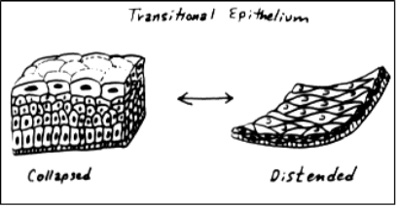
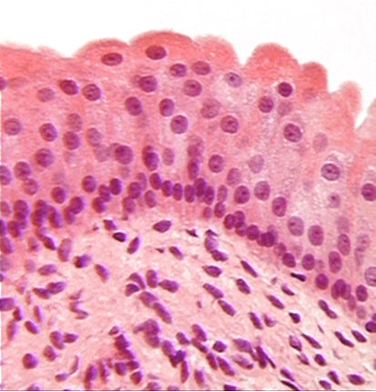
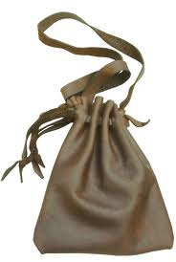
F. Transitional Epithelium
Stretchable
Blocks diffusion (no leaking)
Found in the urinary bladder

Slide 21
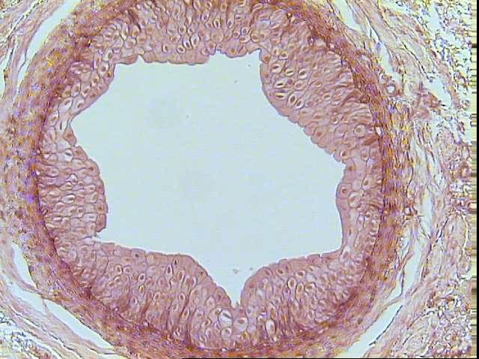
Urinary Bladder

Slide 22
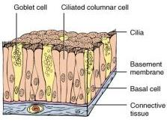
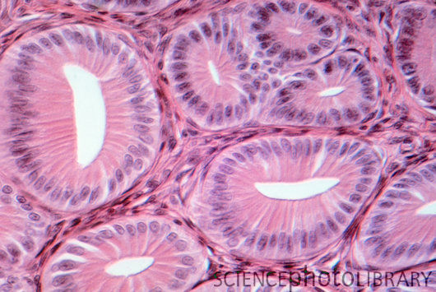
G. Glandular Epithelium
Cells are specialized to secrete substances
They make up the GLANDS
exocrine glands endocrine glands
Examples: salivary, sweat hormones

Slide 23
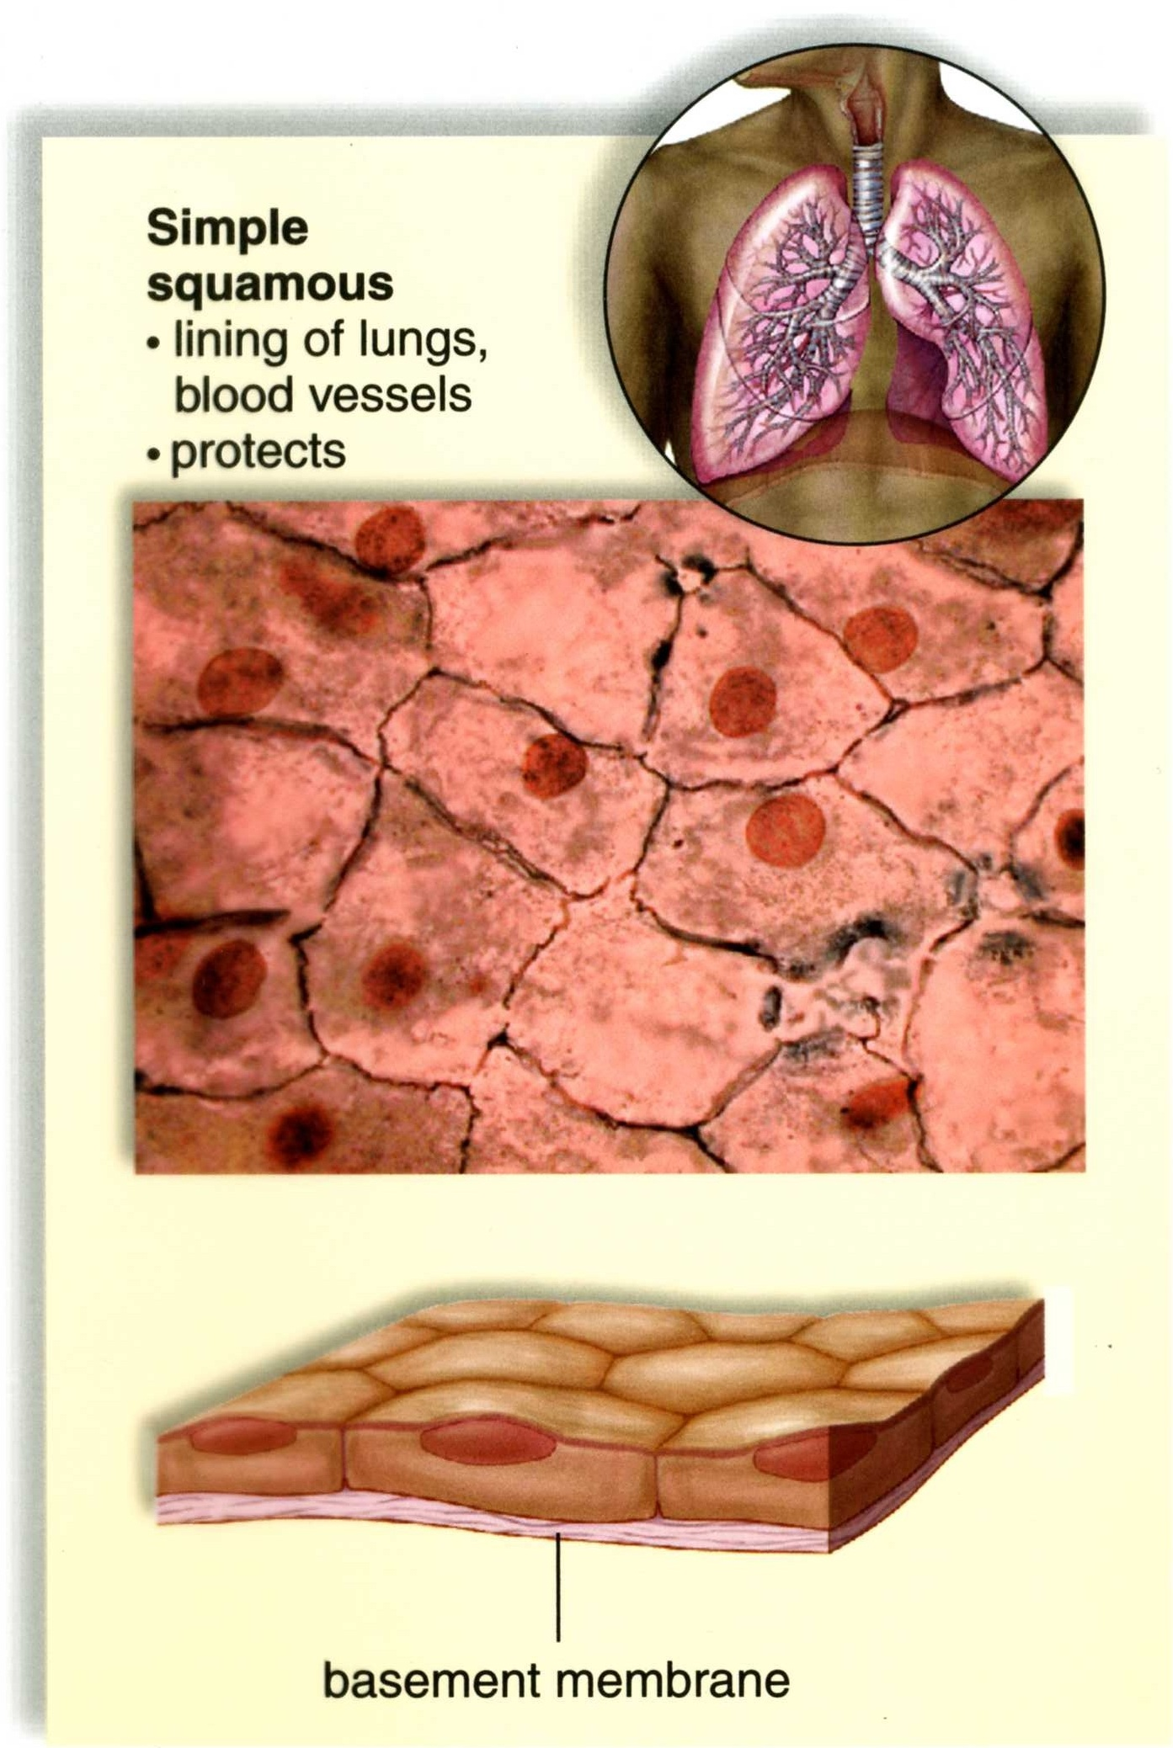
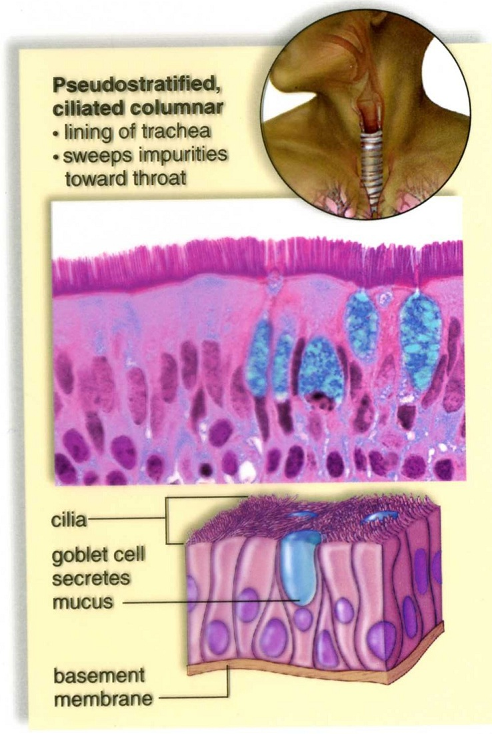

Slide 24
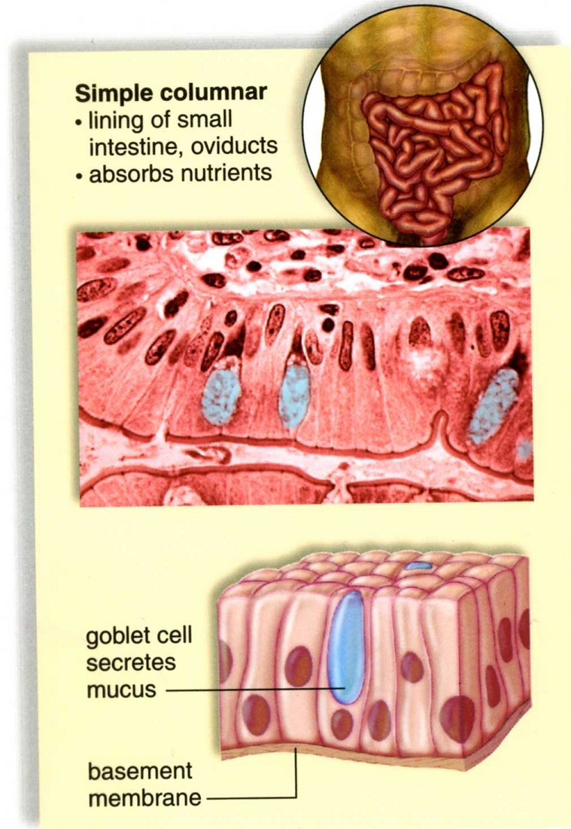
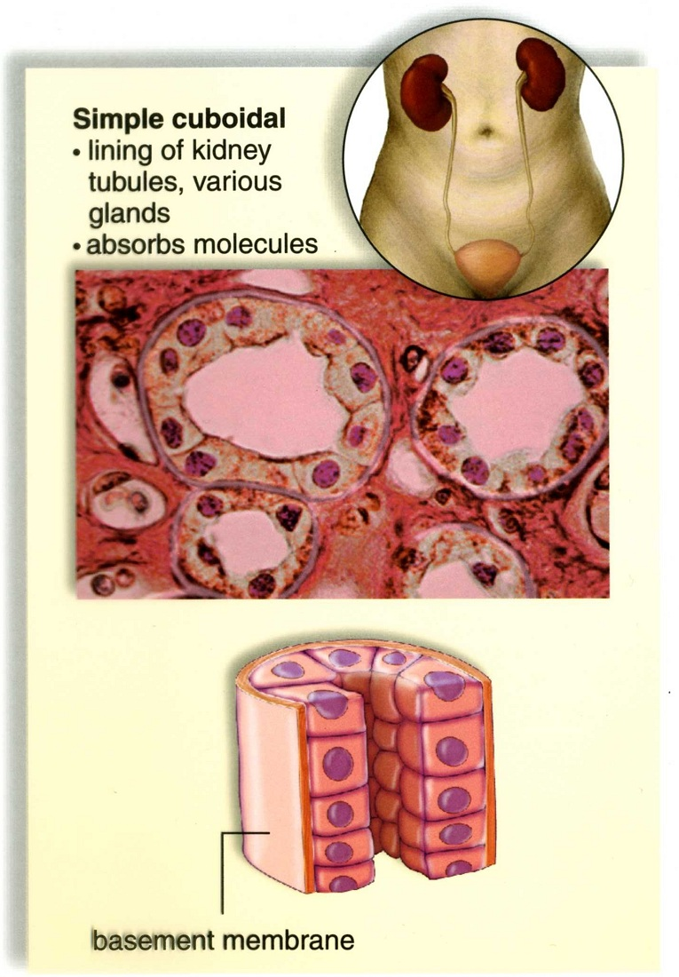

Slide 25
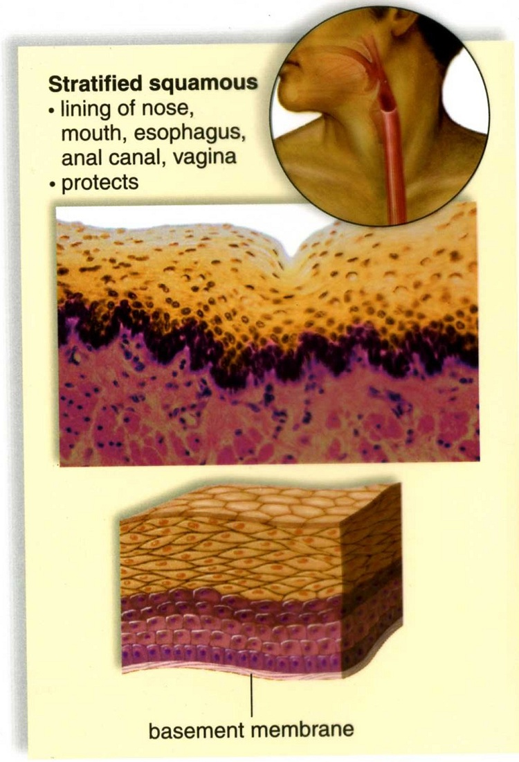

Slide 26
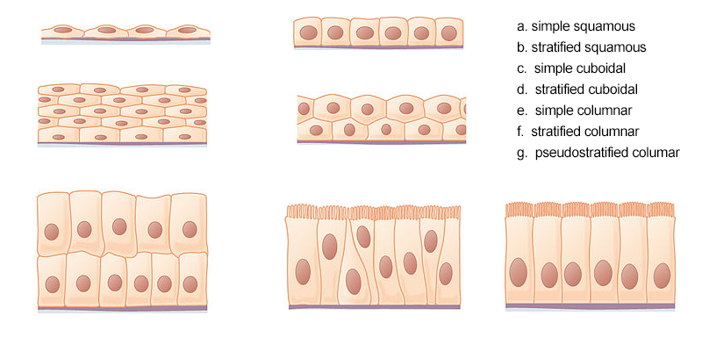
columnar
Notes:
Top: a, c Middle: b, d Bottom: f, g, e Source: https://upload.wikimedia.org/wikipedia/commons/a/ac/403_Epithelial_Tissue.jpg

Slide 27
End Part 1 Notes!
Canvas Assignment:
Epidermolysis bullosa - Ella’s Disease Overview

Slide 28
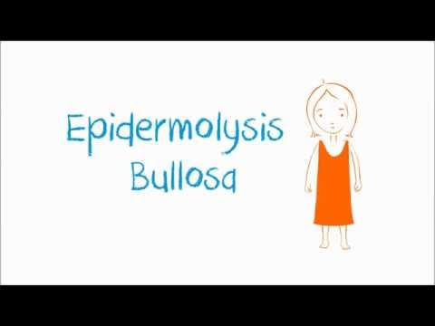
Epidermolysis bullosa - Ella’s disease (overview)
1. How did Ella get the disease?
2. What part of the body does it affect?
3. What are symptoms and complications of the disease?
4. How could this disease be treated or cured?
Read this article about what the future may hold for those with EB. Can we find a cure?

Slide 29
Epidermolysis bullosa simplex is usually inherited in an autosomal dominant pattern, which means one copy of the altered gene in each cell is sufficient to cause the disorder. Some affected people inherit the mutation from one affected parent. Other cases result from new mutations in the gene and occur in people with no history of the disorder in their family.
In rare cases, epidermolysis bullosa simplex is inherited in an autosomal recessive pattern. Autosomal recessive inheritance means the condition results when two copies of the gene in each cell are altered. The parents of an individual with an autosomal recessive disorder typically each carry one copy of the altered gene, but do not show signs and symptoms of the disorder.

Slide 30
2. Connective Tissue
-Most abundant tissue in your body; binds structures together -Provides support, protection, framework, fills space, stores fat, produces blood cells, fights infection
-Composed of more scattered cells within matrix -Made up of a ground substance and fibers -Most have a good blood supply

Slide 31
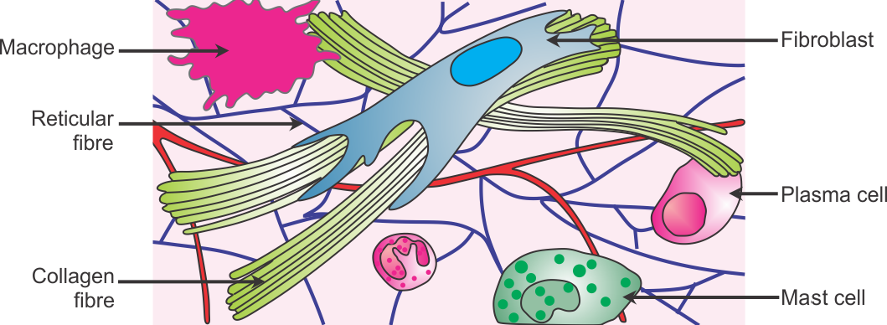
Three types of cells in connective tissue
1. Mast cells (prevents clots)
2. Macrophages (consumers)
3. Fibroblasts (produce fibers)

Slide 32
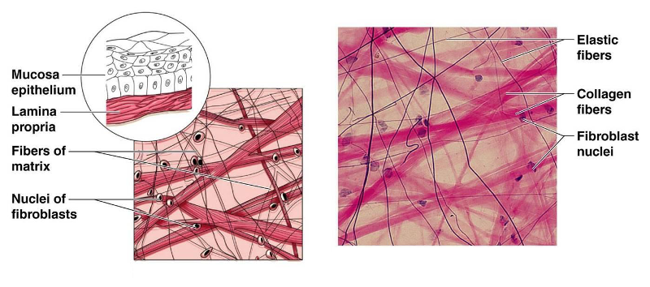
Main types of fibers
Collagenous, found in bones, ligaments, tendons
Elastic, found in ears, vocal cords

Slide 33
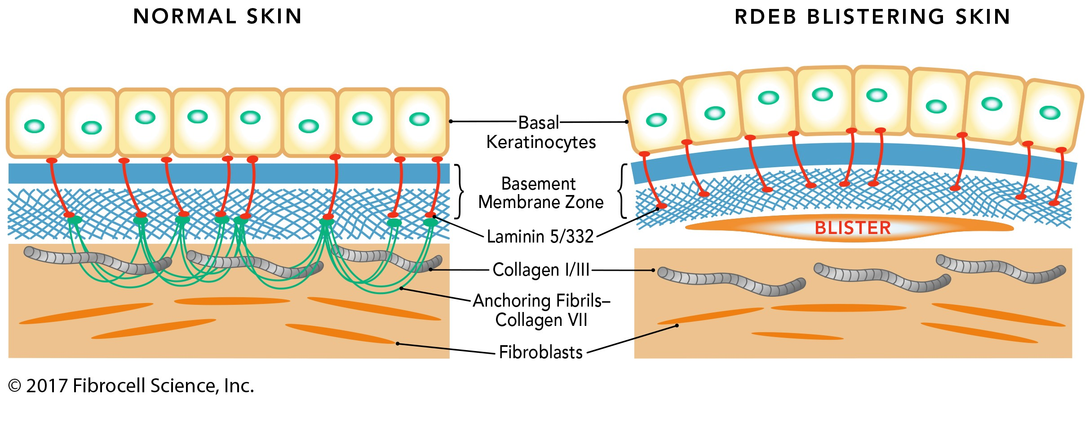
Ella’s Skin - What’s missing?

Slide 34
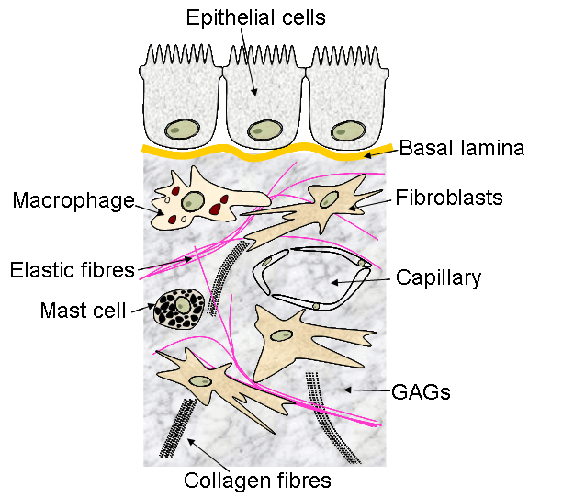
The MATRIX
Gene therapy for EB would target what cells?
Basement Membrane
Ground substance
Assignment: Color the Matrix
Notes:
Gene therapy might target fibroblasts, since those are the cells producing the fibers

Slide 35
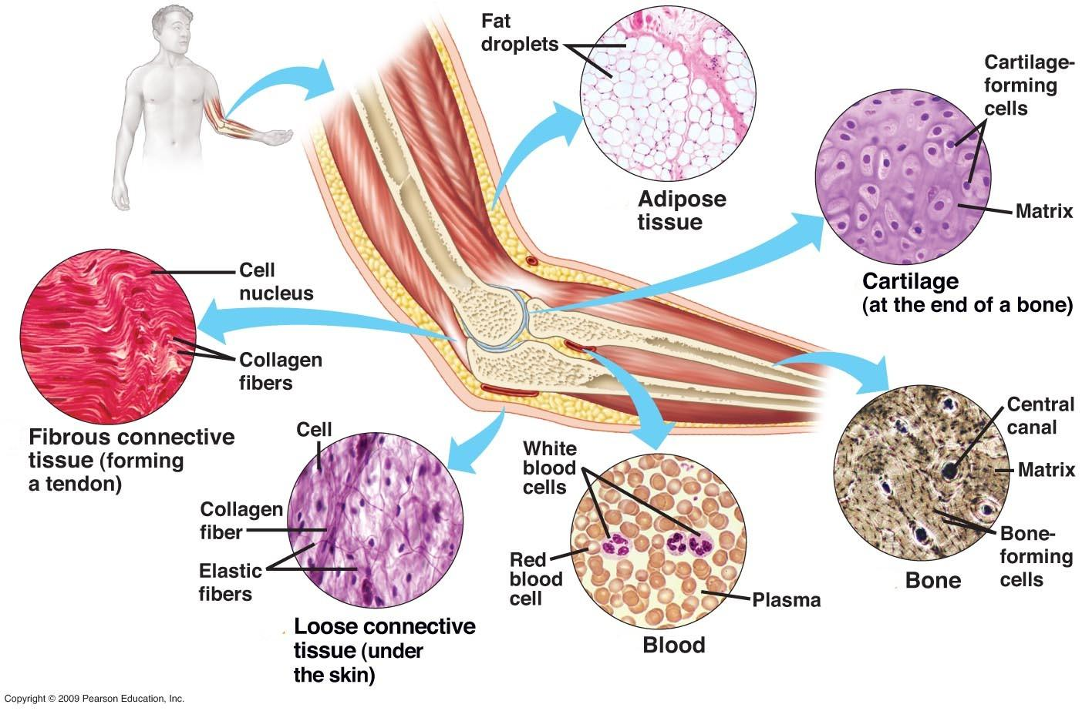
Categories of Connective Tissue

Slide 36
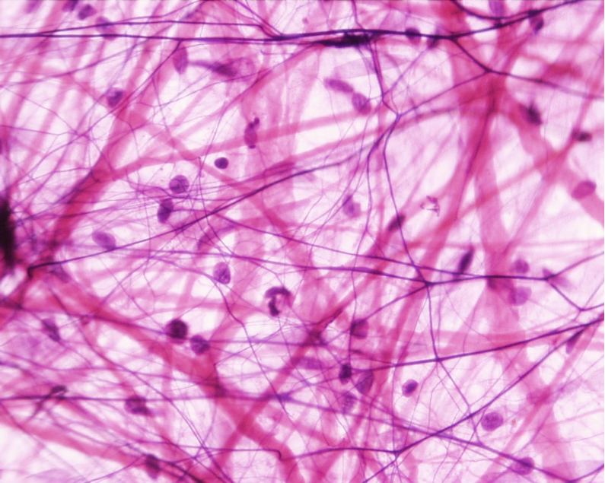
A. Loose Connective Tissue or Areolar Tissue
Binds underlying organs to skin and to each other
Forms delicate thin membranes throughout the body

Slide 37
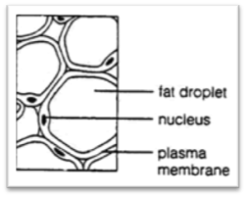
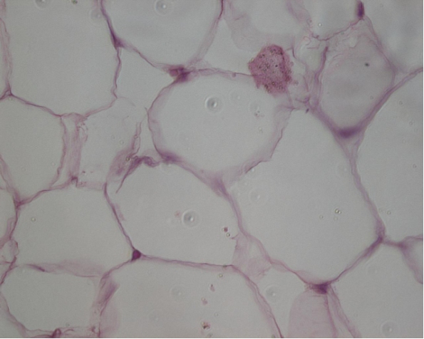
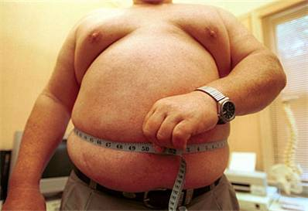
B. Adipose Tissue (fat)
Protective cushion
insulation to preserve body heat
Stores energy.

Slide 38
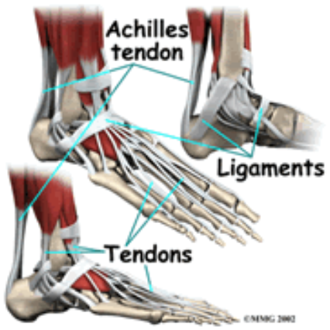
C. Fibrous Connective Tissue
Tendons = muscles to bones
Ligaments = bones to bones

Slide 39
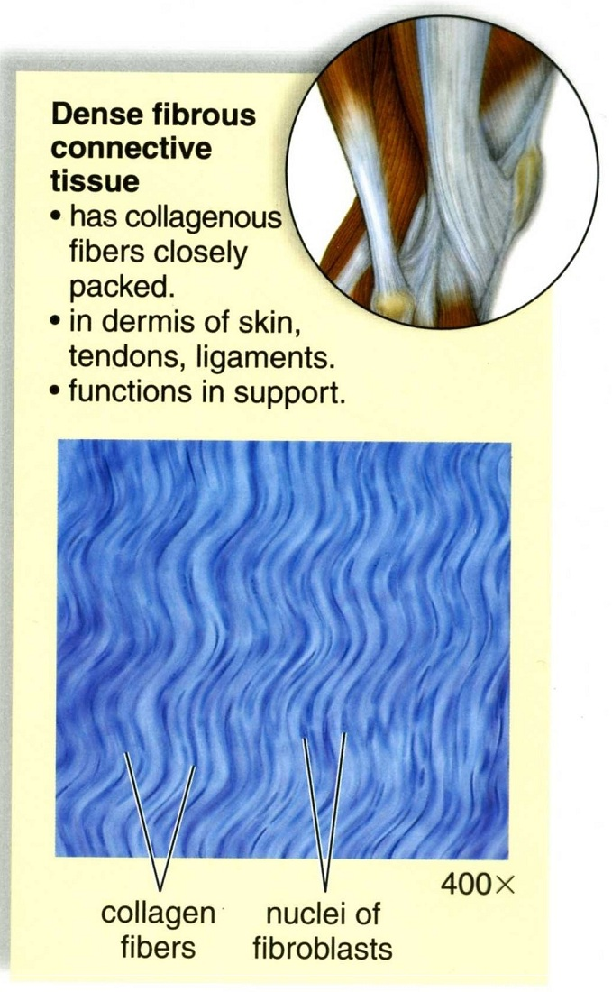
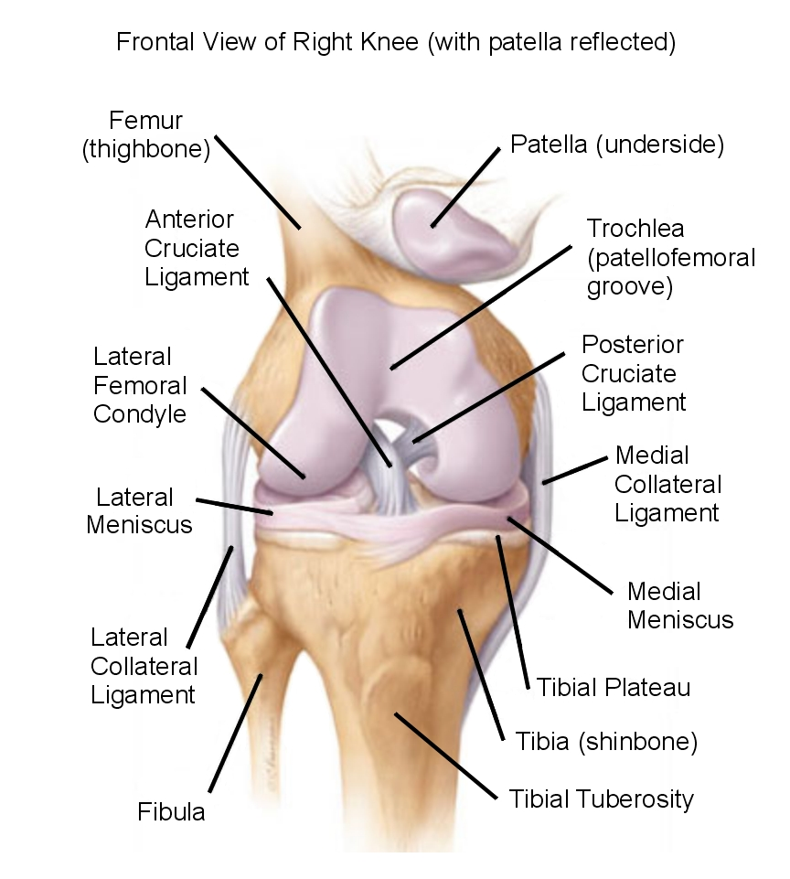

Slide 40
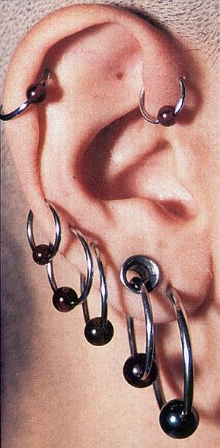
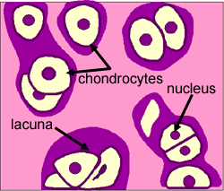
D. CARTILAGE
Cartilage cells are called chondrocytes
Cartilage is a type of “DENSE CONNECTIVE TISSUE”

Slide 41
Hyaline Cartilage
Location: covers ends of joints, nose and respiratory passages, serves as padding

Slide 42
Hyaline cartilage

Slide 43
Elastic cartilage
Location: External Ear and Larynx

Slide 44
Fibrocartilage
Tough, shock absorbing Location: Between vertebrae

Slide 45
E. Bone Tissue (Osseous)
More on this in the skeletal system unit.

Slide 46
F. Blood Tissue
More on this in the circulatory system unit.
Warning: Students often forget that blood is a type of connective tissue!

Slide 47
Muscle Tissue
STRIATED

Slide 48
Cardiac muscle

Slide 49
Skeletal muscle
(striated)

Slide 50
Smooth muscle

Slide 51
Nerve Tissue
Neurons - transmit signals
( Axons & Dendrites )
Neuroglia - support cells

Slide 52
Nervous tissue (spinal cord)

Slide 53
End Part 2 Notes

Slide 54
What about skin color?
Take this test to determine your skin type.

Slide 55
Check out this animation: How Do We Get Our Skin Color? ~4min (click “Launch interactive”)
HHMI How We Get Our Skin Color (Interactive)
1. What are the three main layers of skin? 2. What are the two main cells found in the epidermis? 3. What is melanin? 4. How does melanin protect cells? 5. How does sunlight cause tanning?
Notes:
How has evolution shaped skin color in humans? Are some skin colors more common in certain parts of the world? Why is that?

Slide 56
Skin Pigmentation
Melanocytes
Keratinocytes
MC1R gene
Adaptation / Evolution
Folate
Vitamin D

Slide 57
How to repair skin….
cuts on the skin may need to be stitched if they also go through the underlying tissue.
*This injury was caused during a hockey game, from a ice skate.

Slide 58
Stitches are also called SUTURES and they hold the tissue together while the body heals.
Alternatives to sutures:
Glue
Medical Tape
Staples
A British ice hockey star, Craig Peacock has made a miraculous recovery after suffering a gruesome facial injury when he took an ice-skate blade to the face.

