Slide 1
CHEMISTRY
(FOR ANATOMY)

Slide 3
CHEMICAL

Slide 4
PHYSICAL

Slide 6
ENERGY

Slide 7
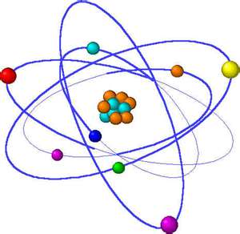
ATOM

Slide 9
MENDELEEV

Slide 10
PROTONS, ELECTRONS, NEUTRONS

Slide 12
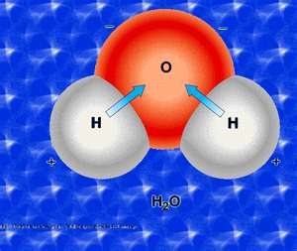
COVALENT BONDING

Slide 13
IONIC BONDING: CATIONS AND ANIONS

Slide 15
SYNTHESIS

Slide 16
DECOMPOSITION

Slide 17
SINGLE DISPLACEMENT

Slide 18
DOUBLE DISPLACEMENT

Slide 19
ENZYMES…END IN –ASE!

Slide 20
FIBROUS/STRUCTURAL

Slide 21
pH

Slide 22
examples

