Slide 1
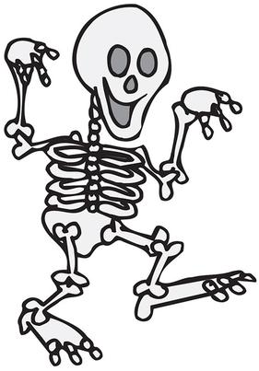
Introduction to anatomy notes

Slide 2
Anatomy
The study of the structure and shape of the body and body parts and their relationshop to one another.
Examining these structures is called gross anatomy {Greek: to cut (tomy) apart (ana)} when completing dissections
Examining smaller structures like tissue or cells is called microscopic anatomy and require a microscope to be seen.

Slide 3
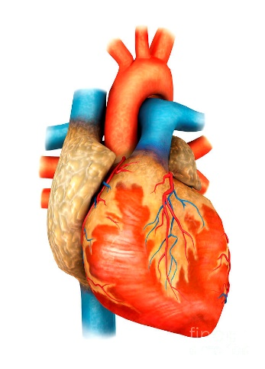
Physiology
The study of how the body and its parts work or function {physio (nature) & ology (study of)}
Many subdivisions depending on what system is being studied
Example: cardiac physiology studies the function of the heart

Slide 4
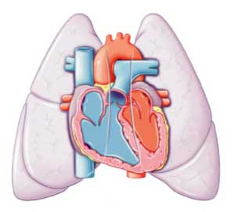
ANATOMY & PHYSIOLOGY
Always related since the parts of your body form a well organized unit and each of those parts have a job to do to make the body operate as a whole.
Example: heart & lungs working together for the blood to carry oxygen to all cells

Slide 5
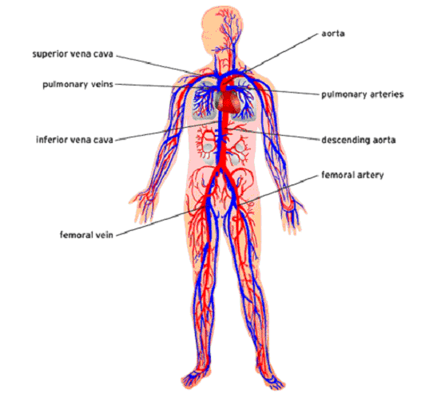
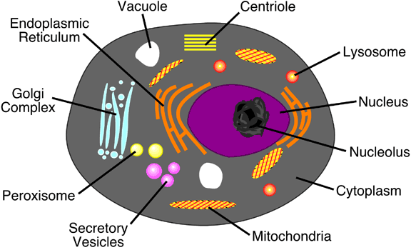
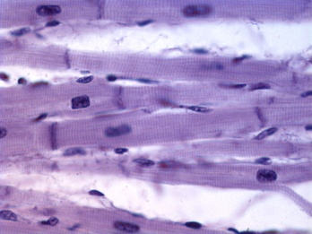
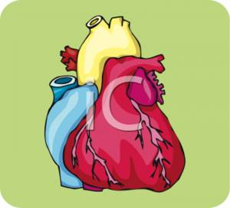
Organization
All cells have smaller parts that work together to perform functions needed by a particular type of cell.
Multi-cellular organisms have the following organization scheme:
Cell → Tissue → organ → organ system → organism

Slide 6
11 systems of the Human Body
Integumentary (skin)
Skeletal
Muscular
Nervous
Endocrine
Cardiovascular
Lymphatic
Respiratory
Digestive
Urinary
Reproductive

Slide 7
8 Necessary Life Functions
Organ systems do not work in isolation. They work together to promote the well being of the entire body
A) Maintaining Boundaries: the “inside” must remain distinct from the “outside”
Every cell is surrounded by an external membrane just as your whole body is covered by your skin = protection of what enters/exits

Slide 8
B) Movement: includes all the activities promoted by the muscular system. Also occurs with blood, food & urine
C) Responsiveness (irritability): sense changes in the environment; stimulus & response
D) Digestion: breaking down food into simple molecules and be absorbed into the blood for delivery to all body cells

Slide 9
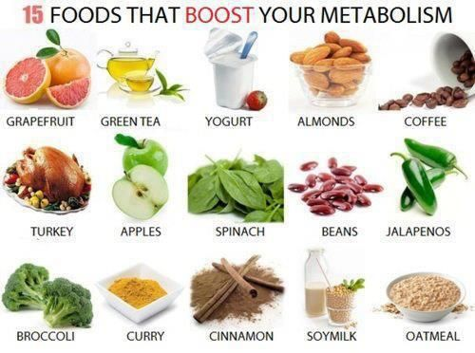
E) Metabolism: chemical reactions that occur within the body cells; depends on the digestive and respiratory system to make nutrients & oxygen available; regulated by hormones
F) Excretion: removing excreta (wastes) from the body; feces, urine & carbon dioxide
https://www.pinterest.com/pin/520658406892831190/?lp=true

Slide 10
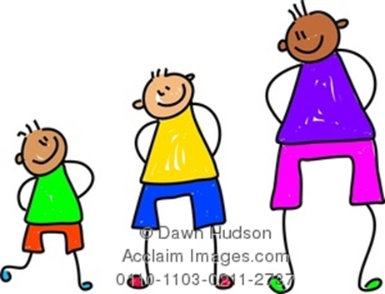
G) Reproduction: produciton of offspring; can occur on the cellular or organism level
H) Growth: increase in size by increasing the number of cells

Slide 11
5 Survival Needs:
Nutrients (diet)
Oxygen
Water
Body Temperature (98.6 degrees F)
Atomospheric Pressure (force exerted on the body)

Slide 12
Homeostasis
Describes the body’s ability to maintain relatively stable internal conditions even though the outside world is contiuously changing
Dynamic state of equilibrium
Body is in homeostasis when its needs are being adequately met

Slide 13
3 Components of Homeostasis
Receptor: monitors and responds to changes in the environment
Control center: determines the level at which variable is to be maintained
Effector: provides the means for the control center’s response to stimulus

Slide 14
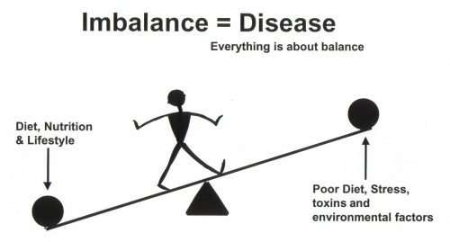
Homeostatic Imbalance:
aging or disease
Organs become less efficient and homeostasis is less stable.
Examples: dehydration, diabetes, cancer, heart attack
http://ainmath.com/index.php/homeostasis-imbalance

