Slide 1
Welcome to
3rd Grade!
Ms. Davis

Slide 2
72dnxyu
Contact Information
Long Mill Elementary School (919) 554-0667 extension: 294
my email: destinidavis@fcschools.net
class canvas page: Miss Davis' Canvas Page

Slide 3
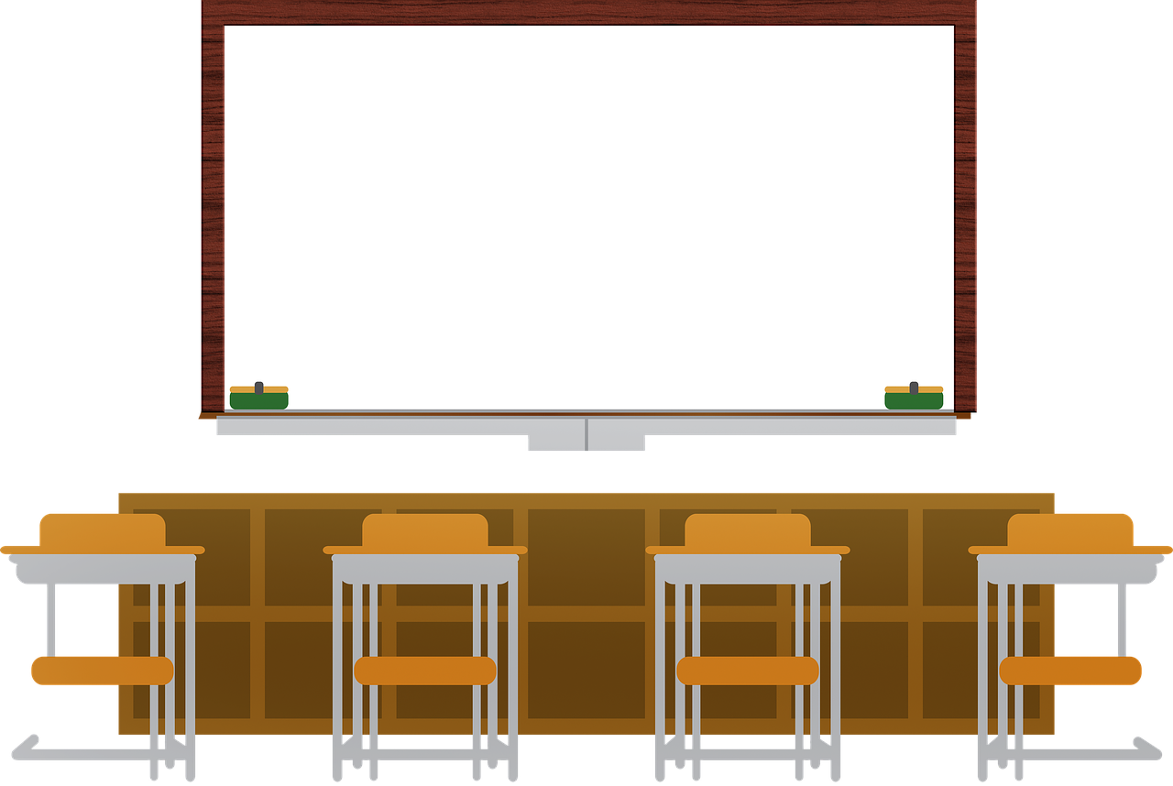
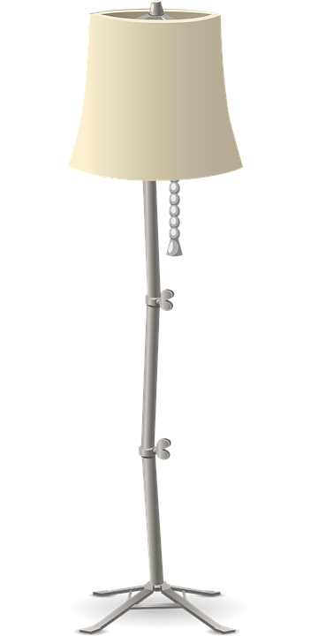

Slide 4
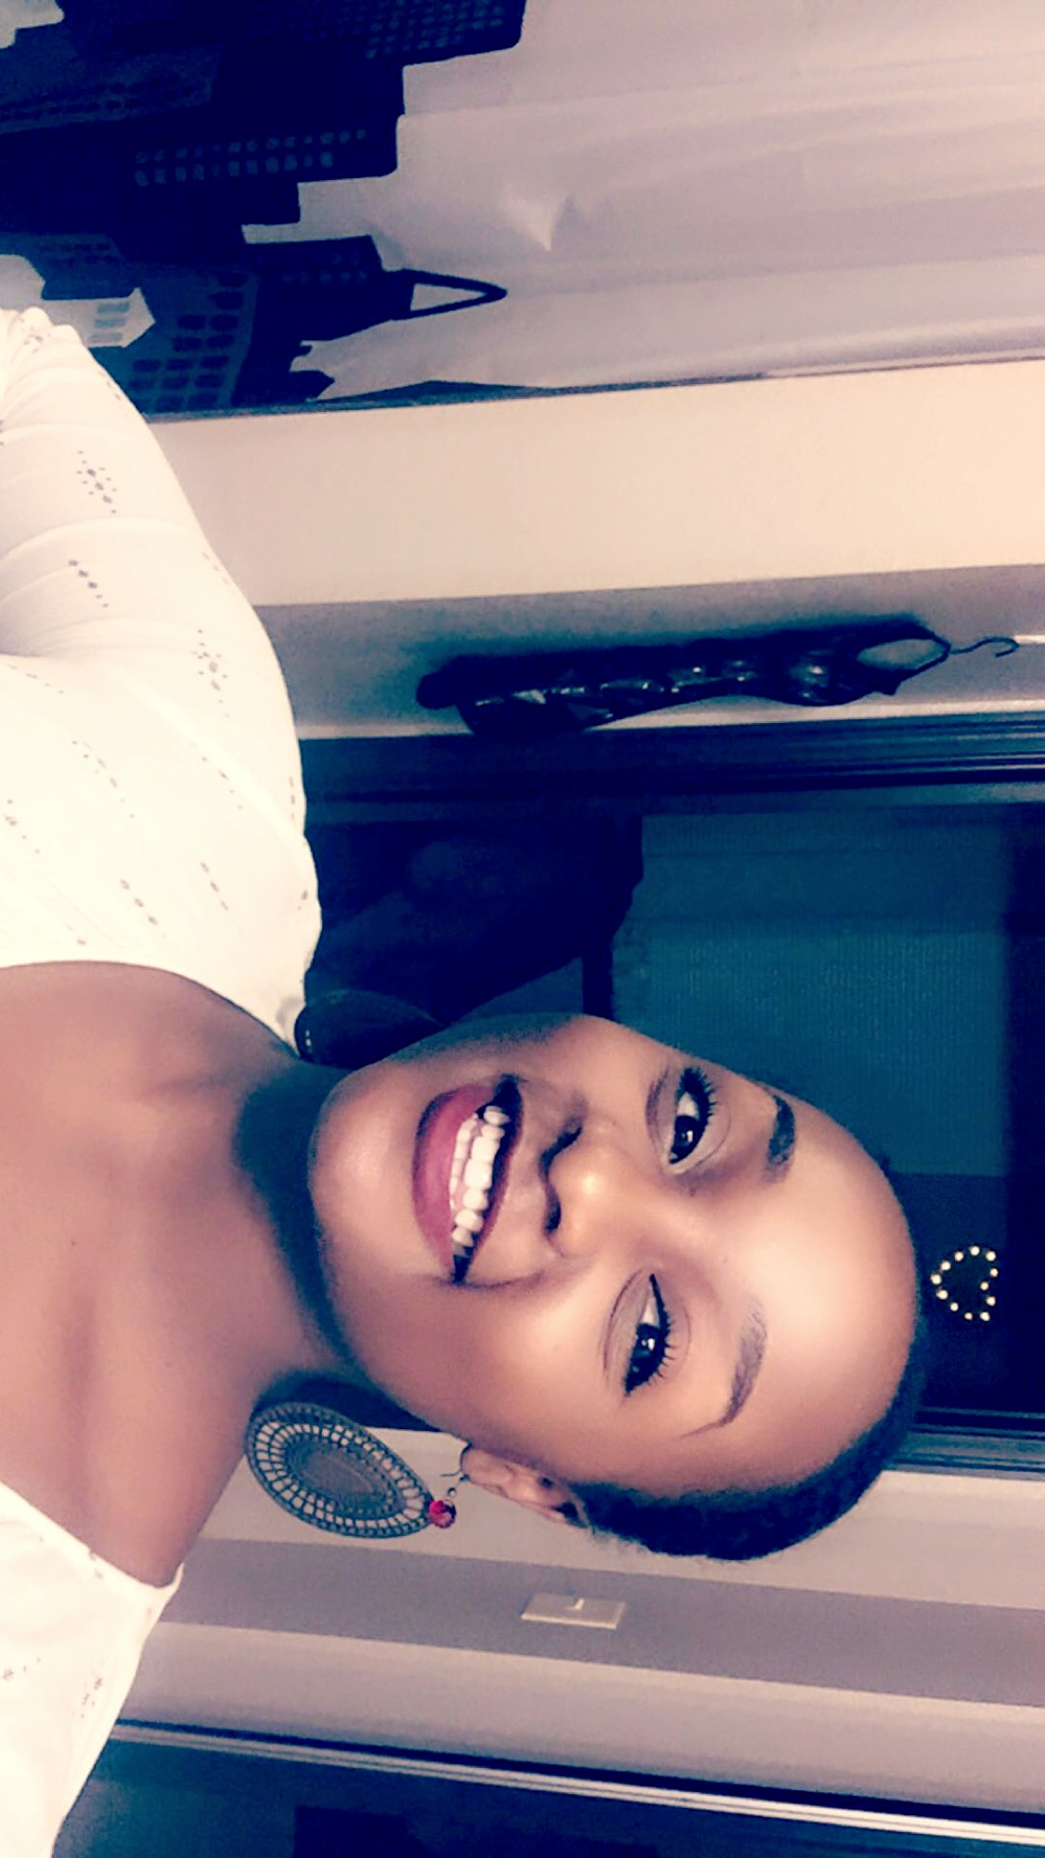
Meet the teacher!
This is my second year as a teacher, and my first year teaching third grade. I graduated in 2019 from NC A&T State University in Greensboro, North Carolina. I am born and raised in Bunn, NC and I have a Maltese, named Cody. I can’t wait to get to know you and help you grow this year!

Slide 5
Staying Healthy
Even though we are not physically meeting in the classroom, make sure you are practicing staying healthy at home (so that you are healthy when it’s time to come back to school) by doing things such as:
Washing your hands.
Not touching your face.
Wearing a mask while in public.
Keeping a social distance of at least 6 feet.

Slide 6
New School Guidelines
No visitors. If you are asked to come to school to pick up something for your student, stay in your car.
Please wear a mask if/when you come to the school to pick up materials, devices, etc.
**These guidelines keep our staff, students, and families safe!**

Slide 7
Mental Health
My number one goal this year is to help children be happy and healthy. I know that last spring was a very difficult time for many families. Mental health will come before academics as we start the year. Long Mill is incorporating a SEL (Social Emotional Learning) class this year to further help students. If at any time you have concerns about your child, please do not hesitate to contact me so we can work together.

Slide 8
Our Schedule
8:00-8:30 Office Hours
8:30-10:15 Reading with me
10:15-12:00 Math with Wilson
12:00-12:45 Lunch
12:45-1:15 Specials
1:15-2:00 iReady/Interventions

Slide 9
Special Schedule 12:45- 1:15
Monday - Music
Tuesday - Art
Wednesday - PE
Thursday -SEL
Friday - No special this day

Slide 10
Distance Learning
We will be using Google Classroom and Google Meet for instruction during remote learning. I will let you know what time we will be meeting via Google Meet each week. Please email or call me if you are having any technology struggles.
I know that it can be difficult for children to stay engaged during Google Meets. However, these are important because they will be getting their instruction during that time.
If at any point you see your child struggling to stay on task during meetings, please contact me and I will work to make adjustments.

Slide 11
3rd Grade Supply List
2 packs regular pencils
Pencil Case
Dry Erase Markers
Dry Erase Eraser
Dry Erase Board
Composition book (show math work)
Index Cards
Headphones or Earbuds
Chromebook Case (optional)
Crayons/Colored Pencils

Slide 12
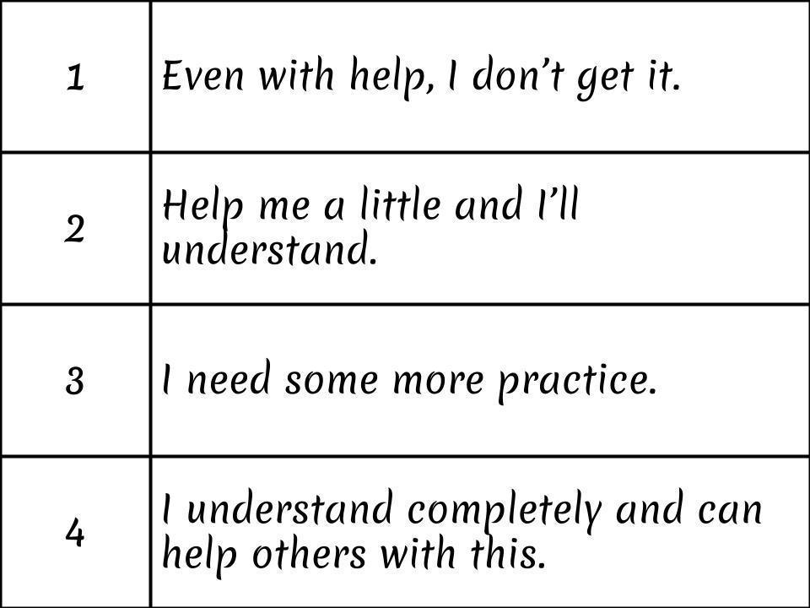

Slide 14
Google Classroom
We will use Google Classroom this summer. My hope is that it will help create easy access and understanding for distance learning. My goal will be to help children learn how to use each piece of this platform so they can be more independent during distance learning.
Don’t hesitate to ask any questions pertaining to google classroom/google meets. We’re all in this together!

Slide 15
Google Classroom Codes
Davis ELA - k5qzwpx
Davis Social Studies - vctpfqp
Wilson Math - e67647d
Wilson Science- xlvj5tp
Music - jjydlex
Art - duwssnr
PE - xc5yzsd
SEL - b6iuuv6

Slide 16
Special Needs or Accomodations?
Please let me know if their are any special needs or accomodations you would like me to know about your child so I can help them be successful!

