Slide 1
Japan, Korea, and China

Slide 2
How much information do you already know about this topic area?
Expert - I have done a lot of learning in this area already.
Above average - I have learned some information about this topic.
Moderate - I know a little about this topic.
Rookie - I am a blank slate...but ready to learn!
0
0
6
0
(AS220-C2L2:LQ1)

Slide 3
In which country did the Edo Period take place?
China
Japan
North Korea
South Korea
1
3
1
0
(AS220-C2L2:LQ2)

Slide 4
Overview
The history of unitary government and the rule of warlords in China
The causes of the shift from isolation to openness in Japan
The impact of domination and division on Korea
The political and economic impact of World War II on China and Japan
Japan, South Korea, and China as economic powerhouses
Notes:
4

Slide 5


Vocabulary Questions Slide Index
Click any link below to go directly to polling that question.
Core shared belief
Government employees and institutions
Proclamations
Land under control of foreign power
Government run by the people
Temporary president
Rulers who exercise both military and civil authority
Military governors in Japan
Warrior aristocrats of Japan
Threat of naval force to reach foreign policy goal
Click here to return to this index.

Slide 6
Vocabulary Questions Slide Index
Click any link below to go directly to polling that question.
Arrangement for one country to govern another
Military rule
Shared
Situation that's out of control
Able to be farmed
Click here to return to this index.

Slide 7
Quick Write
If you had been Lord Macartney, would
you have kowtowed?
Was Emperor Qian Long’s attitude justified?
Explain your answer.
Note to Instructors:
Click the Show/Hide Response Display Button

Slide 8
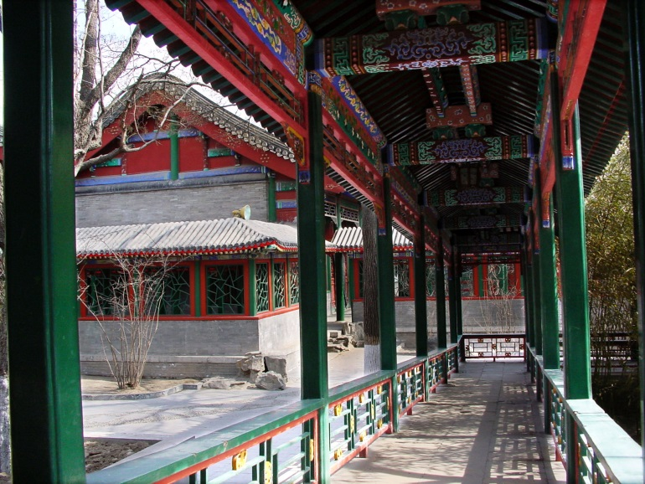
The History of the Unitary Government and the Rule of Warlords in China
The Boxer Rebellion and the Invasion of the Eight-Nation Alliance in 1900
  The Boxers rebelled in China because they opposed foreigners and Christians
Robert Marquand / © 2001 The Christian Science Monitor
Notes:
8

Slide 9
The History of the Unitary Government and the Rule of Warlords in China
The Warlord Period of Chinese History Between 1911 and 1928
  Warlords—rulers who exercise both military and civil authority in the absence of a strong central government
  The era of the warlords in China is described as hard time under brutal rulers
Robert Marquand / © 2001 The Christian Science Monitor
Notes:
9

Slide 10
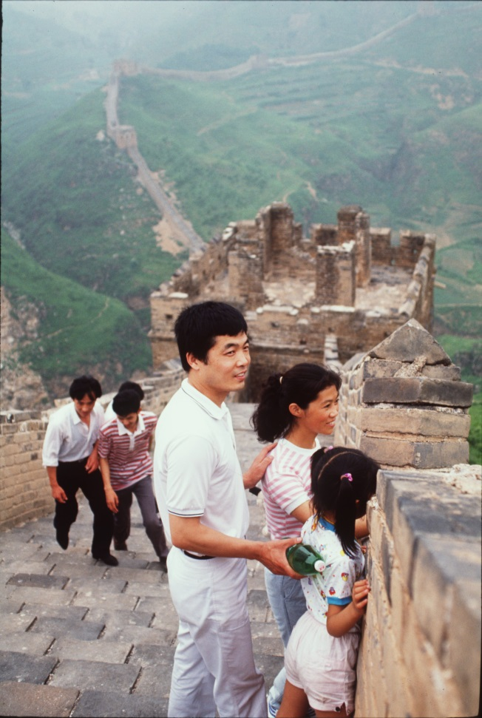
The History of the Unitary Government
and the Rule of Warlords in China, cont.
In 1925 Chiang Kai-shek took over the KMT Party
Mao Zedong came to power in the Communist Party
The two parties struggled for years
1949: Mao proclaimed the founding of the People’s Republic of China
R. Norman Matheny / © 1990 The Christian Science Monitor
Notes:
10

Slide 11
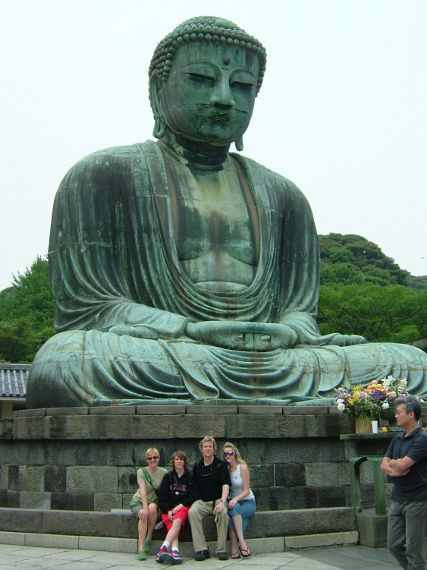
The Causes of the Shift from Isolation to Openness in Japan
Shoguns, or military governors, restricted the movement of foreigners
By 1641 Japan had shut its gates to the outside world
Scholars refer to this time as the Edo period
Distrust of outsiders was a characteristic of the Edo period
Gloria Goodale / © 2006 The Christian Science Monitor
Notes:
11

Slide 12
The Causes of the Shift from Isolation to Openness in Japan, cont.
“Gunboat diplomacy” refers to the threat, or limited use, of naval force to reach a foreign policy goal
1853: Commodore Matthew Perry’s mission was to negotiate a trade agreement - he opened two ports to American ships
The Convention of Kanagawa
Notes:
12

Slide 13
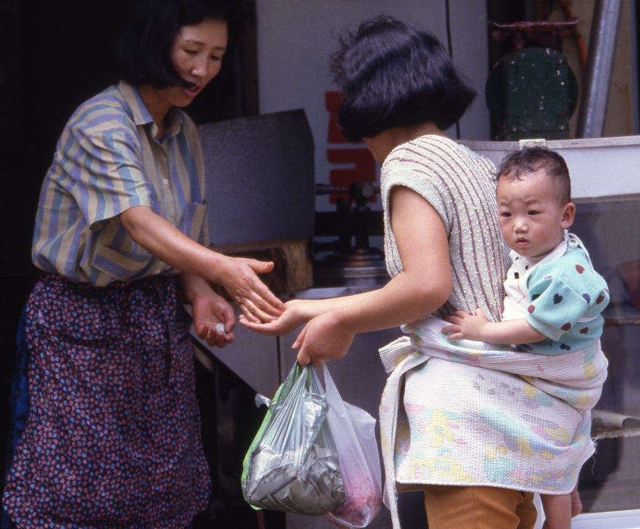
The Impact of Domination and Division on Korea
China and Japan dominated Korea prior to 1945
After World War II the Allies split Korea in two at the 38th parallel
Cold War politics shattered hopes of a unified independent Korea
Robert Harbison / © 1989 The Christian Science Monitor
Notes:
13

Slide 14
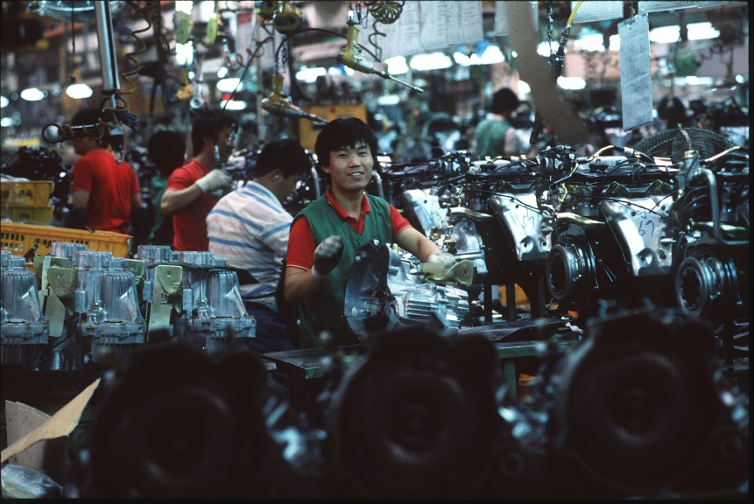
The Impact of Domination and Division on Korea, cont.
North Korea
  Communist
  Rigid, centralized government
  Millions starved to death in 1990s
South Korea
  Spectacular economic growth
  Democratic activism
Robert Harbison / © 1989 The Christian Science Monitor
Notes:
14

Slide 15
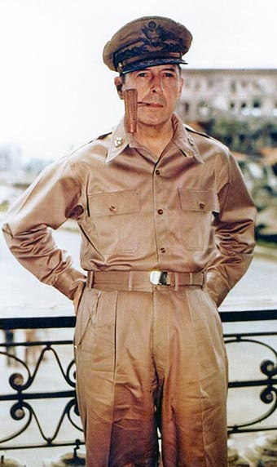
The Political and Economic Impact of World War II on China and Japan
Under its agreement with the Allies, Japan had to consent to occupation by Allied forces
Demilitarization and democratization began
Role of General Douglas MacArthur
Japan rebounded quickly
Photo courtesy U.S. Navy
Notes:
15

Slide 16
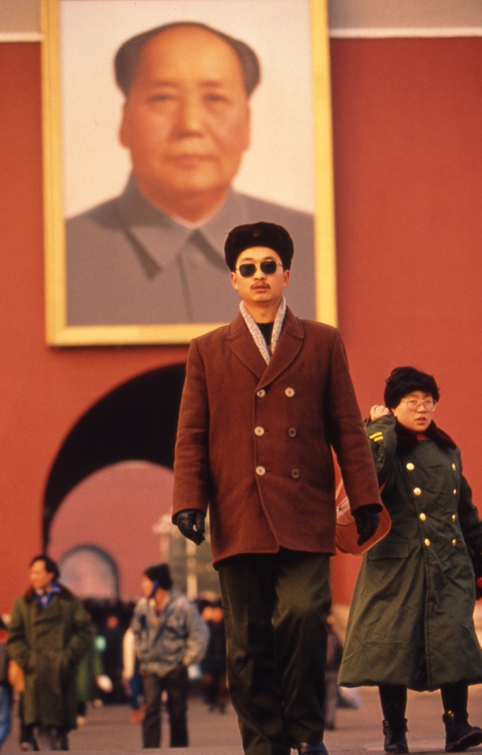
The Political and Economic Impact of World War II on China and Japan, cont.
Rise of the Communist System of Government in China
First Five-Year Plan: 1953-57
  Goals: Industrialization and collectivization of agriculture
  Political centralization
Mao broke with the Soviet model
  Great Leap Forward
  Cultural Revolution
Robert Harbison / © 1994 The Christian Science Monitor
Notes:
16

Slide 17
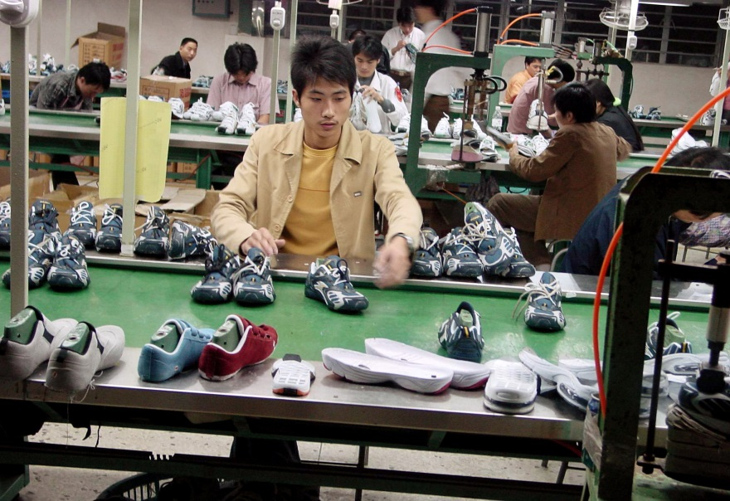
Japan, South Korea, and China as Economic Powerhouses
Japan
  Industrialized free-market economy
  Second largest in the world
South Korea
  Export-oriented economy
  Important trade partner
China
  Since 1979 reformed economy
  World’s factory
Robert Marquand / © 2003 The Christian Science Monitor

Slide 18
Which country is referred to as the Hermit Kingdom?
China
Japan
North Korea
South Korea
0
3
2
0
(AS220-C2L2:LQ3)

Slide 19
Who introduced the Great Leap Forward?
Sun Yat-sen
Deng Xiaoping
Chiang Kai-shek
Mao Zedong
0
0
1
0
(AS220-C2L2:LQ4)

Slide 20
Activity 1: Japan, Korea, and China Review
Define each vocabulary term
in complete sentences
and
categorize the terms according to
the country to which they refer
Notes:
20

Slide 21
Activity 2: Speech Analysis
China has an immense global impact now and it will continue to grow. The summary from the speech of US Treasury Secretary Timothy Geithner at Peking University on June 1, 2009 stresses global connections and the need for cooperation.
Notes:
21

Slide 22
Activity 3: Analysis of Economies of Japan, China, and South Korea
What are the economic strengths of these countries?
What are their economic weaknesses?
What is the role and impact of each of these countries on the global economy?
Notes:
22

Slide 23
Technology Enrichment: A North Korean Defector Speaks Out
Based on information from this lesson in the text and from the video, do you think that the two Koreas will ever reunite? Why or why not?
What did you find most striking about Myong Hui Eom’s story?
Which country on the map is safest for North Korean defectors?
Notes:
23

Slide 24
Review
On 1 October 1949 Mao proclaimed the founding of the People’s Republic of China (PRC)
The opening of Japan to trade with the West is a classic example of gunboat diplomacy
Cold War politics shattered hopes of a unified independent Korea
Notes:
24

Slide 25
Review
Japan has an industrialized free-market economy that is still the second largest in the world
South Korea remains an important trade partner of the United States and Japan
China is the world’s factory

Slide 26
Should the United States be concerned that North Korea and South Korea are technically still at war? Why or why not?
Note to Instructors:
Click the Show/Hide Response Display Button
(AS220-C2L2:LQ5)

Slide 27
Which of the following would be the MOST USEFUL to you to continue your learning after this class?
Look up more information about this topic on the internet.
Spend more time reading the textbook.
Work with others to study or review the material.
Other
Nothing. I feel confident I have learned/mastered this material.
0
0
0
0
0
(AS220-C2L2:LQ6)

Slide 28
Summary
The history of the unitary government and the rule of the warlords in China
The causes of the shift from isolation to openness in Japan
The impact of domination and division on Korea
The political and economic impact of World War II on China and Japan
Japan, South Korea, and China as economic powerhouses
Notes:
28

Slide 29
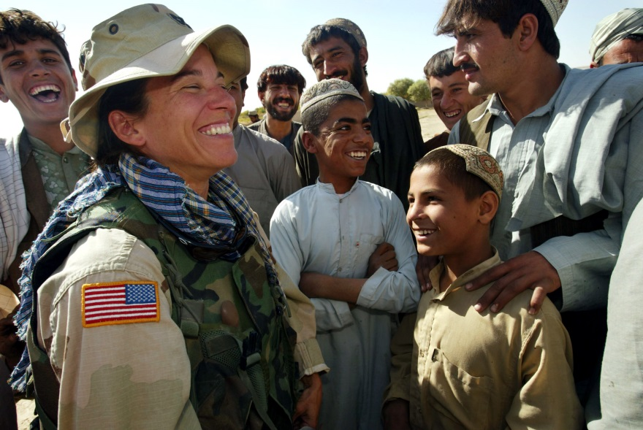
Next…
Melanie Stetson Freeman / © 2003 The Christian Science Monitor
Done—Japan, Korea, and China
Next—India, Pakistan, and Afghanistan
Notes:
29

Slide 30
Team Assignment
Alpha
Bravo
Charlie
Delta

Slide 31
A core shared belief (p.154)
Edict
Ideology
Protocol
Belief system
0
0
0
0
(AS220-C2L2:VQ1)

Slide 32
Government employees and institutions (p.154)
Civil service
Diplomatic corps
Foreign service
Government service corps
1
1
1
1
(AS220-C2L2:VQ2)

Slide 33
Proclamations or commands (p.155)
Decrees
Proclamations
Edicts
Public orders
1
1
1
1
(AS220-C2L2:VQ3)

Slide 34
A land area under the control of a foreign power (p.156)
Concession
Colony
Territory
Purchase
1
1
1
1
(AS220-C2L2:VQ4)

Slide 35
A form of government run by the people generally through elected representatives (p.157)
Monarchy
Democracy
Oligarchy
Republic
1
1
1
1
(AS220-C2L2:VQ5)

Slide 36
A temporary president is a/an _____________ president. (p.157)
permanent
provisional
elected
appointed
1
1
1
1
(AS220-C2L2:VQ6)

Slide 37
Rulers who exercise both military and civil authority in the absence of a strong central government (p.158)
Governors
Civil servants
Bureaucrats
Warlords
1
1
1
1
(AS220-C2L2:VQ7)

Slide 38
Military governors in Japan (p.160)
Samurai
Bushido
Shoguns
Oligarchs
1
1
1
1
(AS220-C2L2:VQ8)

Slide 39
The warrior aristocrats of Japan (p. 161)
Chonindo
War lords
Bakufu
Samurai
1
1
1
1
(AS220-C2L2:VQ9)

Slide 40
The threat, or limited use, of naval force to reach a foreign policy goal (p. 161)
Naval diplomacy
Gunboat diplomacy
Cold War
Preemptive action
1
1
1
1
(AS220-C2L2:VQ10)

Slide 41
An arrangement for one country to govern another under international control
(p. 164)
Protectorate
Trusteeship
Concession
Provisional government
1
1
1
1
(AS220-C2L2:VQ11)

Slide 42
Military rule (p. 166)
Martial law
Foreign domination
A UN peace keeping force
Democratic activism
1
1
1
1
(AS220-C2L2:VQ12)

Slide 43
Another word for shared (p.169)
Provisional
Social
Central
Communal
1
1
1
1
(AS220-C2L2:VQ13)

Slide 44
A situation that's out of control with, in effect, where no one is in charge (p.171)
Communism
Socialism
Anarchy
Plutocracy
1
1
1
1
(AS220-C2L2:VQ14)

Slide 45
Able to be farmed (p.172)
Aqueous
Arable
Arterial
Arboreal
1
1
1
1
(AS220-C2L2:VQ15)

Slide 46
Leaderboard
Last
Slide
Points | Participant | Points | Participant

Slide 47
Team Scores
Last
Slide
Points | Team | Points | Team

Slide 48
Team MVP
Last
Slide
Points | Team | Participant

Slide 49
Whiteboard
Last
Slide

