Slide 1
Customs and Courtesies for Junior ROTC

Slide 2
Lesson Overview
Customs and courtesies
Historic customs and courtesies
Proper methods to demonstrate recognition and respect
Military time

Slide 3
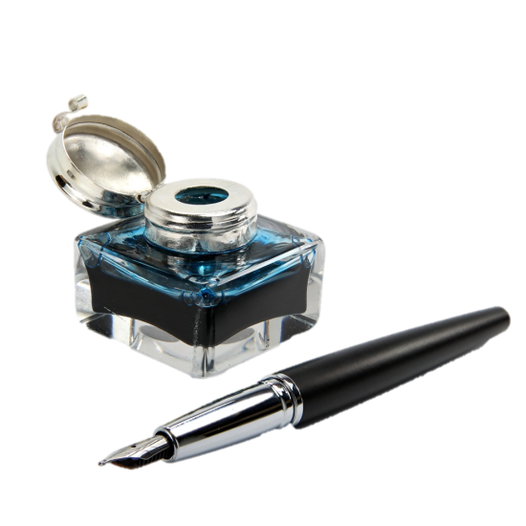
Quick Write
Jot down three customs in your everyday life—based on friendships, family, sports, or community activities—that you think are important. Why are they important?
Note to Instructors:
Click the Show/Hide Response Display Button
Photo Courtesy of Fotolia

Slide 4
Customs and Courtesies
Customs
Help build confidence
Vary from family to family, region to region, and country to country
Like unwritten laws
Keys to proper behavior in military and civilian life
Photo Courtesy of Fotolia

Slide 5
Courtesies
Courtesies
Expression of consideration or respect
Goes beyond basic politeness
Build morale and discipline
Photo Courtesy of Fotolia

Slide 6
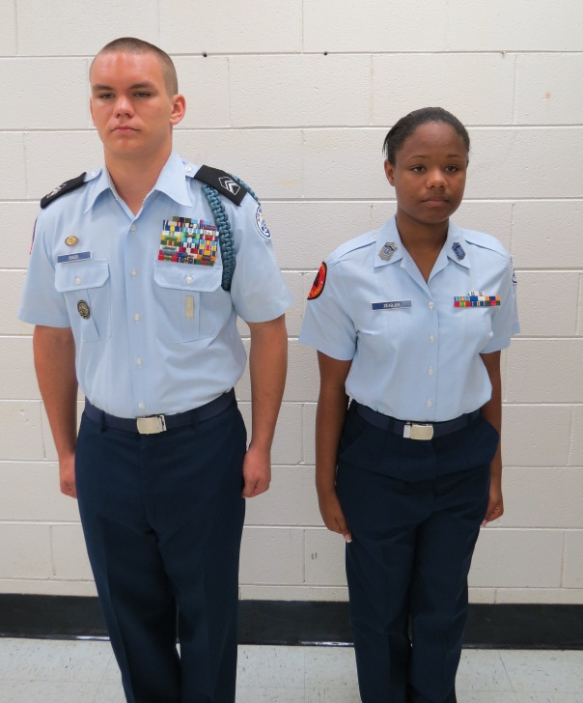
Historic Customs and Courtesies
Position of Honor
Walk or sit to the left of those with higher rank
Hand Salute
Says “I greet you”
Signals recognition and respect
Sloppy salute shows lack of confidence or respect
Photo Courtesy of Michael Wetzel/US Air Force JROTC

Slide 7
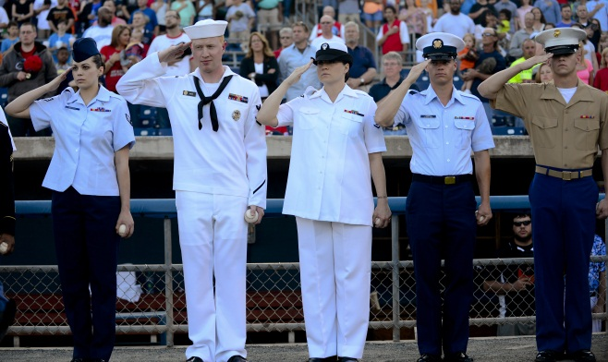
How to Salute
Execute salute smartly with right hand; with headgear, without headgear, with glasses
Shoulder to elbow is parallel to the ground
Thumb and fingers - extended and joined
Posture - erect and alert
Must be standing or marching at attention
Photo Courtesy of Senior Airman Kayla Newman/Defense Video & Imagery Distribution System

Slide 8
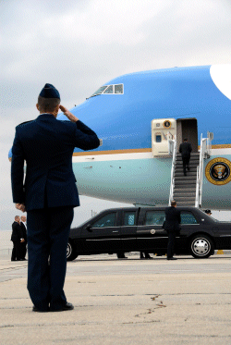
Whom to Salute
President of the United States
All Commissioned and Warrant Officers of the US Armed Forces
Officers of friendly foreign nations
Secretary of Defense
Secretaries of the US Military Service Branches
Any Medal of Honor Recipient
Photo Courtesy of Wisconsin Army National Guard photo by Sgt. 1st Class Vaughn R. Larson

Slide 9
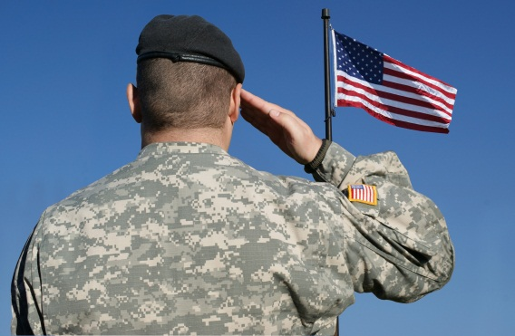
When to Salute
Always return a salute, unless unable
If you are junior rank, you salute first
Do not salute indoors, except during a formal report or receiving a formal award from an officer
Outdoor salutes exchanged upon recognition
In special instances, salutes are not exchanged
Photo Courtesy of Fotolia

Slide 10
Activity 2: The Hand Salute
Review the section in your textbook on historic customs and courtesies, then answer the questions
In groups, practice executing a proper hand salute

Slide 11
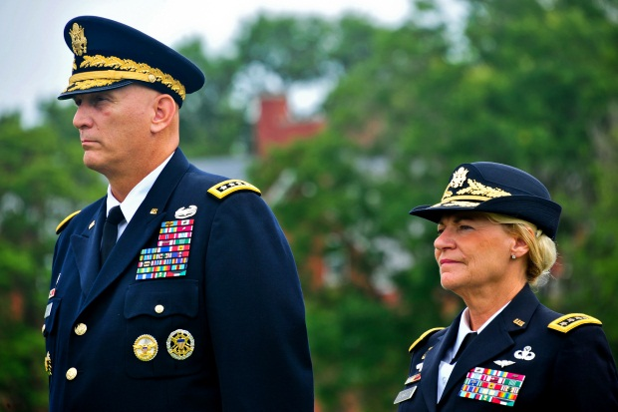
Recognition and Respect
You can recognize an officer by:
Service hat visor or band
Hat or beret insignia
Flight cap and insignia
Marked government vehicles and staff cars may indicate an officer is aboard
Photo Courtesy of Dunwoody, Department of Defense

Slide 12
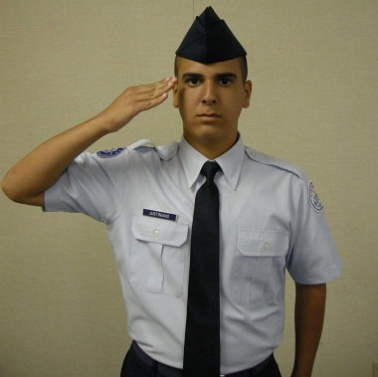
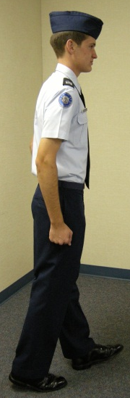
Reporting to an Officer or Board
Entrance
Turn off cellphone
Knock loudly and firmly once
Reporting Process—the most critical step
Use snap and precision; salute properly
Departure
Take the most direct route out
Photo Courtesy of Michael Wetzel/US Air Force JROTC

Slide 13
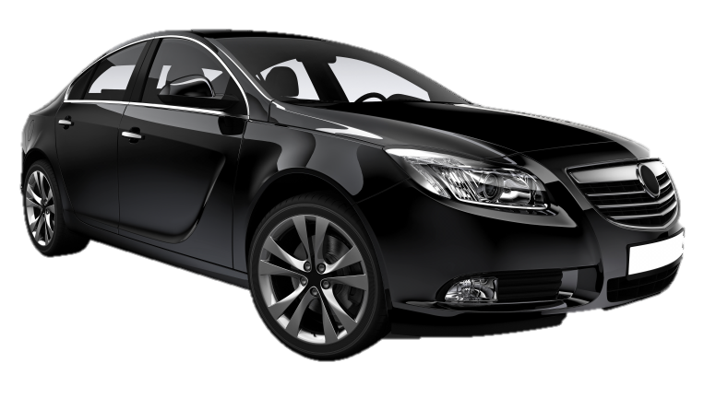
Personal Courtesies
Walk, ride, or sit to the left of higher-ranking person
Stand when an officer speaks to you
Get out of the vehicle before speaking to higher-ranking person outside vehicle
Junior-ranking members enter a vehicle first
Photo Courtesy of Fotolia

Slide 14
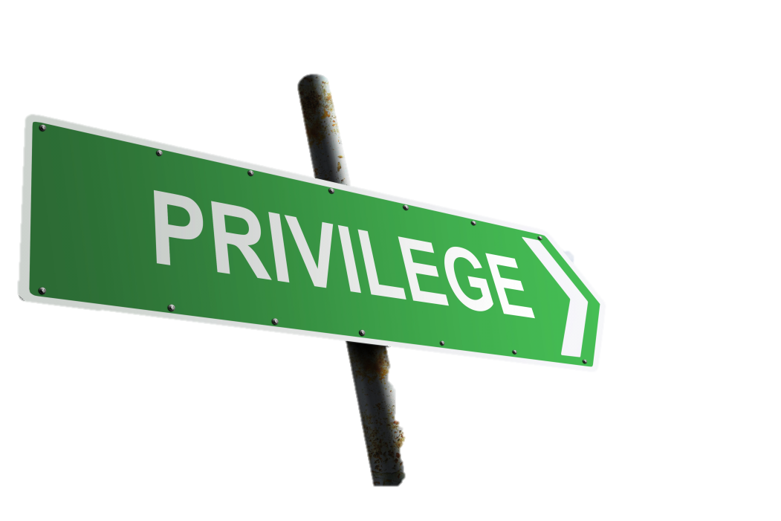
Personal Courtesies, cont.
RHIP – Rank Has Its Privileges
Privilege and responsibility go hand-in-hand
Positions must never be abused
Best privileges are those you earn
Photo Courtesy of Fotolia

Slide 15
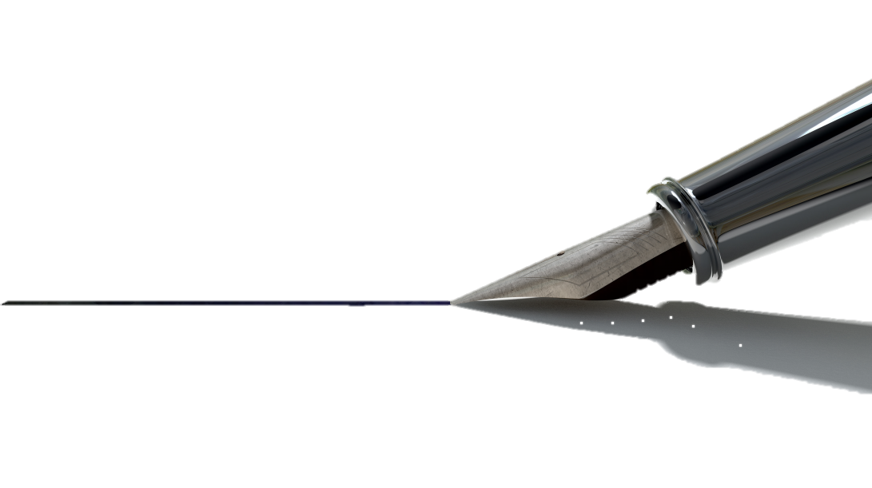
Military Titles
Use correct title to show respect for rank
Official written correspondence—use full title
Speaking to officers or NCOs—use formal or abbreviated military titles
Photo Courtesy of Fotolia

Slide 16
Military Titles, cont.
Address civilians as Mr., Mrs., Miss, or Ms.
Address medical doctors, dentists, and veterinarians as Doctor
Address chaplains as Chaplain
Address retirees by their retired rank
Mr.
Mrs.
Miss
Ms.

Slide 17
Additional Courtesies
Calling a room to attention
Don’t keep people waiting
Taboos
Showing disrespect to the uniform
Electronic devices
Gossip
Vulgar conduct and language
Photo Courtesy of Fotolia

Slide 18
Activity 3: Recognition and Respect
Review the section in your textbook on the proper methods to demonstrate recognition and respect, personal courtesies, and taboos
Describe each military courtesy and taboo then answer the questions

Slide 19
Military Time
24-hour clock beginning at midnight
If the time is 12:15 a.m. you say:
“zero-zero-fifteen” or “zero-zero-fifteen hours”
“oh-oh-fifteen” or “oh-oh-fifteen hours”
Photo Courtesy of Fotolia

Slide 20
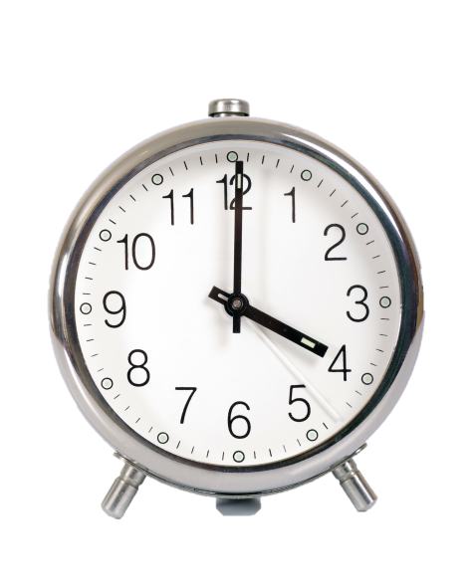
Greenwich Mean Time
24 time zones around the world
12 east of Greenwich and 12 west of Greenwich
U.S. Military refers to GMT as Zulu Time
Attaches the "Zulu" (Z) suffix to ensure time zone is clear
Photo Courtesy of Fotolia

Slide 21
Activity 4: Military Time
Complete the tables by converting military and standard times
Answer the questions on Greenwich Mean Time

Slide 22
Summary
Customs and courtesies
Historic customs and courtesies
Proper methods to demonstrate recognition and respect
Military time

Slide 23
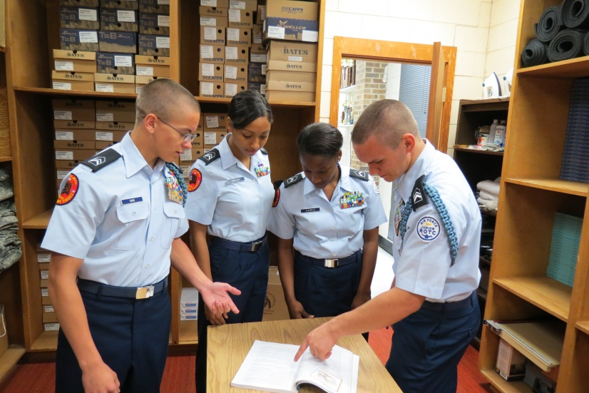
Next….
Done – customs and courtesies for Junior ROTC
Next – attitude, discipline, and respect
Photo Courtesy of Michael Wetzel/US Air Force JROTC

