Slide 1
The Military Uniform and
Appearance Standards

Slide 2
Lesson Overview
Uniform wear and history
Uniform wear, restrictions, and standards
Uniforms used within special teams
Cadet appearance and grooming standards
Military pay grades and rank insignia

Slide 3
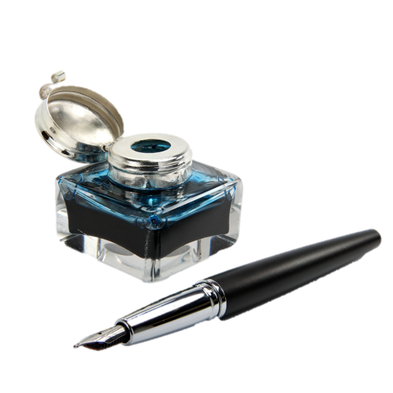
Quick Write
List the first three things you think of when you see a person in a uniform.
Note to Instructors:
Click the Show/Hide Response Display Button

Slide 4
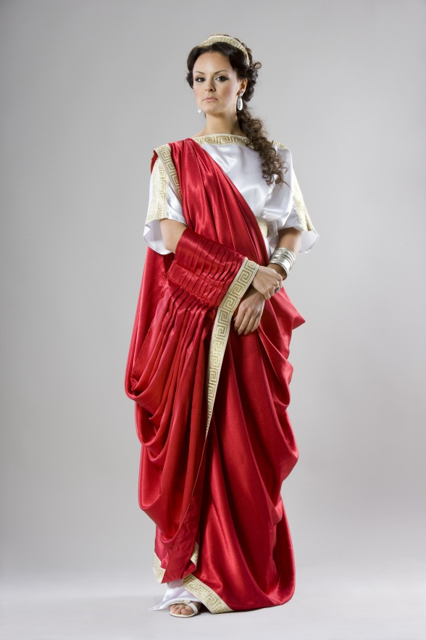
Uniform Wear and History
People wear to show they belong to an organization
Military uniform is public symbol of the nation’s defense forces
Should be worn proudly
Key elements: neatness, cleanliness, safety, and military image
Photo Courtesy of Fotolia

Slide 5
You never get a second chance to make a first impression

Slide 6
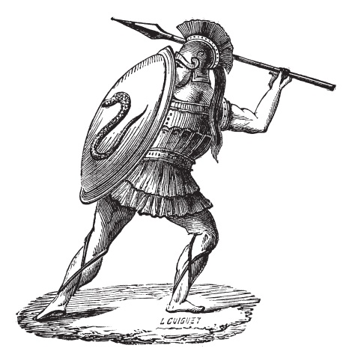
The History of the Military Uniform
In ancient times acquired degree of sameness
Greece, Athenian, and Spartan soldiers dressed according to position
In the 15th and 16th centuries in Europe, national armies wearing standardized uniforms came into being
Photo Courtesy of Fotolia

Slide 7
Uniform Wear, Restrictions, and Standards
Cadets generally wear same uniform as parent military service
Restrictions for military personnel
Barred from engaging in political activity in uniform
Prohibited from publicly supporting a candidate
Requires absolute obedience to elected leaders
Photo Courtesy of Fotolia

Slide 8
Uniform Wear, Restrictions, and Standards, cont.
As citizens, military are encouraged to vote
Federal law forbids military in uniform from participating in public demonstrations
No item of JROTC uniform may be worn by groups that sponsor JROTC programs

Slide 9
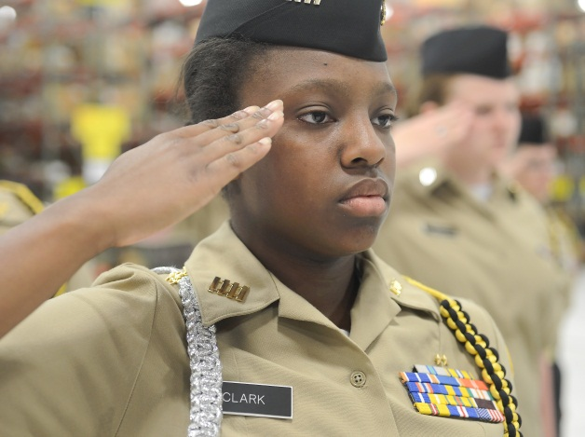
Dos for Wearing the Uniform
Wear properly and with pride
Wear on the established day
Wear as specified by the instructor staff
Wear when flying on military aircraft
Wear when participating in a color guard or on a drill team
Photo Courtesy of US Air Force photo/Greg L. Davis/Defense Video & Imagery Distribution System

Slide 10
Dos for Wearing the Uniform, cont.
Keep your shoes polished and shined
Wear shoes appropriate for the activity
Ensure that badges, insignia, belt buckles, and other metallic devices are clean
Keep ribbons clean
Wear the distinctive uniform required

Slide 11
Don’ts for Wearing the Uniform
Do not wear with other clothing
Do not lend your uniform to anyone who is not a JROTC member
Do not allow articles to be visible
You may have a cell phone clipped to your belt as long as it is in a black case
Unless required in uniform:
Do not walk around with earphones or headphones on you or around your neck
Photo Courtesy of Fotolia

Slide 12
Activity 1: Restrictions for Wearing the Military Uniform
Review the section in your textbook on the restrictions and dos and don’ts for wearing the uniforms
Answer the questions

Slide 13
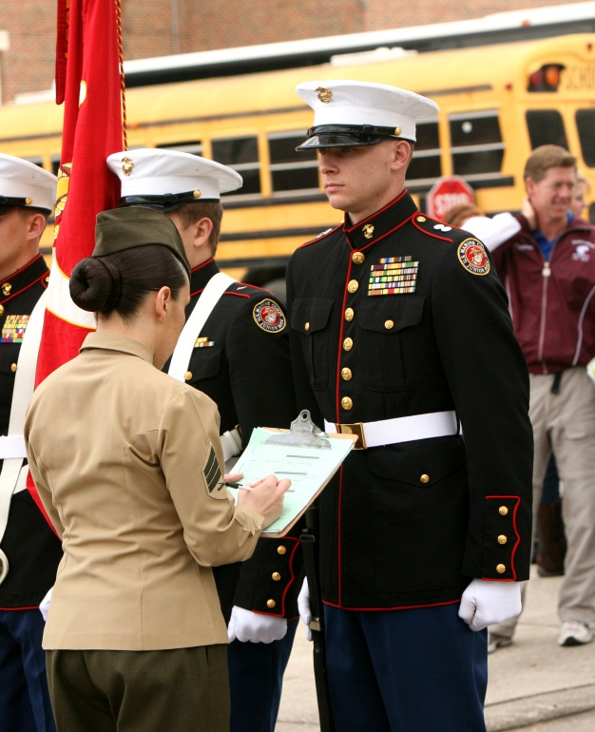
Uniform Standards
All JROTC programs have same general uniform standards
AFJROTC standards are in three instructions
Publications provide complete details on fitting standards and personal grooming requirements
It’s your responsibility to maintain uniform items
Photo Courtesy of Lance Cpl. Nana Dannsaappiah/Defense Video & Imagery Distribution System

Slide 14
Standard Cadet Uniform
AFJROTC Male Service Dress Uniform
Dark blue service coat and trousers
Light blue long sleeve shirt and dark blue tie
AFJROTC Female Service Dress Uniform
Dark blue service coat with slacks or skirt
Light blue blouse and tie tab
Photos Courtesy of Michael Wetzel/US Air Force JROTC

Slide 15
Activity 2: JROTC Uniform Standards
Describe the standard cadet uniforms worn in your JROTC unit
Include a brief description of each uniform and the proper wear

Slide 16
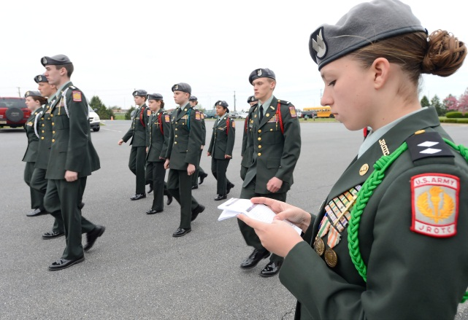
Uniforms Used Within Special Teams
Color guards, honor guards, sabre teams, and drill teams may wear additional uniform items or distinctive style of military uniform
Worn only when performing as a member of a specialized group
Photo Courtesy of US Air Force photo/Greg L. Davis/Defense Video & Imagery Distribution System

Slide 17
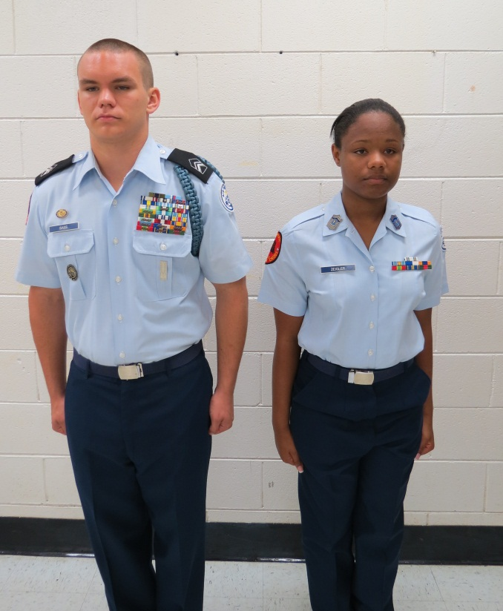
Cadet Appearance and Grooming Standards
Responsible for a neat, clean, and professional military image in uniform
Uniform standards are neatness, cleanliness, safety, and military image
AF uniform is plain but distinctive dress
Photo Courtesy of Michael Wetzel/US Air Force JROTC

Slide 18
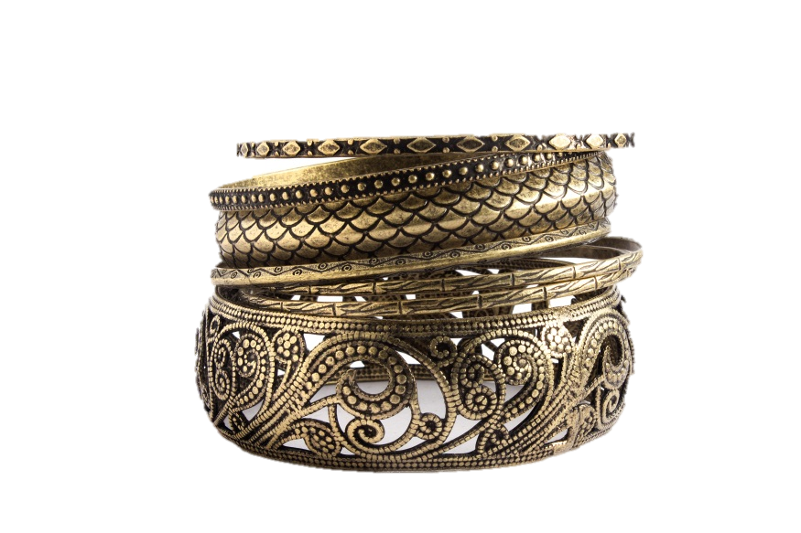
Wearing Jewelry in Uniform
May wear a wristwatch
Rings: no more than 3 total for both hands
One neat and conservative wrist bracelet; ankle bracelets not allowed
No ornaments on your head or around neck
Females may wear conservative earrings; male cadets may not wear earrings
Photo Courtesy of Fotolia

Slide 19
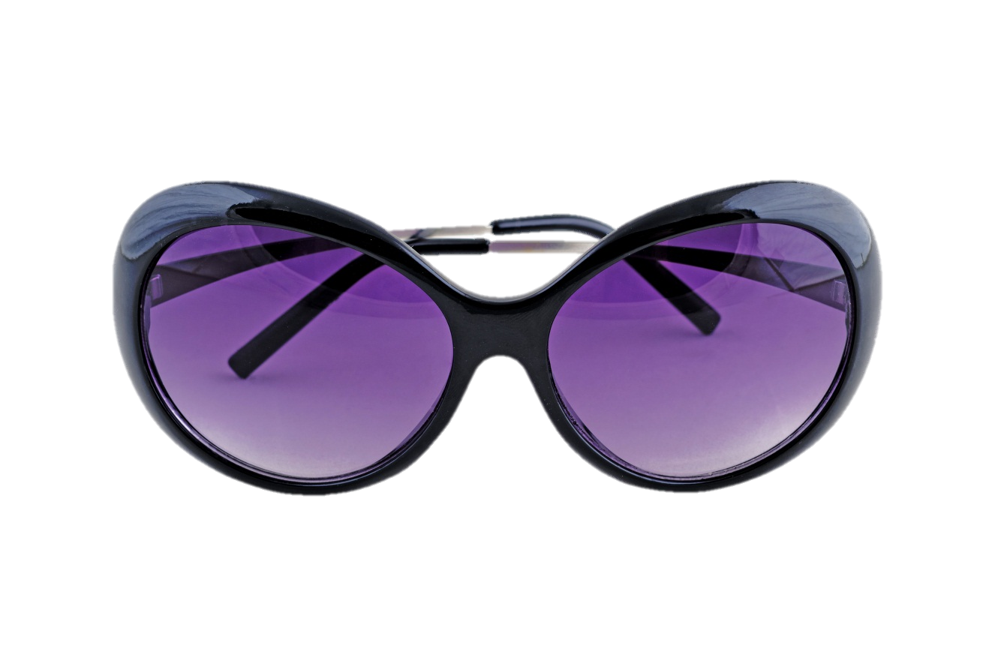
Eyeglasses or Sunglasses
Lenses may be conservative, clear, slightly tinted, or have photosensitive lenses
Sunglasses not allowed in military formation
Cannot be worn around the neck or top of the head in uniform
Photo Courtesy of Fotolia

Slide 20
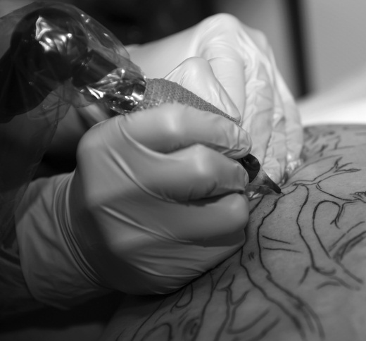
Tattoos, Brands, and Piercings
Tattoos and brands:
Not allowed if they are obscene
Not allowed if they advocate sexual, racial, ethnic, or religious discrimination
No excessive tattoos exposed in uniform
Body piercings not allowed in uniform
Photo Courtesy of Fotolia

Slide 21
Specific Female Guidelines
Hair
Will end above the bottom of the collar edge and an invisible line drawn parallel to ground
Hairstyle must be conservative—no extreme or faddish styles are allowed
Skirt: fits smoothly, hang naturally, and must not be excessively tight
Must wear hosiery that compliments uniform and skin tone
Photo Courtesy of Michael Wetzel/US Air Force JROTC

Slide 22
Specific Male Guidelines - Hair
Keep hair clean, neat, and trimmed
Should not exceed 1 and ¼ inch in bulk
No foreign items attached
If you dye your hair, it must look natural
No beards or goatees
Mustaches are allowed but
must be trimmed properly
Photo Courtesy of Michael Wetzel/US Air Force JROTC

Slide 23
Activity 3: Cadet Appearance and Grooming Standards
Review the section in your textbook on cadet appearance and grooming standards
List one of the rules from each category
Why do you think each rule is important?

Slide 24
Military Pay Grades and Rank Insignia
The higher the rank, the more responsibility
Pay grade system has two categories:
Officer grades
Enlisted grades
Photo Courtesy of US Air Force

Slide 25
Officers
Proper methods of address when speaking to officers are:
Lieutenant
Colonel
General
Use full titles for official written correspondence
Photo Courtesy of US Air Force

Slide 26
Enlisted
Enlisted ranks are subdivided into two categories:
Noncommissioned Officers (NCOs)
Airman
NCOs serve in ranks of staff sergeant through chief master sergeant
Photo Courtesy of US Air Force

Slide 27
Enlisted, cont.
NCOs:
First Sergeants hold a position of trust and responsibility—link between commander and unit
Highest position is chief master sergeant of the Air Force (CMSAF)
Airman ranks: Airman basic (AB), Airman (Amn) , Airman first class (A1C), and Senior Airman (SrA)
Photo Courtesy of US Air Force

Slide 28
AFJROTC Rank Insignia
Officers: Rank insignia for military and cadet officers is very different
Enlisted: Only slight differences exist between enlisted ranks
For cadets: Inside of chevron has torch
Chevron is pointed at the bottom
Photo Courtesy of Michael Wetzel/US Air Force JROTC

Slide 29
Ribbons
Ensure proper order based on the AFJROTC ribbon chart
Lowest ribbon worn at the lowest left position
Highest ribbon worn at the top right

Slide 30
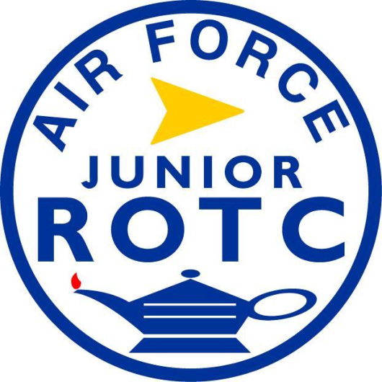
The AFJROTC Patch
The yellow arrow points to the future
The lamp represents knowledge
Colors of the AF are in the design— ultramarine blue, AF yellow, white, and red
Disc shape used for the JROTC organization
Photo Courtesy of US Air Force JROTC

Slide 31
Activity 4: Rank Insignia of the US Military
Visit the US DoD website and the section on the US Military Rank Insignia
Explore both the Officer and Enlisted Insignia Links, then answer the questions

Slide 32
Summary
Uniform wear and history
Uniform wear, restrictions, and standards
Uniforms used within special teams
Cadet appearance and grooming standards
Military pay grades and rank insignia

Slide 33
In your opinion, why is it important to have uniform standards and cadet appearance and grooming standards?
Note to Instructors:
Click the Show/Hide Response Display Button
(LE100-C1L2:LQ9)

Slide 34
What parts of this lesson were the hardest to understand? What parts were the easiest?
Note to Instructors:
Click the Show/Hide Response Display Button
(LE100-C1L2:LQ10)

Slide 35
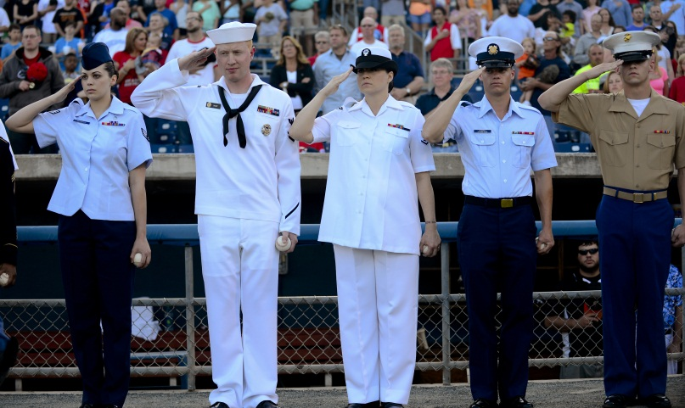
Next….
Done – the military uniform and appearance standards
Next – customs and courtesies for Junior ROTC
Photo Courtesy of Senior Airman Kayla Newman/Defense Video & Imagery Distribution System

