Slide 1
The American Flag and Other National Symbols

Slide 2
Lesson Overview
History of the American flag
Courtesies rendered to the flag of the United States
Courtesies rendered to the National Anthem, Pledge of Allegiance, and American’s Creed
The Great Seal of the United States and military services’ seals

Slide 3
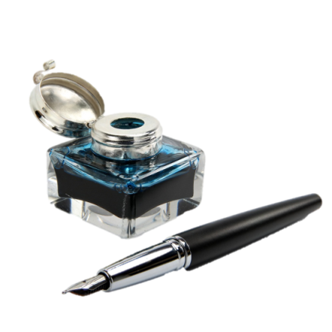
Quick Write
Make a list of everything you know about the design of the American flag. Then write a summary of what the American flag and other patriotic symbols mean to you.
Note to Instructors:
Click the Show/Hide Response Display Button
Photo Courtesy of Fotolia

Slide 4
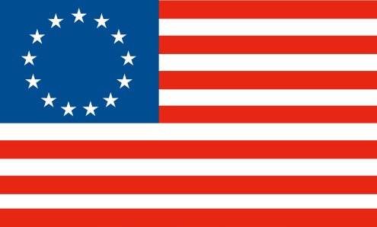
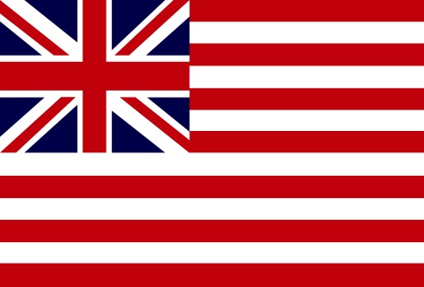
History of the American Flag
Called “Stars and Stripes” and “Old Glory”
Adopted on June 14, 1777
June 14th is now celebrated as Flag Day
Betsy Ross flag
Grand Union flag
Photo Courtesy of Fotolia

Slide 5
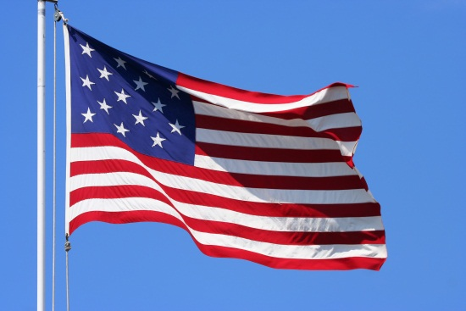
The Final Flag Design
Union of 20 white stars on a blue field with one star for each state
The 13 alternating stripes would remain unchanged
Symbolic colors
White – purity and innocence
Red – hardiness and valor
Blue – vigilance, perseverance, and justice
Photo Courtesy of Fotolia

Slide 6
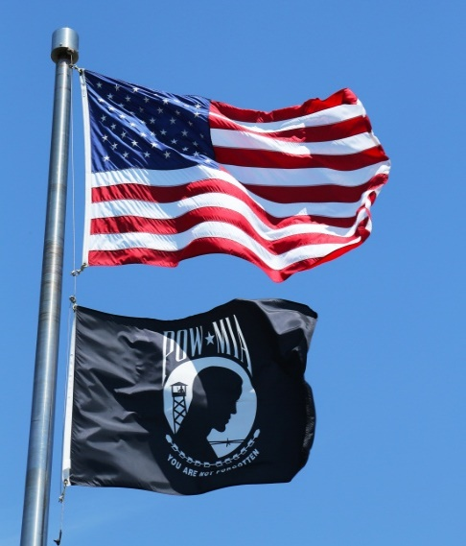
The Flag Today
13 horizontal stripes – seven red and six white
Union of white stars of five points on a blue field
The number of stars equals the number of states in the Union
Photo Courtesy of Fotolia

Slide 7
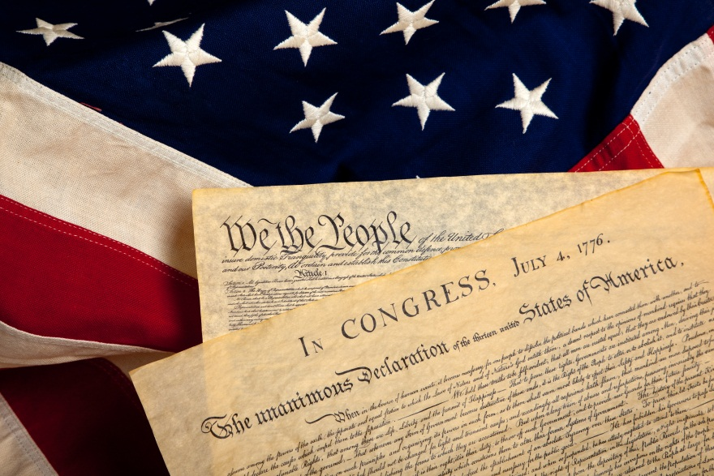
Flag Laws and Regulations
Title 4, Chapter 1
Title 18, Chapter 33
Title 36, Chapter 10
Photo Courtesy of Fotolia

Slide 8
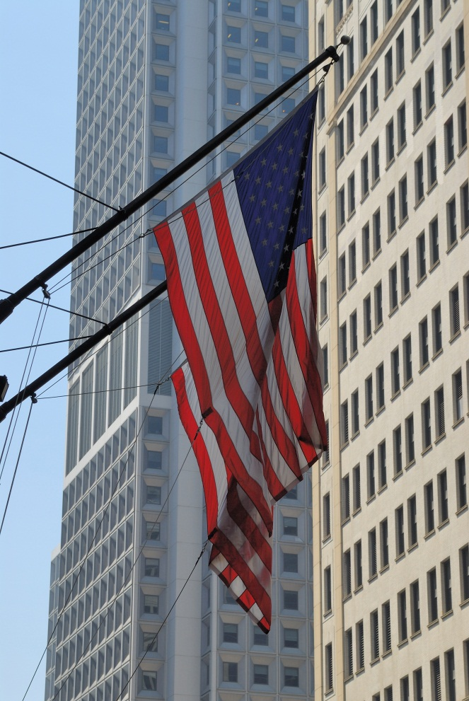
Displaying the Flag
Display from sunrise to sunset on building and stationary flagstaffs
Can display 24 hours a day if it is an all-weather flag and is properly illuminated at night
Hoist briskly and lower ceremoniously
Many ways to position and display the flag
Photo Courtesy of Fotolia

Slide 9
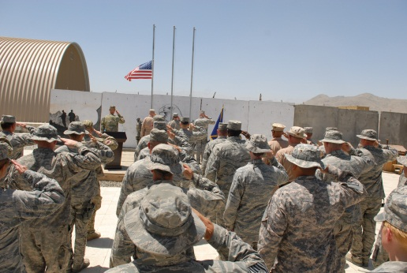
Half-Staff
The flag should fly at half-staff in the event of death
On Memorial Day, the flag is flown at half-staff until noon, and then raised to its peak
When putting the flag up at half-staff, you hoist it to its peak and then lower it to half staff
When bringing the flag down from half-staff, you hoist it to its peak and then
lower the flag
Photo Courtesy of Tech. Sgt. Brian Christiansen/Defense Video and Image Distribution System

Slide 10
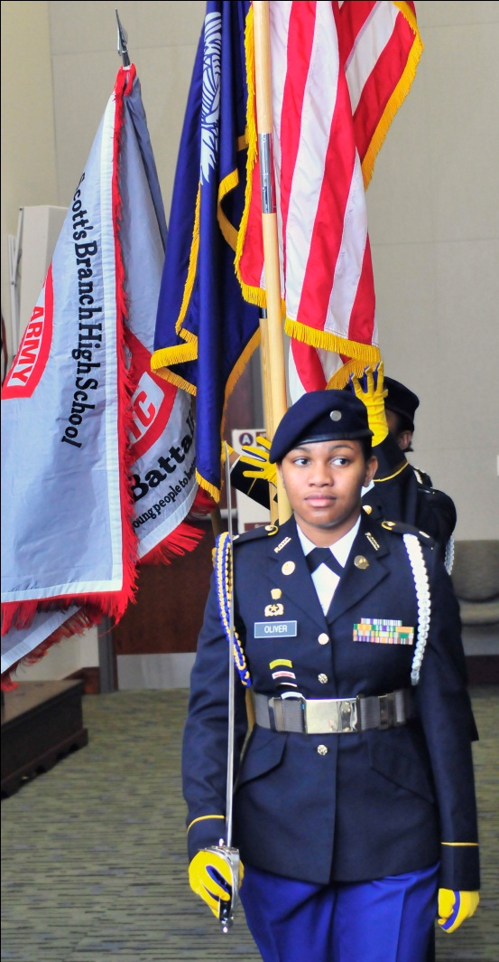
Respecting the American Flag
Always show respect to the American flag
Retire the flag when it is no longer a fitting emblem of display
Should be destroyed in a dignified way (burning)
Photo Courtesy of SSG Mylinda Durousseau/Defense Video & Imagery Distribution System

Slide 11
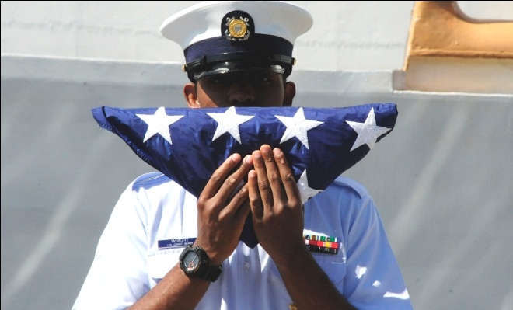
Flag Folding Ceremony
Done at retreat ceremony as a tribute to our nation’s honored dead
Source and date of flag folding procedure is unknown
When completely folded, the stars are uppermost
Photo Courtesy of Petty Officer 3rd Class Loumania Stewart/Defense Video & Imagery Distribution System

Slide 12
Activity Flag Folding
Review the information on the handout
In groups, practice folding the flag correctly

Slide 13
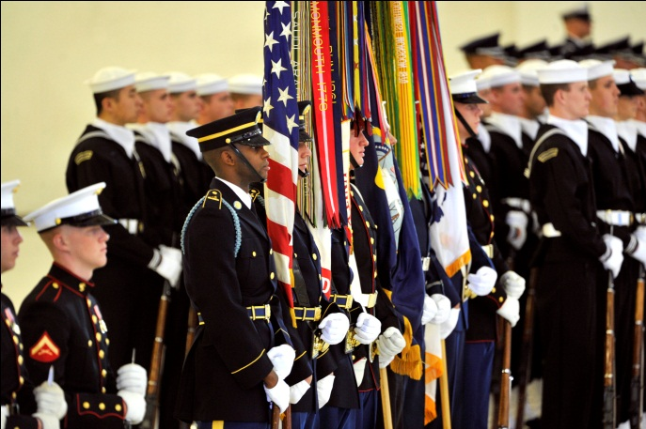
Military and Civilian Courtesies
In uniform and formation
In uniform, outdoors, but not in formation
In uniform, indoors, and the National Anthem or “To the Colors” is played
Indoors or outdoors in civilian clothes
Photo Courtesy of Glenn Fawcett/Defense Video & Imagery Distribution System

Slide 14
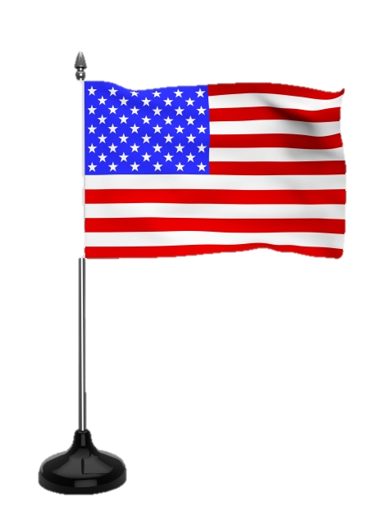
Military and Civilian Courtesies, cont.
To an escorted flag outdoors
On a stationary flagstaff
By vehicle passengers
At half-staff
Miniature flags
Conduct during hoisting, lowering, or passing of the American Flag
Photo Courtesy of Fotolia

Slide 15
Activity 5: Military and Civilian Courtesies to the Flag
Review the section in your textbook on military and civilian courtesies to the flag
Match each situation to its correct courtesy and answer the questions

Slide 16
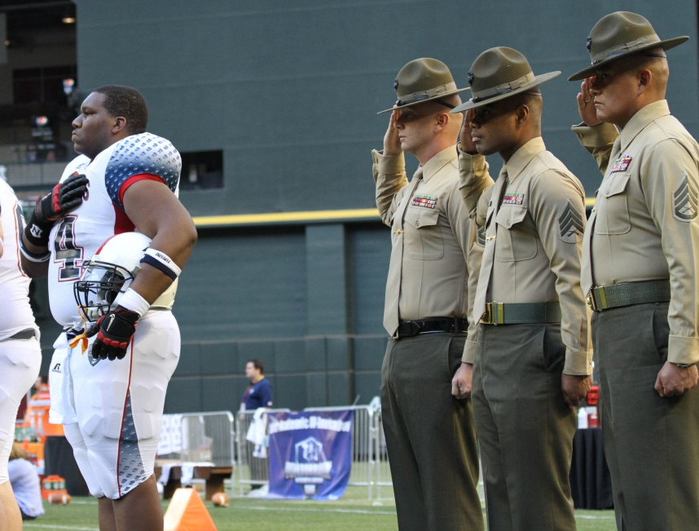
Other Courtesies
National Anthem
The Pledge of Allegiance to the flag
The American’s Creed
Photo Courtesy of Cpl Samuel A. Nasso/Defense Video & Imagery Distribution System

Slide 17
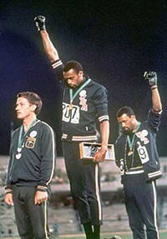
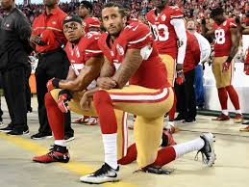
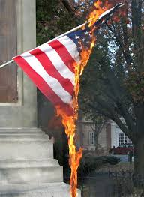
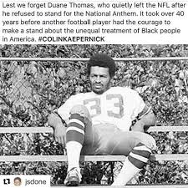
Protests using the American Flag

Slide 18
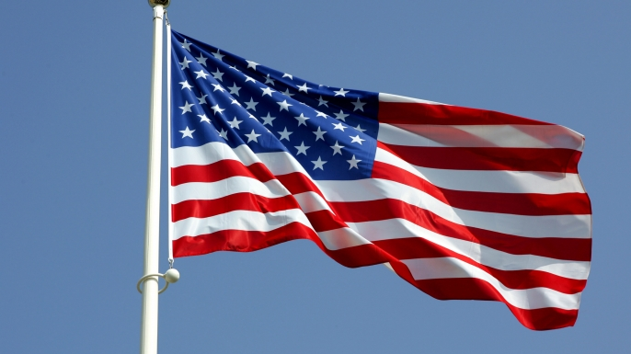
Is this correct?
On the next few slide, a picture of an flag will appear. Tell me if the flag is being flown or handled properly or not. Ready?

Slide 19
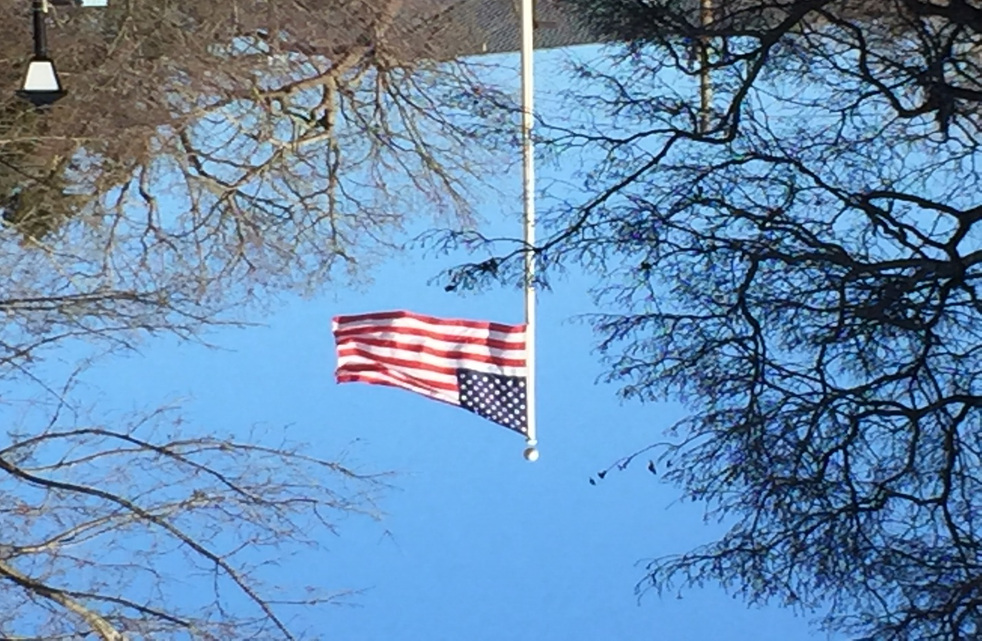
Is this correct?
Yes.

Slide 20
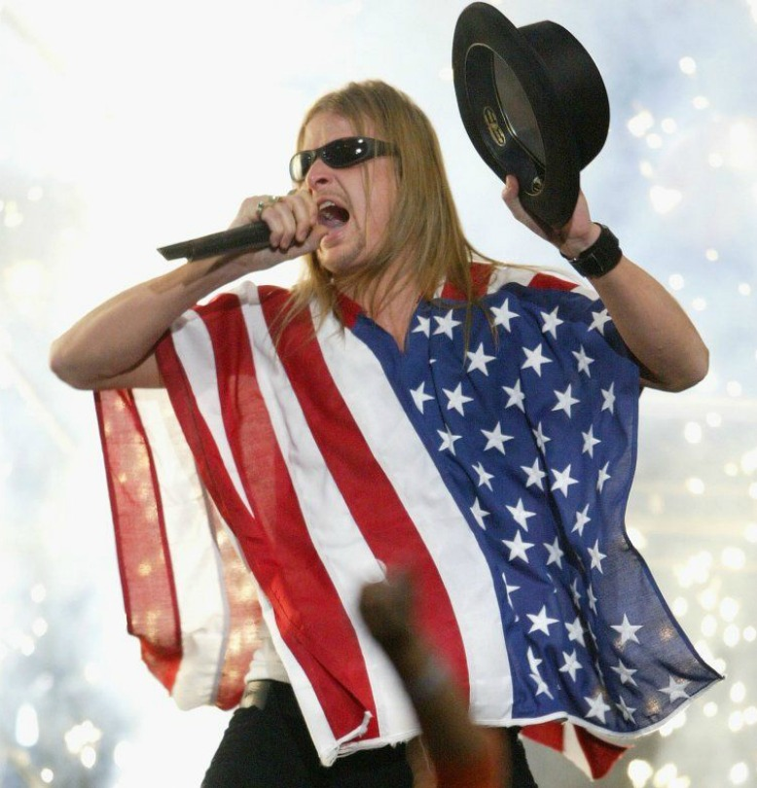
Is this correct?
No. 4 US Code 8d says the flag should never be used as wearing apparel, bedding, or drapery.

Slide 21
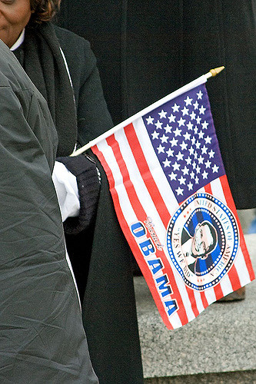
Is this correct?
No. 4 US Code 8i says the flag should never be used for advertising purposes in any manner whatsoever.

Slide 22
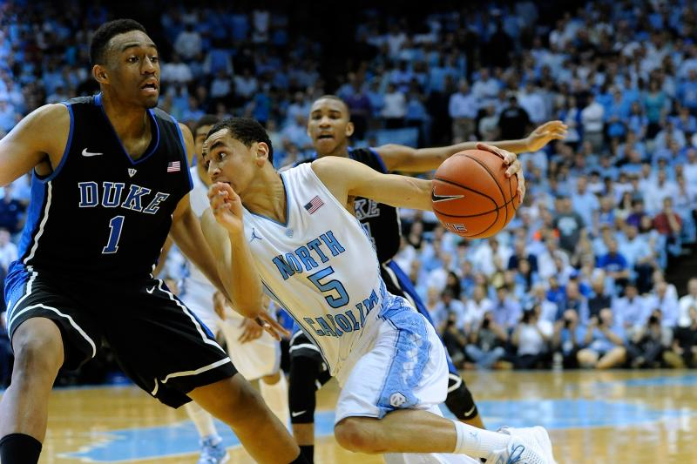
Is this correct?
Yes. 4 US Code 8j says no part of the flag should ever be used as a costume or athletic uniform. However, a flag patch may be affixed to the uniform of military personnel, fireman, policeman, and members of a patriotic organization.

Slide 23
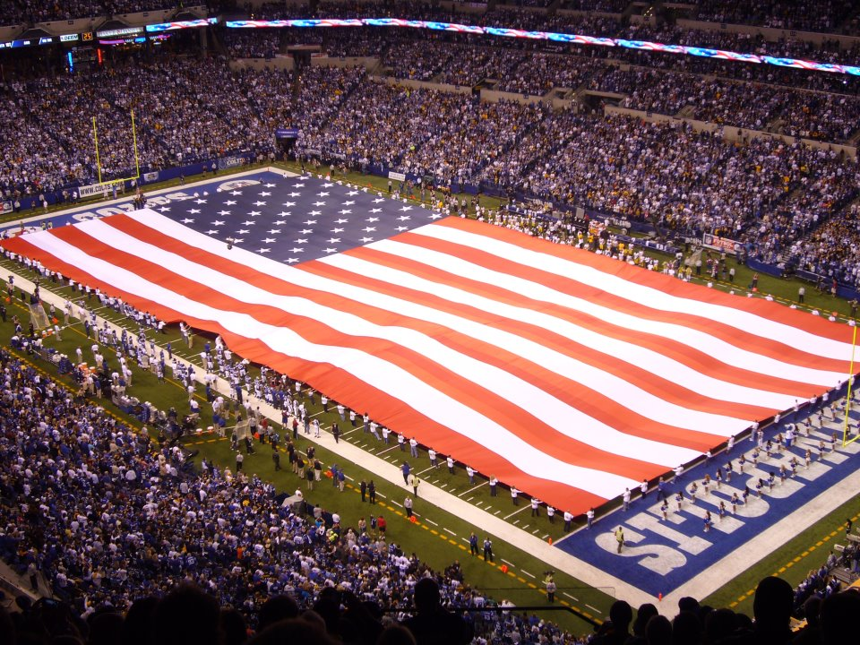
Is this correct?
No. 4 US Code 8a says the flag should never be carried flat or horizontally, but always aloft and free

Slide 24
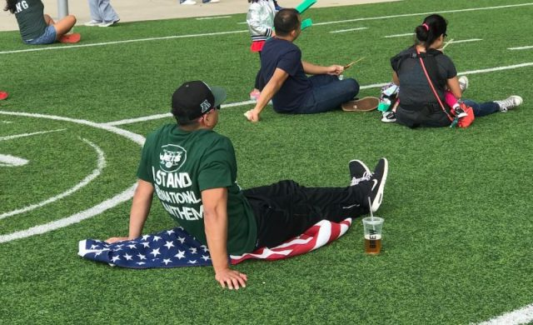
Is this correct?
No. 4 US Code 8b says the flag should never touch anything beneath it, such as the ground, the floor, water, or merchandise

Slide 25
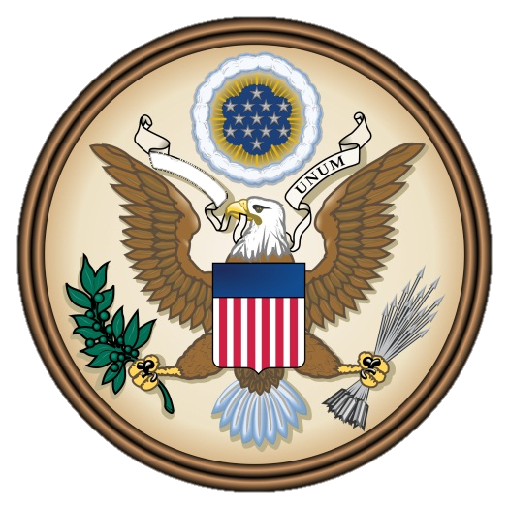
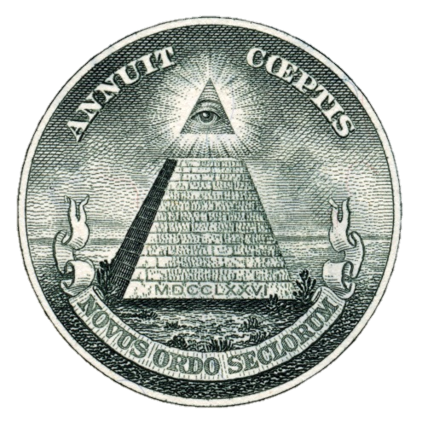
The Great Seal of the United States
Obverse of the Great Seal
Used to authenticate the president’s signature
Reverse of the Great Seal
On the one-dollar bill
Photo Courtesy of Fotolia

Slide 26
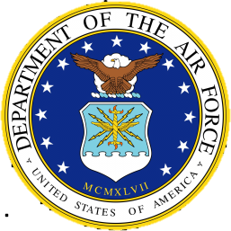
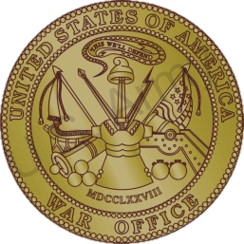
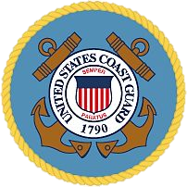
Military Services’ Seals
The Air Force Seal
The Army Seal
The Navy Seal
The Marine Corps Seal
The Coast Guard Seal
Photo Courtesy of the US Air Force/www.wpafb.af.mil
Photo Courtesy of Fotolia
Photo Courtesy of the US Navy/www.navy.mil
Photo Courtesy of the US Department of Defense/
www.defense.gov
Photo Courtesy of the US Department of Defense/
www.defense.gov

Slide 27
Summary
History of the American flag
Courtesies rendered to the flag of the United States
Courtesies rendered to the National Anthem, Pledge of Allegiance, and American’s Creed
The Great Seal of the United States and military services’ seals

Slide 28
What is your perspective now on the American Flag and other national symbols? Why?
Note to Instructors:
Click the Show/Hide Response Display Button
(LE100-C5L1:LQ9)

Slide 29
What is the most interesting thing you learned in this lesson? Why?
Note to Instructors:
Click the Show/Hide Response Display Button
(LE100-C5L1:LQ10)

Slide 30
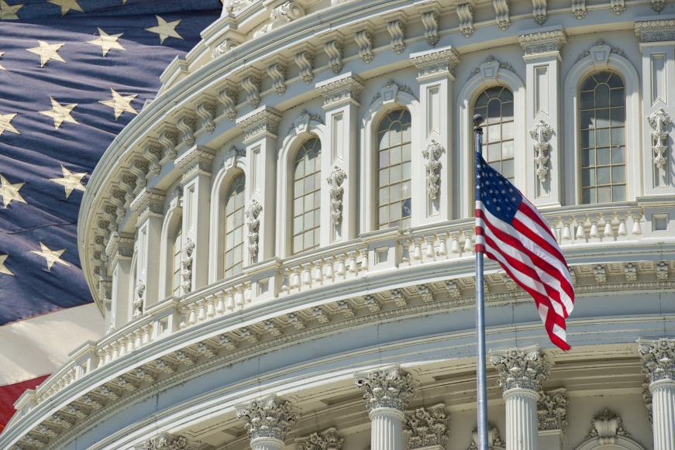
Next….
Done – the American flag and other national symbols
Next – Introduction into AFJROTC
Photo Courtesy of Fotolia

