Slide 1
GREEK OVERVIEW

Slide 2


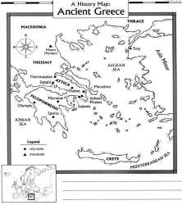



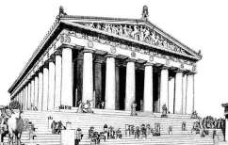


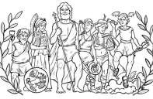




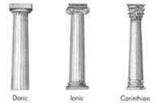
Geography
Mountainous terrain
Lack of arable land
City-States
Located on Balkan Peninsula
Aegean Sea at heart of civilization
Black & Med. Seas –
colonization
Governments
The Polis
Athens
  Education
  Government
  Economy
  Democracy
Sparta
  Militaristic
  Oligarchy
Individual cities = Individual Governments
Monarchy: Aristocracy: Tyranny
Oligarchy – Sparta
Direct Democracy - Athens
Dardanelles – access to the Black Sea
Ancient
Greece
 | Greek Golden Age
Hellenic Culture “Golden Age of Pericles” Drama: Aeschylus, Sophocles Poetry: Homer o Iliad, Odyssey History: Herodotus, Thucydides Sculpture: Phidias Philosophy: Socrates, Plato, Aristotle Medicine: Hippocrates
Religion
Greek Wars
“United we stand, divided we fall”
Persian Wars
Greek city-states united
Battles
  Marathon
  Salamis
Athens becomes dominant city-state
Peloponnesian Wars
Greek Civil War
Delian League vs. Peloponnesian League
Sparta victorious
Weakens Greek City-states
The Parthenon
Roots of Democracy
Polytheistic
Explained natural phenomena
Expressed human
frailties/emotions
Tyrant Reformers
  Draco – Law Code
  Solon – Outlaws debt slavery
Pericles – extends citizenship
Citizens
  Male-landowners
o Responsibility of civic participation
DIRECT DEMOCRACY

Slide 3

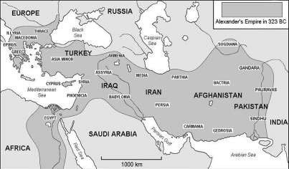








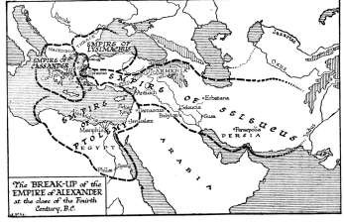

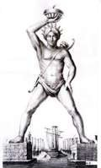

Philip II
Father to Alexander the Great
•
Recognizes Greece’s weakened
state after the Peloponnesian War – Captures most of the Greek city- states.
Raises Alexander to appreciate all
things Greek.
Assassinated at Daughter’s Wedding Celebration
Empire
Alexander completes takeover of Greece.
Captures Anatolia Peninsula from Persia
Proclaimed Pharaoh in Egypt.
Completes defeat of Persian Empire
Stretches Empire to Indus River Valley in the East
Hellenistic Culture
Alexander the Great & Hellenistic Culture
Blending of Greek and Persian, Egyptian,
Indian (Oriental) cultures.
Exposure to others’ ideas leads to an explosion of creativity & scientific achievement.
Science:
After Alexander
Aristarchus
Ptolemy
Eratosthenes
No clear successor after Alexander’s Death
Fighting among generals splits the Empire.
Mathematics:
Euclid
Archimedes
Pythagoras

Slide 4
Create a visual representation(pictures and words) that shows at least 5 ways in which Ancient Greece still impacts us today.
democracy
scientific
method
epics
trial by
jury
classification
theater
architecture
Olympics
Hippocratic
Oath
Socratic
Method
Greek
mythology
tragedy
comedy
marathon
philosophy

Slide 5
