Slide 1
Genetics

Slide 2
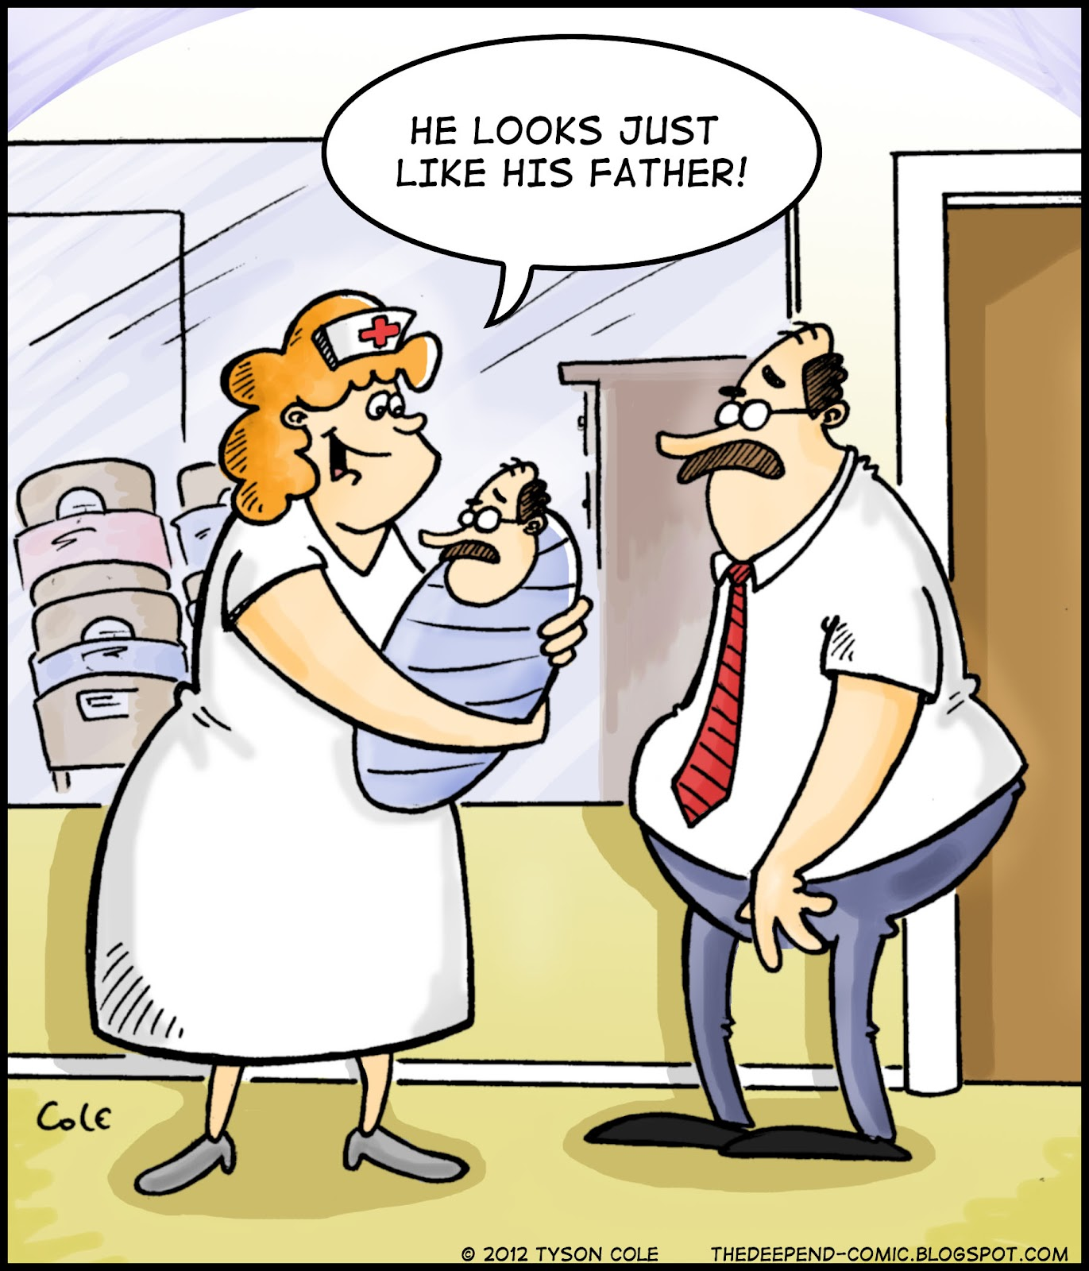

Slide 3
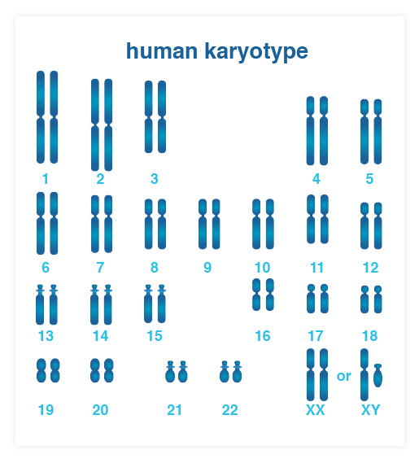
Chromosomes
If you look carefully at all 46 chromosomes, you would see that there are 2 of each type or 23 pairs
1 comes from mom and the other is from dad
That means there are actually two chromosomes with instructions for each kind of trait (such as freckles, nose shape, etc.)

Slide 4
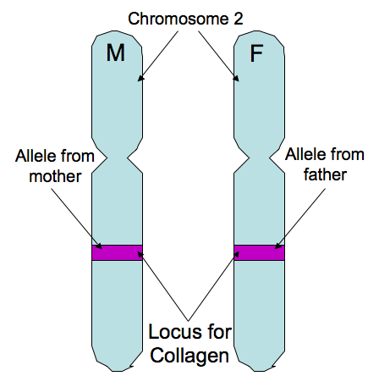
Genes are segments of DNA or the places on the chromosomes that code for specific traits.
Such as height, eye color, etc.

Slide 5
Reading the Chromosomes
Sometimes the two chromosomes in a pair don’t have the same instructions.
The instructions from mom may be different from the ones that you inherit from dad.

Slide 6
Gregor Mendel
https://www.youtube.com/watch?v=cWt1RFnWNzk

Slide 7
Gregor Mendel
(1822-1884) was an Austrian monk that taught high school science and tended the garden of the monastery.
While he was not a considered a well known scientist of his time, today he is considered to be the father of modern genetics.
Genetics is the branch of biology that studies heredity or the passing of traits from parent to offspring.

Slide 8
Gregor Mendel
It took approximately 8 years for Mendel to gather enough data to support his theories of heredity.
Using many generations (of over 25,000 pea plants) he was able to show how traits could be passed from parents to offspring, even traits that couldn’t be seen on the parent.
P₁– Parental Generation
F₁– 1st generation of offspring
F₂– 2nd generation of offspring

Slide 9
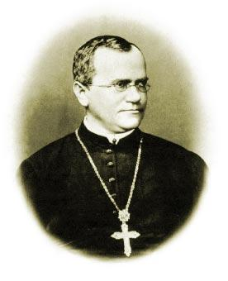
Gregor Mendel, the “Father of Genetics” - an Austrian monk who lived in the 1800s. Studied how traits were passed from generation to generation of pea plants in his garden.
Mendel noticed on a pea plant that a purple flower crossed with a white flower produced purple flowers – NOT light purple flowers.
pp
P Generation – Parent
F1 Generation – P offspring
F2 Generation – F1 offspring
PP
x
P
p
p
F₁
Purple = Dominant trait = P
White = Recessive trait = p
P
Pp
Pp
100%
PP = Purple
Pp = Purple
pp = White
P
Pp
Pp

Slide 10
Mendel’s Conclusions
Mendel drew two conclusions from his experiments:
Inheritance is determined by traits that are passed from one generation to the next.
Some forms of a trait are dominant and others are recessive.

Slide 11
Dominant vs. Recessive
In most cases, when both parents pass down contrasting alleles, one usually is expressed and the other one is hidden.
The DOMINANT allele is the trait that will show up even when paired with a different allele.
The RECESSIVE allele is a trait that can be hidden or masked when it is paired up with a dominant allele.

Slide 12
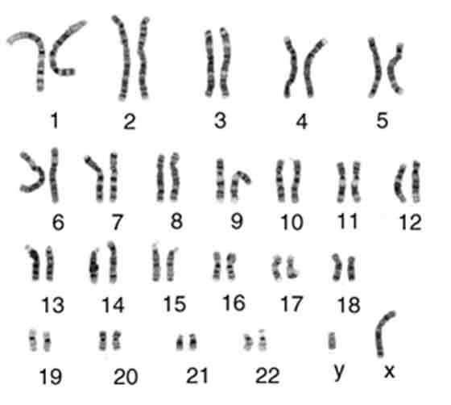
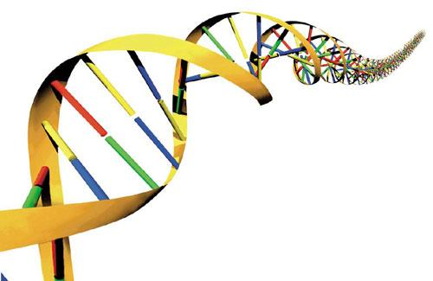
Important Terms to Know:
One possible gene
Heredity - the genetic make-up of an organism
Alleles - factors that determines traits
Gene – Section of DNA that codes for a trait
Chromosome – Tightly wrapped DNA – think a ball of string! Humans have 23 pairs of chromosomes. The 23rd pair codes for gender.
Dominant – An allele that “dominates” (hides) another allele
Recessive – An allele that can be “hidden” by another allele
Phenotype – description of an organism’s trait, e.g. blue eyes or thick hair
Genotype – description of an organism’s genetic makeup, e.g.BB, Bb, bb
Homozygous – Organism that has two identical alleles for a trait, e.g. AA or aa
Heterozygous – Organism that has two different alleles for a trait, e.g. Aa
Normal male karyotype

Slide 13
PRACTICE
TRAIT | DOMINANT ALLELE | RECESSIVE ALLELE
Seed shape | R = round | r = wrinkled
Seed color | Y = yellow | y = green
Seed coat color | G = gray | g = white
Flower position | A = axial | a = terminal
Plant height | T = tall | t = short
Identify the phenotype or genotype
Trait | Genotype (symbol) | Phenotype
seed shape | RR
seed shape | Rr
seed shape | rr
plant height |  | tall
plant height |  | short
flower position |  | terminal
flower position |  | axial
seed coat color | Gg
Round
Round
Wrinkled
TT or Tt
tt
aa
AA or Aa
Gray

Slide 14
SYMBOLS
TRAIT | DOMINANT ALLELE | RECESSIVE ALLELE
Seed shape | R = round | r = wrinkled
Seed color | Y = yellow | y = green
Seed coat color | G = gray | g = white
Flower position | A = axial | a = terminal
Plant height | T = tall | t = short
Hybrid:
has one Dominant & one Recessive
Write the symbol or identify if it is not possible.
pure tall stems
homozygous yellow seeds
pure short stems
pure green seeds
homozygous terminal flowers
hybrid round seeds
pure round seeds
homozygous axial flowers
homozygous wrinkled seeds
hybrid tall stems
Heterozygous wrinkled seeds
hybrid axial flowers
heterozygous short stems
heterozygous yellow seeds
heterozygous seed coat color
TT
rr
YY
Tt
tt
yy
Aa
aa
Rr
Yy
RR
Gg
AA

Slide 15
Questions:
Why are some of these not possible?
What is/are the genotype(s) for short height?
What is/are the genotype(s) for tall height?
Can I always identify the genotype if I know the phenotype? Explain your answer.
You cannot have a hybrid for a recessive trait.
tt only
TT or Tt
Only for recessive traits because dominant traits can have two different genotypes.

Slide 16
How likely is that trait to be passed on to the offspring
Probability is the likelihood that an event will occur.
So if we know the genetic makeup of the mom and dad, we should be able to figure out if it is probable (how likely) and/or possible (could it) for them to pass down certain traits.
We will use a box called a Punnett Square to determine the probability that specific traits will be passed down from parent to offspring.

Slide 17
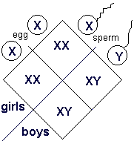
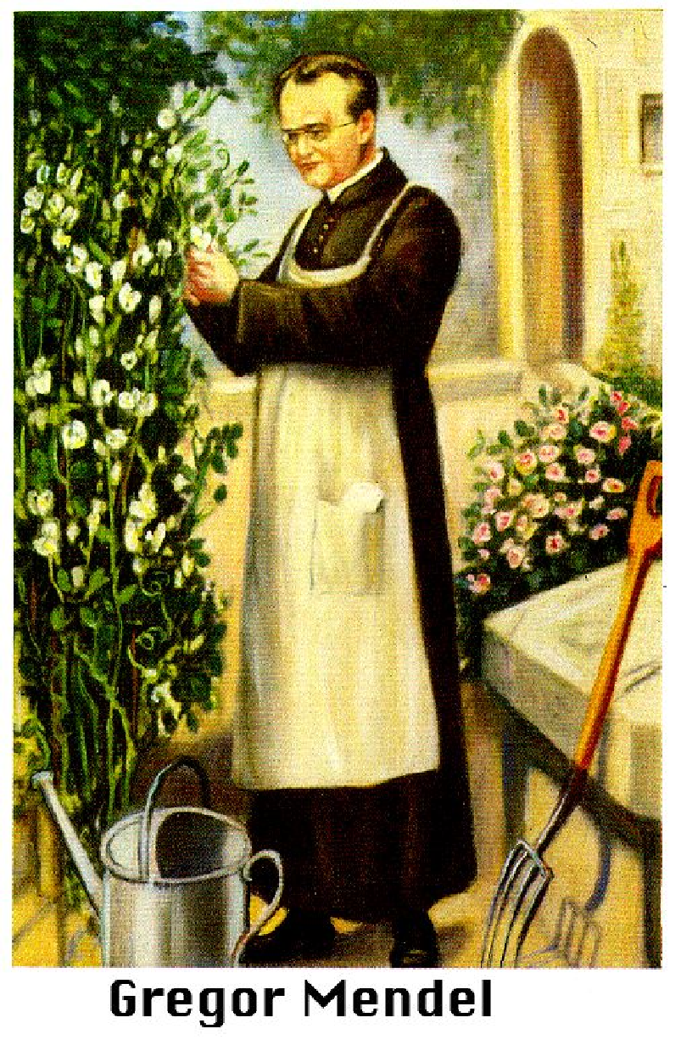
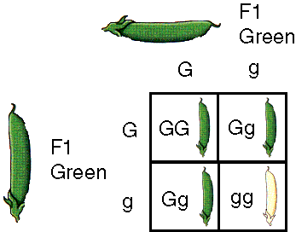
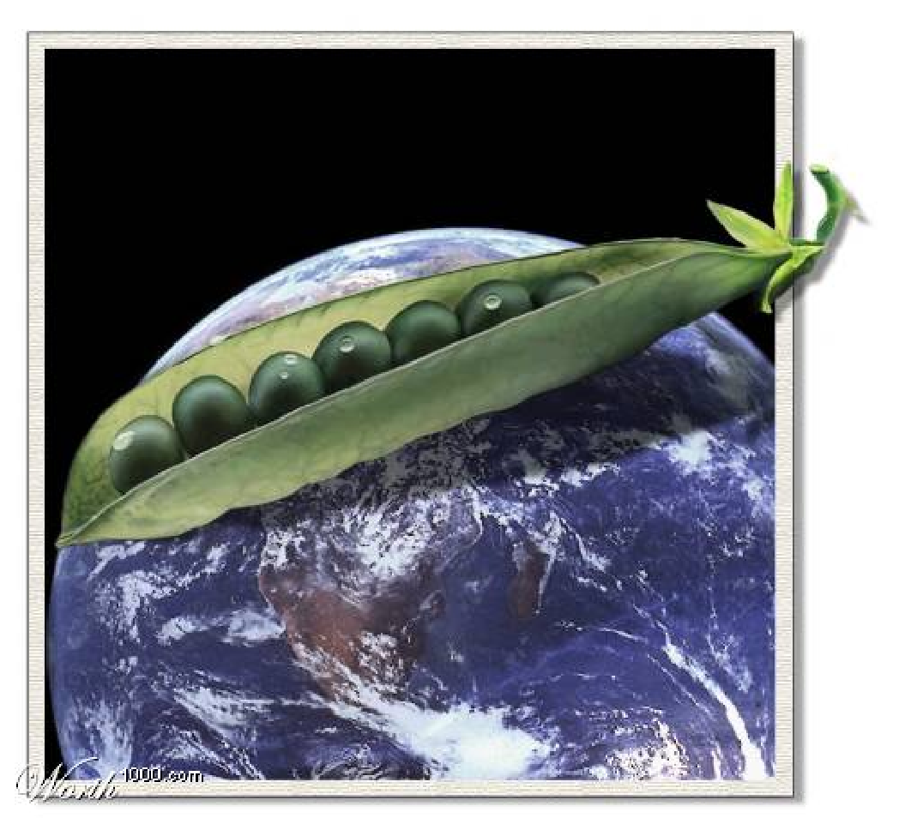
Punnett Square
A method of predicting the probability of offspring inheriting a specific trait.
XX chromosomes = Female
XY chromosomes = Male
GG or Gg = Green
gg = White
G = dominant
g = recessive

Slide 18
Punnett Squares
Monohybrid Cross - a cross that involves one pair of contrasting traits.
Dad’s Genotype:
 | E | e
E
e
EE
Ee
Mom’s Genotype:
Ee
ee

Slide 19
Punnett Squares
Dihybrid Cross - a cross that involves two pairs of contrasting traits.
Dad’s Genotype:
Mom’s Genotype:

Slide 20
Practice
In pea plants, tall is dominant over short. (T = tall, t = short)
What letters will represent a heterozygous tall plant?
What letters will represent a homozygous short plant?
What type of offspring would result if we crossed a heterozygous tall plant with a short plant? Complete the Punnett square below to find out.
Parents (P) = Tt X tt
What are the possible genotypes of the offspring (include fractions)?
What is the genotypic ratio?
What are the possible phenotypes of the offspring (include fractions)?
What is the phenotypic ratio?
Tt
tt
0/4 TT; 2/4 Tt; 2/4 tt
0:2:2
2:2 → 1:1
2/4 Tall; 2/4 Short

Slide 21
Practice #1
Red flowers are dominant to white flowers.
(R = red, r = white)
What letters will represent a homozygous red flowered plant?
What letters will represent a homozygous white flowered plant?
Cross a homozygous red plant with a white plant:
Parents (P) = RR X rr
List the possible genotypes?
What is the genotypic ratio?
What are the resulting phenotypes?
What is the phenotypic ratio?

Slide 22
Practice #2
In pea plants, round seeds are dominant to wrinkled seeds. (R=round, r=wrinkled)
Write the genotype of a pea plant that is heterozygous for round seeds?
Cross a plant that is heterozygous for round seeds with another heterozygous plant.
What are the genotypes of both parents?
Parent (P): ____________ X ___________
List the possible genotypes?
What is the genotypic ratio?
What are the resulting phenotypes?
What is the phenotypic ratio?

Slide 23
Practice #3
In pea plants, green pea pods are dominant to yellow pea pods. (G=green, g=yellow)
Cross a heterozygous plant with a yellow plant.
What are the genotypes of both parents?
Parent (P): ___________ X ___________
List the possible genotypes?
What is the genotypic ratio?
What are the resulting phenotypes?
What is the phenotypic ratio?

Slide 24
Test Cross
Cross-breeding the dominant phenotype — unknown genotype — with a homozygous recessive (pp) to determine the identity of the unknown allele
Homozygous dominant = PP Homozygous recessive = pp Heterozygous = Pp
is it PP or Pp?
x
pp
PP
x
pp
Pp
x
pp
p
p
p
p
P
Pp
Pp
P
Pp
Pp
50%:50% 1:1
100%
P
Pp
Pp
p
pp
pp

Slide 25
Test Crosses
A test cross is used to determine the unknown genotype of a specific organism.
In most cases, if you have an organism that is showing the dominant trait, you can not tell if they are homozygous or heterozygous by looking at them.
It is possible to determine their genotype by crossing (breeding) the unknown with an individual that is homozygous recessive. By looking at their offspring you can usually determine the genotype of the unknown parent.

Slide 26
Test Crosses - Example
In tulips, red is dominant over white. When you see a red flower you can’t be sure if the flower is homozygous red (RR) or heterozygous red (Rr). To determine this you can cross it with a plant that produces white (rr) flowers (homozygous recessive) & observe the color of the offspring.
Possibility #1: Possibility #2:
Red (R?) x white (rr) Red (R?) x white (rr)
If most offspring have red flowers IF all offspring have red flowers and several have white flower… there are no white flowers…
Then the unknown MUST BE The unknown parent is Rr (its not possible for it to be RR) MOST LIKELY RR

Slide 27
Extra Practice
Sample test cross: In dogs, there is a hereditary deafness caused by a recessive gene, “d.” A kennel owner has a male dog that she wants to use for breeding purposes if possible.
The dog can hear, so the owner knows his genotype is either DD or Dd.
If the dog’s genotype is Dd, the owner does not wish to spend the money to use him for breeding.
The only way to be certain is to breed the dog with a deaf female (dd) and observe the offspring that they produce.

Slide 28
Extra Practice Continued
If the male dog is DD what is the probability that he would pass on the allele for deafness?
If the male dog is Dd what is the probability that he would pass on the allele for deafness?
Since the female is dd what is the probability that she would pass on the allele for deafness?
Since we do not know what the genotype of the male is, we will complete both punnett squares below to show the possible outcome of the test cross:
Assume the male is DD Assume the male is Dd

Slide 29
Extra Practice Continued
If he is DD, what percentage of the puppies would be expected to have normal hearing? _______ deaf? ___________
If he is Dd, what percentage of the puppies would be expected to have normal hearing? _________ deaf? ___________
If any of the puppies are deaf, the male’s genotype MUST BE _______; but assuming a litter of at least about 4 to 5 puppies or more, if they can all hear, his genotype is MOST LIKELY __________.

Slide 30
Comparing Multiple Traits
Sometimes instead of just comparing a single trait (like we have been with the four box punnett square) – we may want to see the results of two or more different traits, at the same time.
Example: AAbbCC x aaBBcc …
Can you tell what genotype their offspring would have?

Slide 31
To help you understand this we will use the following example:
Your two prize show dogs accidentally mate and now the female is expecting a litter. Both are purebreds, but each has two distinct differences from one another.
The male has black fur and a black nose. The female has white fur with a pink nose. Since you know their pedigree, you are certain that at they are homozygous for both traits.
Dad’s genotype =
Mom’s genotype =
Since each parent will only pass down one allele for each trait then:
Their offspring’s genotype must be:
Their offspring’s phenotype must be:
BBNN
bbnn
BbNn
Black fur &
Black noses

Slide 32
Crossing
Several years later, two of their offspring mate and are expecting a litter of puppies. We want to know ‘what percentage of their puppies are expected to have black fur & a pink nose?’
There are two ways that this question can be solved.
Method # 1– Set up 2 four-box punnett squares to answer this question; one for each trait.
According to the problem, two of their offspring, which are heterozygous for fur color and heterozygous for nose color, produce a litter of puppies.

Slide 33
What percentage of their puppies are expected to have black fur & a pink nose?
In box #1 we will cross the trait for fur color.
Parents: Bb x Bb
In box #2 we will cross the trait for nose color.
Parents: Nn x Nn
 | B | b
B
b
 | N | n
N
n
BB
Bb
NN
Nn
Bb
bb
Nn
nn

Slide 34
 | B | b
B
b
 | N | n
N
n
Now, circle the phenotypes black fur & pink nose.
Write the fractions from each one below:
BB
Bb
NN
Nn
¾ puppies are expected to have black fur
¼ puppies are expected to have a pink nose
Bb
bb
Nn
nn
Genotype Ratios: Genotype Ratios:
Phenotype Ratios: Phenotype Ratios:
1/4 = BB
2/4 = Bb
1/4 = bb
1/4 = NN
2/4 = Nn
1/4 = nn
¾ = black fur
¼ = white fur
¾ = black nose
¼ = pink nose

Slide 35
Calculating the percentage…
To figure out how many are expected to have black fur with a pink nose, use the above fractions &:
multiply the top numbers with one another;
then multiply the bottom numbers together.
3 X 1 = 3 with black fur & a pink nose
4 4 16

Slide 36
Crossing
Method #2 - Set up a 16 box punnett square, called a dihybrid cross. This shows two traits being crossed at the same time. The 16 box punnett square is already set up below to show the results of crossing these two hybrid puppies.
What are the genotypes of the parents?
BbNn x BbNn

Slide 37
Dihybrid Cross
 | BN | Bn | bN | bn
BN | BBNN | BBNn | BbNN | BbNn
Bn | BBNn | BBnn | BbNn | Bbnn
bN | BbNN | BbNn | bbNN | bbNn
bn |  | Bbnn |  | bbnn
BbNn
bbNn
Fill in the two missing boxes
(use the other boxes to figure out the pattern of your letters)
Circle the boxes that have the genotypes for black fur AND a pink nose.
What fraction of the boxes did you circle? ____ out of ____ boxes = _____
3
16
3/16
The result is the fraction of puppies that are expected to have both traits. Your answer should be the same as the one you found on the previous page.

Slide 38
Practice
The following problem shows a cross between a white, tall plant and a red, dwarf plant.
Red flower color (R) is dominant over white flower color (r) and tall (T) is dominant over dwarf (t).
Since you haven’t been told if the parents are homozygous or heterozygous for their traits, you can use the punnett square to figure out the genotypes of the parents?
__________ x ___________

Slide 39
Finish the Square
 | rT | rt | rT | rt
Rt |  | Rrtt | RrTt | Rrtt
Rt | RrTt | Rrtt | RrTt | Rrtt
rt | rrTt | rrtt | rrTt
rt | rrTt | rrtt | rrTt
Fill in the genotype for any boxes that are blank.
What fraction of their offspring to we expect to be red AND tall?
What fraction of their offspring do we expect to be white AND dwarf?
What fraction of their offspring do we expect to be red?

