Slide 1
RNA

Slide 2
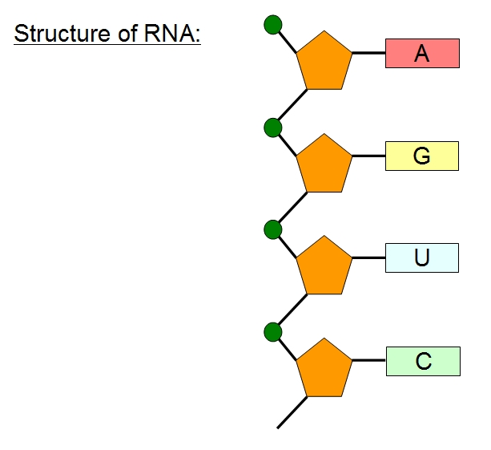
RNA
RNA – ribonucleic acid
RNA is a messenger between the DNA and the ribosome.
Its job is to help in the process of making proteins!

Slide 3
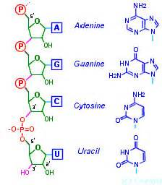
RNA structure
RNA like DNA is made up of a long chain of nucleotides.
Each nucleotide is made up of 3 parts:
1. Ribose – a 5 carbon sugar
2. A phosphate group
3. A nitrogenous base

Slide 4
DNA VS RNA
There are 3 major differences between RNA & DNA:
Difference | RNA | DNA
SUGAR: | Ribose | Deoxyribose
STANDS: | SINGLE strand of nucleotides | TWO stands of nucleotides (double helix)
NITROGENOUS BASES: | Uracil | Thymine
3 bases are the same for both: G, A, C

Slide 5
Transcription – the process in which a molecule of DNA is copied into a complementary strand of RNA.
The result is a single stand of RNA
Therefore, it is not an exact copy of DNA
Very much like replication, but instead of making DNA, RNA is made.

Slide 6
. Messenger RNA (mRNA)
The carrier of the genetic information from the DNA in the nucleus to the ribosomes in the cytoplasm.
DNA cannot leave the nucleus; therefore, something has to deliver the genetic code to the ribosomes (like the mailman)

Slide 7
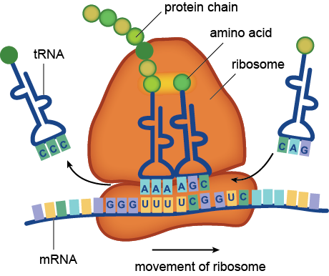
Ribosomal RNA (rRNA)
Combines with proteins to make up the ribosome.
Made up of two subunits that snap together around the mRNA.

Slide 8
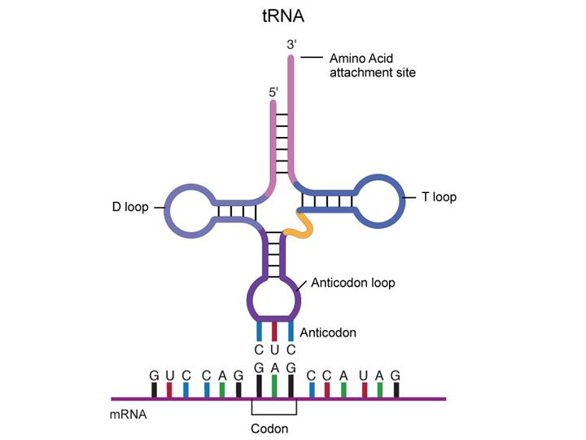
Transfer RNA (tRNA)
Is the complement to the mRNA.
Its job is to translate a recipe for a protein from one language (nucleic acid or RNA) into another (amino acids).

