Slide 1
Protein Synthesis
How nucleic acids (DNA & RNA) work to make proteins

Slide 2
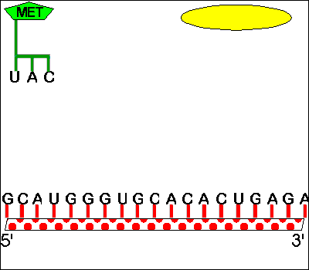
What is Protein synthesis
Protein Synthesis is the joining of amino acids in a specific sequence in order to form a protein or polypeptide.
Protein Synthesis requires transcription and translation in order for proteins to be made.

Slide 4
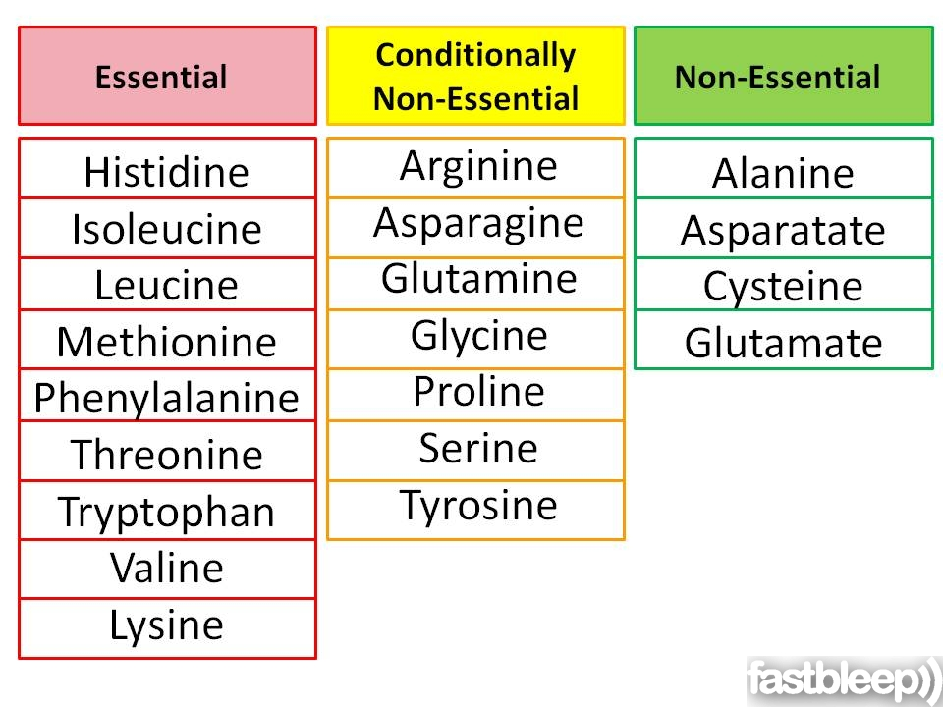
Amino Acids
There are only 20 different amino acids normally found in most humans.
Proteins can be hundreds to thousands of amino acids long.
The order of the amino acids also affects which protein is made.

Slide 5
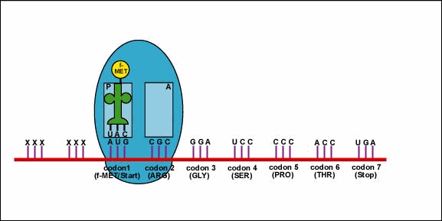
Protein Synthesis
If there is a mistake in the DNA, called a mutation, then it is likely that there will be a problem with the protein that it wants to produce.
The DNA (through the mRNA) will tell the ribosome exactly what protein must be made.

Slide 6
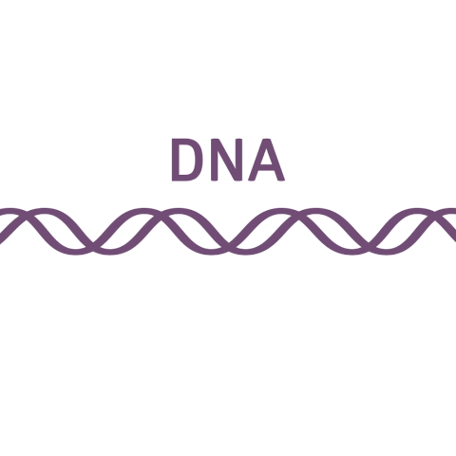
Transcription
The first step in protein synthesis is transcription.
The first step occurs in the nucleus.
A complementary strand of RNA (mRNA) is formed from a strand of DNA.

Slide 7
Translation
The second step of protein synthesis is translation.
The second step happens in the cytoplasm at the ribosome.
At the ribosome, the mRNA is “read” in groups of three bases which is also known as a codon.
Since the ribosome doesn’t understand the message sent from the DNA, it requires a translator (tRNA).

Slide 8
Translation
The tRNA translates the message of the mRNA into a chain of amino acids.
Each tRNA caries one amino acid to the ribosome. To be able to drop off the amino acid, part of the tRNA must be able to match up with the mRNA that is being read.
The three tRNA letters that matches up with the mRNA codon is called an anticodon.

Slide 9
Translation
The mRNA continues to be translated until the ribosome reaches a stop codon.
Making mRNA form the DNA is called
When the anticodon pairs up with the codon it is called
DNA | mRNA (codon) | tRNA (anticodon) | Amino Acid
TAC | AUG | UAC | Methionine
AAG | UUC | AAG | Phenylalanine
Transcription
Translation

Slide 10
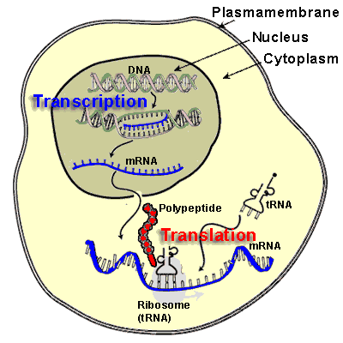
Protein Synthesis

Slide 11
Complete the Diagram:
Transcription |  | Translation
Label | Name | Label | Name
A |  | C
B |  | D
 |  | E
 |  | F
 |  | G
 |  | H
Nucleus
Ribosome
mRNA
tRNA
Anticodon
Codon
mRNA
H
Amino Acid

