Slide 1
DNA
What is it?

Slide 2
What is DNA?
DNA stands for deoxyribonucleic acid
DNA is responsible for storing & transferring genetic information from one generation to the next.

Slide 3
The DNA Structure.
DNA is made from many nucleotides joined together
The shape of each DNA looks like a ladder that has been twisted
This shape is called a double helix
The shape was discovered by two scientists:
Crick & Watson

Slide 4
Each nucleotide is made up of 3 parts
deoxyribose – a 5 carbon sugar
A phosphate group
A nitrogenous base (contains nitrogen)

Slide 5
Nitrogenous Bases.
There are 4 nitrogenous bases:
(G) Guanine
(A) Adenine
(C) Cytosine
(T) Thymine

Slide 6
Base pairing
Base pairing is t two nitrogenous bases that produces a force that holds the two strands of DNA together.

Slide 7
Base Pairs
The base pairing rule states that:
ADENINE will always pair with THYMINE
CYTOSINE will always pair with GUANINE

Slide 8
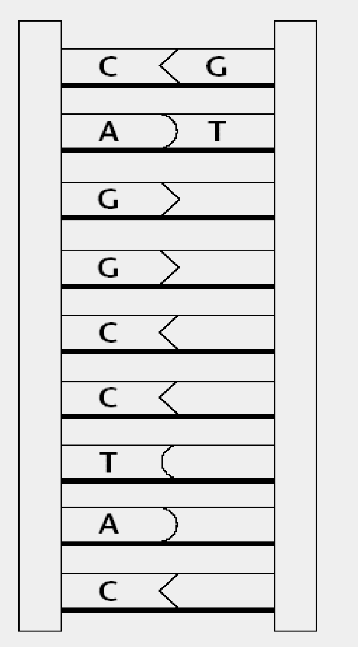
Bond Types
Hydrogen Bonds
The base pairs in the double helix are held together by weak hydrogen bonds.
The backbone of DNA is made up of alternating (D) deoxyribose and (P) phosphate molecules which are held together by strong covalent bonds.
Covalent Bonds

Slide 9
Is there a connection between the number of G’s and C’s?
Is there a connection between the number of A’s and T’s?
C
C
G
G
A
T
G

Slide 10
When the DNA molecule is split in half, each side becomes a template for a new DNA molecule.
By attaching the complementary base to each nucleotide, two new strands of DNA may be created.

Slide 11
Before a cell divides to become two cells, the DNA must replicate (copy) itself so that each cell will have a copy of the same genetic code. This copying process is called replication.

Slide 12
An enzyme (helicase) comes in and breaks the hydrogen bonds between the base pairs which causes the strand of DNA to split or “unzips” (what is left looks like a ladder cut in two).

Slide 13
A second enzyme called DNA polymerase matches up the appropriate complementary bases

Slide 14
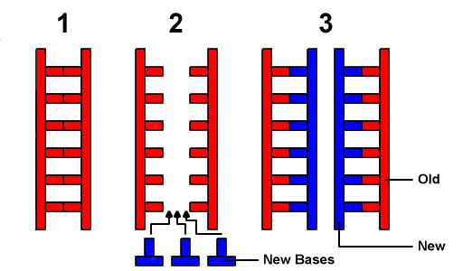
Then alternating sugar & phosphate molecules are then attached (the sides of the ladder).
What you are left with is two identical strands of DNA – the cell can now divide.

Slide 15
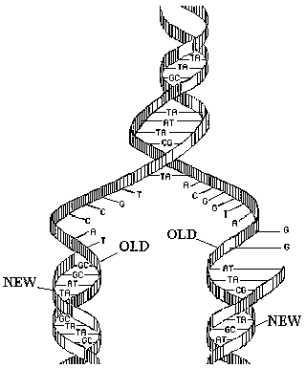
Color the backbone of the original strand blue and the newly formed strand red.

