Slide 1
Meiosis Sex Cell Division

Slide 2
New term
Homologous chromosomes: pair of chromosomes with the genes for the same traits (1 from mom and 1 from dad)
not identical DNA

Slide 3
Meiosis
Goal: To produce sex cells (gametes).
Stages:
Interphase, Prophase I, Metaphase I, Anaphase I, Telophase I, Interkinesis, Prophase II, Metaphase II, Anaphase II, Telophase II, Cytokinesis

Slide 5
Sexual Reproduction: One cell divides into 4 non-identical gametes. Two gametes (sperm and egg) come together to form a zygote (fertilized cell).

Slide 6
Diploid vs. Haploid
(2n)
Two sets of chromosomes
Somatic cells
Zygote
(n)
One set of chromosomes
Gametes

Slide 7
Asexual Reproduction vs. Sexual Reproduction
Mitosis
Meiosis

Slide 8
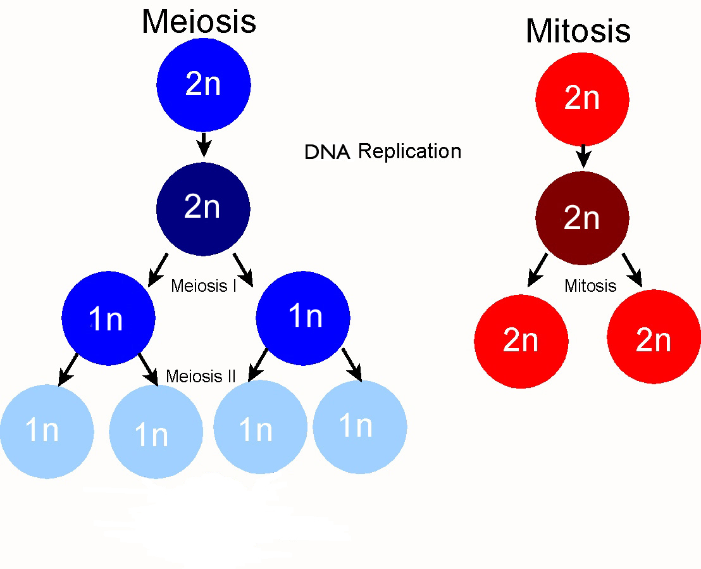
Daughter DNA is exact replica of parent
Each gamete has a different assortment of alleles.

Slide 9
1 parent, 2 daughter cells
1 parent, 4 daughter

Slide 10
Diploid
Haploid

Slide 11
2 types: sperm & egg
Creates zygote after fertilization with a mix of both parents’ DNA

Slide 12
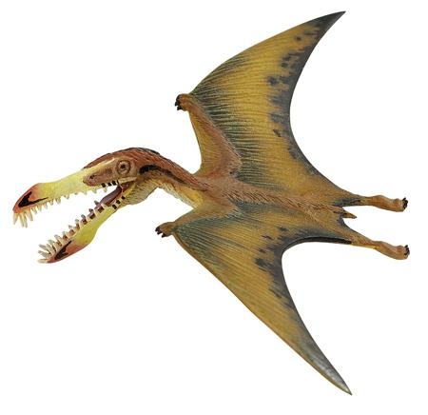
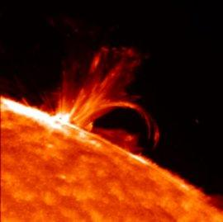
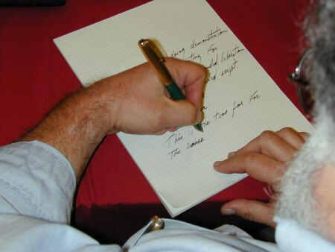
Why is Genetic Variation Important?
This classroom represents the entire human population.
A giant bird predator only preys on humans taller than 6 feet.
A solar flare causes blindness in all brown-eyed humans.
The CEO of Microsoft is left-handed and starts designing programs that work better for humans who are left-handed.

Slide 13
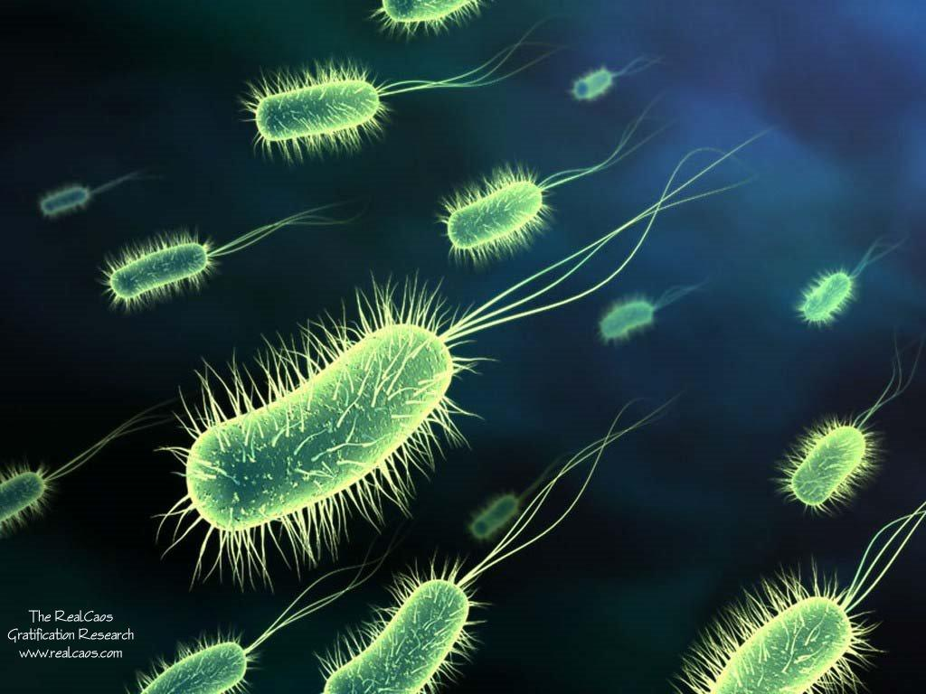
Asexual vs. Sexual Reproduction & Variation
Bacteria only reproduce by mitosis.
Do they have high or low genetic variation?

Slide 14
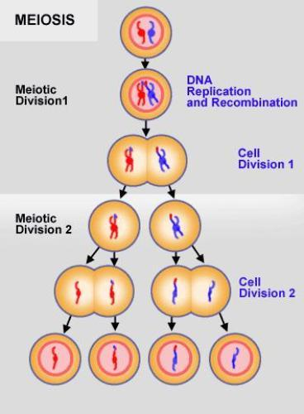
Law of Segregation
Law of Segregation: Every individual has 2 alleles of each gene. Each gamete receives one of these alleles.
Segregated means “separated”

Slide 15
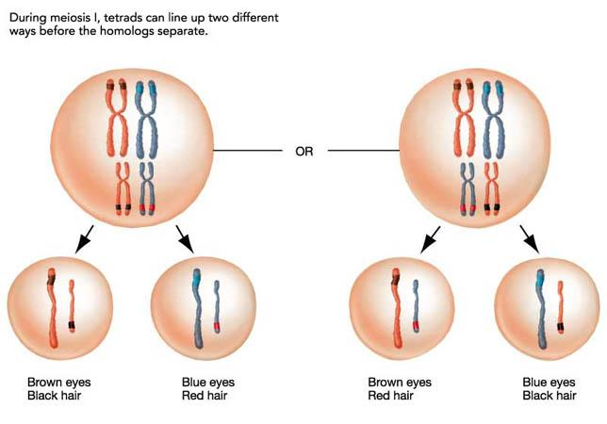
Law of Independent Assortment
Law of Independent Assortment: Genes for different traits are inherited independently of each other. (ex. eye color & hair color)

Slide 16
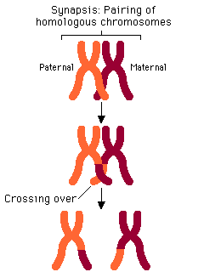
Crossing Over
Crossing Over:
Homologous chromosomes pair up during Metaphase I.
Genetic material is exchanged between non-sister chromatids!

Slide 17
Sources of Variation
Meiosis provides genetic variation by:
Gene Mutations - during DNA replication
Random Arrangement of Chromosomes - line up randomly during Metaphase I
Crossing over – between homologous chromosomes in Metaphase I
Nondisjunction - homologous chromosomes do not separate during Anaphase I
Fertilization - random pairing of gametes (egg and sperm)
Notes:
Removed: haploid daughter cells

Slide 18
Mitosis vs. Meiosis
Mitosis
Meiosis
Asexual Reproduction
Starts with a diploid cell
DNA Replication
1 division:
Sister chromatids separate.
2 identical diploid daughter cells
Sexual Reproduction
Starts with a diploid cell
DNA Replication
2 divisions:
Homologous chromosomes separate.
Sister chromatids separate.
4 different haploid daughter cells (gametes – egg or sperm)

