Slide 1
Cell Cycle
Cell Replication

Slide 2
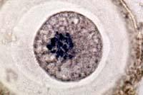
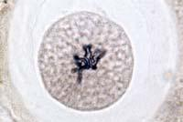
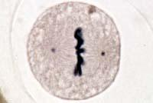
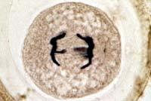
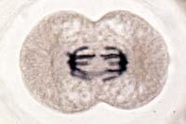
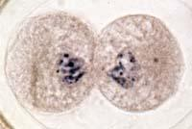
Animal Mitosis
1) Interphase | 2) Prophase
3) Metaphase | 4) Anaphase
5) Telophase | 6) Cytokinesis

Slide 3
Cell Cycle
Cell Cycle
The growth & division of a cell
Interphase
Growth & DNA replication
Mitosis
Division of the nucleus (4 Stages)
Cytokinesis
Division of the cytoplasm

Slide 4
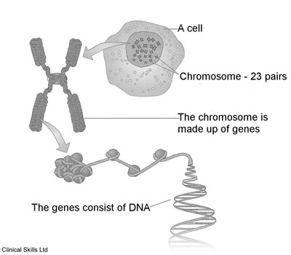
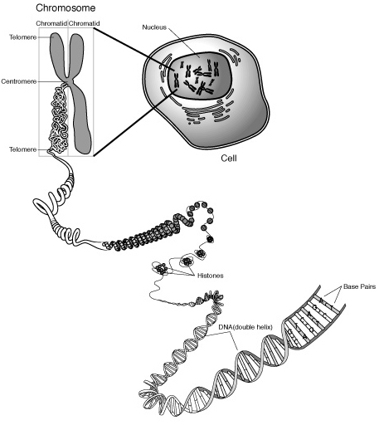
How is DNA organized in the nucleus?
Chromatin
Strands of DNA wrapped around proteins called histones.
Stays in this form most of the time
Chromosomes
Long strands of chromatin are reorganized (condensed) into chromosomes during mitosis.
chromatin

Slide 5
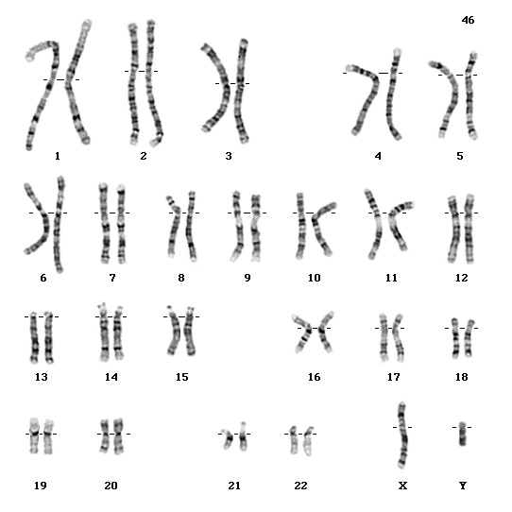
Humans have 23 pairs (46 total) of Chromosomes!

Slide 6
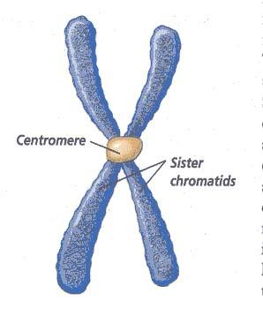
Chromosome Structure
Sister Chromatids
After DNA is copied, 2 sister chromatids exist (each containing the same genetic information).
Centromere
Holds sister chromatids together.

Slide 7
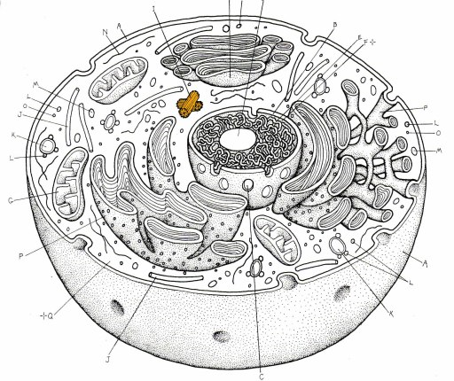
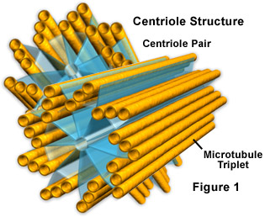
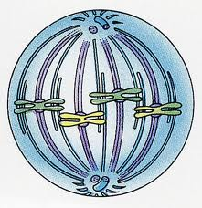
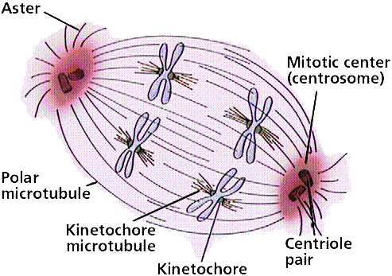
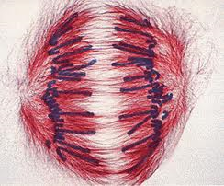
Centrioles & the Spindle
Centrioles (animal cells only)
Small, dark cylindrical structures located just outside the nucleus
Play role in separating sister chromatids
Spindle
Football-shaped cagelike structure consisting of thin fibers
Attach to centromeres, line up chromosomes along midline of cell, and pull apart sister chromatids.

Slide 8
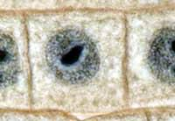
Interphase
G1 (Growth 1): Cell grows & proteins produced
S (Synthesis): Cells make a copy of their chromosomes (DNA synthesis)
G2 (Growth 2): Mitochondria & other organelles are manufactured; centrioles replicate

Slide 9
MITOSIS

Slide 10
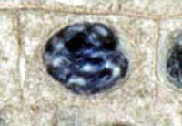
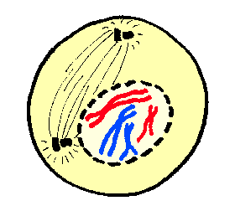
Stage 1: Prophase
Chromatin condenses into distinct chromosomes (2 sister chromatids attached by the centromere).
Nuclear membrane dissolves.
Centrioles (animal cells) migrate to opposite ends of the cell.
Spindle begins to form between centrioles & attaches to centromeres.

Slide 11
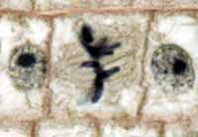
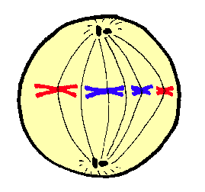
Stage 2: Metaphase
Spindle pulls chromosomes so they line up along the center (midline) of the cell.

Slide 12
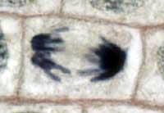
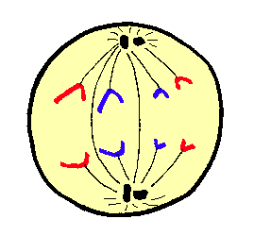
Stage 3: Anaphase
Sister chromatids are pulled apart & move towards opposite poles (ends) of the cell.

Slide 13
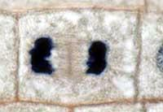
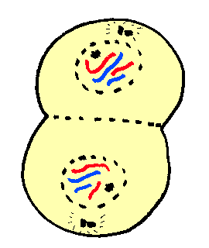
Stage 4: Telophase
Chromatids reach opposite poles of the cell.
Chromosomes begin to uncoil into chromatin.
Spindle breaks down
Nuclear envelope reforms around each set of chromosomes.
A new phospholipid membrane begins to form between the two new nuclei.

Slide 14
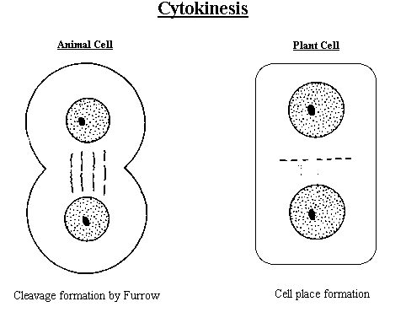
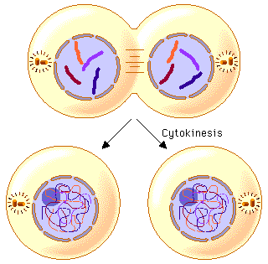
Cytokinesis
Division of cytoplasm
Formation of plasma membrane & cell wall (plants)

Slide 15
Animal Mitosis
Interphase | Prophase
Metaphase | Anaphase
Telophase | Cytokinesis

Slide 16
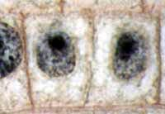
Plant Mitosis
Interphase | Prophase
Metaphase | Anaphase
Telophase | Cytokinesis

Slide 17
Phases – To Help You Remember
Phase | Word Part | Memory Aid
Interphase | “inter” | “between”
Prophase | “pro” | “early”
Metaphase | “meta” | “middle”
Anaphase | “ana” | moving “apart”
Telophase | “telo” | “far”
Cytokinesis | “cyto” | “cytoplasm” division

Slide 18
How Often Cells Divide
Type of Cell | How Often Cells Divide
Embryo Cells | 30 minutes
Skin Cells | 20 hours
Intestinal Cells | 3 days
Blood Cells | 3 months
Nerve Cells | Never
Cancer: uncontrolled cell division

Slide 19
Cell Cycle: Amount of Time Spent in Each Phase
Onion Root Tip Activity
Worksheet
Notes:
http://www.biology.arizona.edu/cell_bio/activities/cell_cycle/cell_cycle.html

Slide 20
National Institute of Health (NIH) Cell Cycle & Cancer Videos
CB5-CB8
CB1A-CB1E

Slide 21
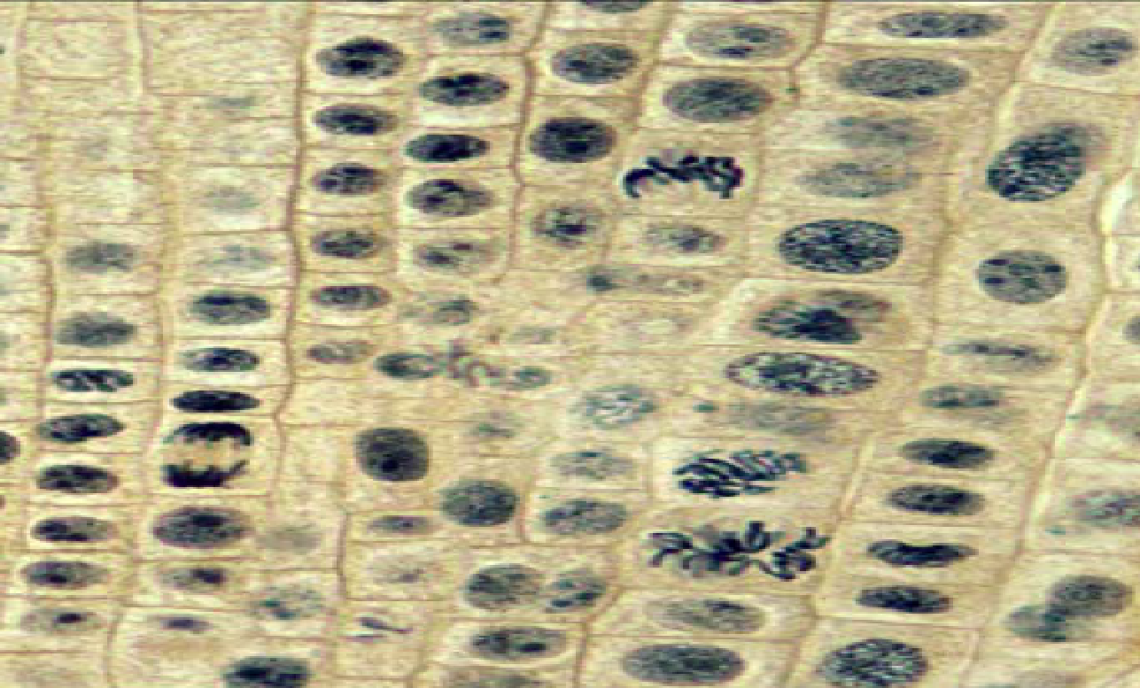
Find and Label the 6 phases in the Cell Cycle

