Slide 1
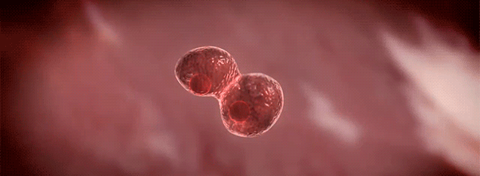
Cell Cycle

Slide 2
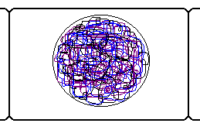
The Cell Cycle
Cell Cycle
The growth & division of a cell
Interphase
Growth & DNA replication
Mitosis
Division of the nucleus (4 Stages)
Cytokinesis
Division of the cytoplasm

Slide 3
How is DNA organized in the nucleus?
Chromatin
Strands of DNA wrapped around proteins called histones.
Stays in this form most of the time

Slide 4
Chromosomes
Chromosomes
Long strands of chromatin are reorganized (condensed) into chromosomes during mitosis.

Slide 5
Humans have 23 pairs (46 total) of Chromosomes!

Slide 6
Chromosome Structure
Sister Chromatids
After DNA is copied, 2 sister chromatids exist (each containing the same genetic information).
Centromere Holds sister chromatids together.

Slide 7
Centrioles
Centrioles (animal cells only)
Small, dark cylindrical structures located just outside the nucleus
Play role in separating sister chromatids

Slide 8
Spindle
Spindle
Football-shaped cage like structure consisting of thin fibers
Attach to centromeres, line up chromosomes along midline of cell, and pull apart sister chromatids.

Slide 9
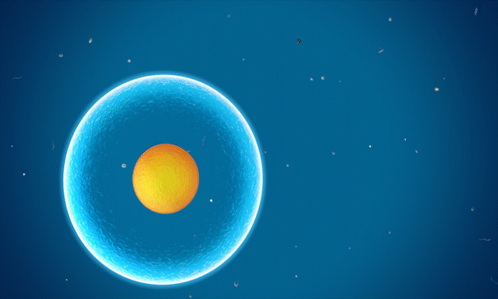
MITOSIS

Slide 10
Interphase
G1 Mitochondria and other organelles will make a copy of themselves.
S. Chromosomes will make a copy of themselves also.
G2. Cell will check to see if there is any error in the copies made.

Slide 11
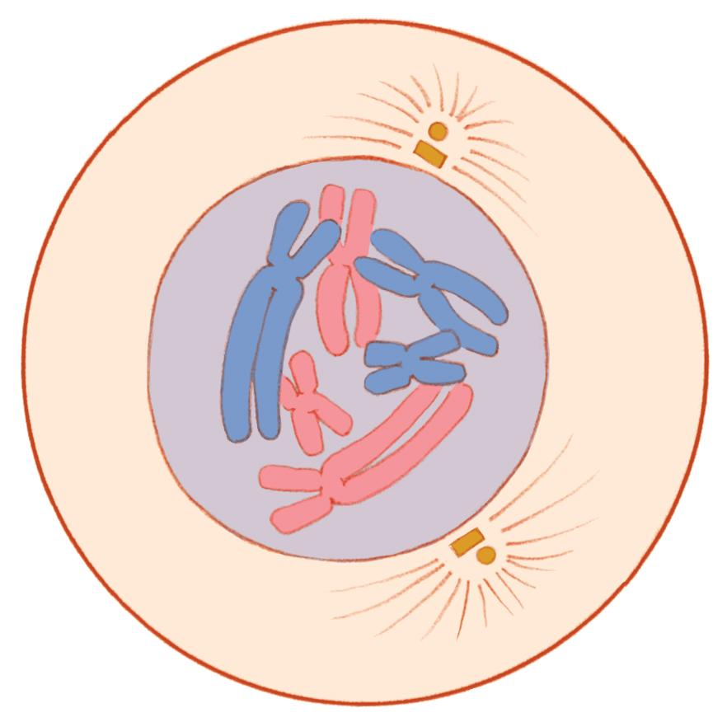
Stage 1: Prophase
Chromatin condenses into distinct chromosomes (2 sister chromatids attached by the centromere).
Nuclear membrane dissolves.
Centrioles (animal cells) migrate to opposite ends of the cell.
Spindle begins to form between centrioles & attaches to centromeres.

Slide 12
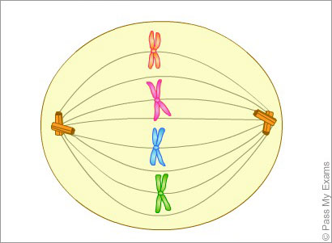
Stage 2: Metaphase
Spindle pulls chromosomes so they line up along the center (midline) of the cell.

Slide 13
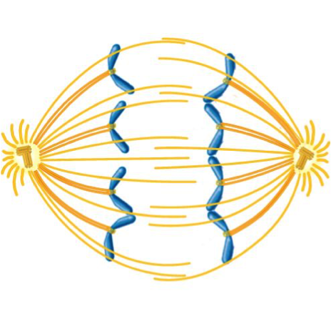
Stage 3: Anaphase
Sister chromatids are pulled apart & move towards opposite poles (ends) of the cell.

Slide 14
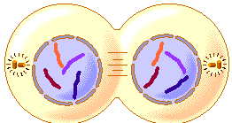
Stage 4: Telophase
Chromatids reach opposite poles
of the cell.
Chromosomes begin to uncoil into chromatin.
Spindle breaks down
Nuclear envelope reforms around each set of chromosomes.
A new phospholipid membrane begins to form between the two new nuclei.

Slide 15
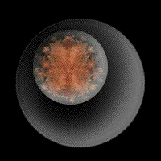
Cytokinesis
Division of cytoplasm
Formation of plasma membrane & cell wall (plants)

Slide 16
Plant Mitosis Animal Mitosis

Slide 17
Mitosis in Animls

Slide 18
Phases – To Help You Remember
Phase | Word Part | Memory Aid
Interphase | “inter” | “between”
Prophase | “pro” | “early”
Metaphase | “meta” | “middle”
Anaphase | “ana” | moving “apart”
Telophase | “telo” | “far”
Cytokinesis | “cyto” | “cytoplasm” division

Slide 19
How Often Cells Divide
Type of Cell | How Often Cells Divide
Embryo Cells | 30 minutes
Skin Cells | 20 hours
Intestinal Cells | 3 days
Blood Cells | 3 months
Nerve Cells | Never
Cancer: uncontrolled cell division

