Slide 1
Photosynthesis
Warm up

Slide 2
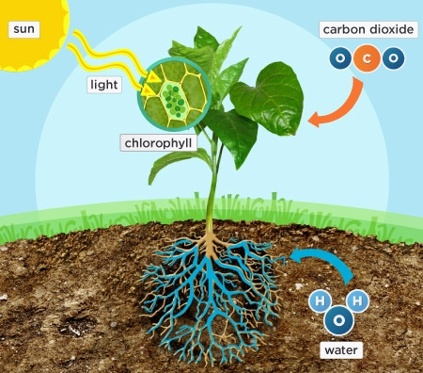
Plants need water, carbon dioxide, and light for photosynthesis. According to the diagram, how does the plant absorb water for photosynthesis?
A. Through the chlorophyll
B. Through the leaves
C. Through the roots
D. Through the sun

Slide 3
According to the diagram, how does the plant absorb carbon dioxide?
A. Through the chlorophyll
B . Through the leaves
C. Through the roots
D. Through the sun

Slide 4
According to the diagram, where does the plant get the energy that powers photosynthesis?
From chlorophyll
From sunlight
From carbon dioxide
From water

Slide 5
According to the diagram, what absorbs the light energy for photosynthesis?
Chlorophyll
Roots
Sun
Carbon dioxide

Slide 6
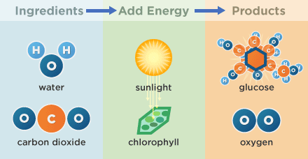
What are the ingredients of photosynthesis?
A. Water and chlorophyll
B. Water and oxygen
C. Water and carbon dioxide
D. Glucose and oxygen

Slide 7
What are the products of photosynthesis?
Glucose and chlorophyll
Oxygen and water
Water and carbon dioxide
Glucose and oxygen

Slide 8
Which of the sentences below best describe the process of photosynthesis?
In photosynthesis, plants absorb water through their roots.
B. In photosynthesis, plants make chlorophyll, the pigment in the leaves.
C. In photosynthesis, plants use light energy to transform water and carbon dioxide into glucose and oxygen.
D. Through photosynthesis, plants take in carbon dioxide and release oxygen through their leaves.

Slide 9
The chemical formula for carbon dioxide is CO₂. Based on what you know about chemical elements and their symbols, what elements do you think make up carbon dioxide?
A. Carbon and hydrogen
B. Hydrogen and oxygen
C. Carbon
D. Carbon and oxygen

Slide 10
The chemical formula for glucose is C₆H₁₂O₆. Based on what you know about chemical elements and their symbols, what elements do you think make up glucose?
A. Carbon and hydrogen
B. Hydrogen and oxygen
C. Carbon, hydrogen, and oxygen
D. Carbon and oxygen

