Slide 1
CELL RESPIRATION AND FERMENTATION
If you print this out, please print 6 slides per page to save paper.
File >Print > Print What: Handouts > 6 per page

Slide 2
Cell Respiration
The process of breaking down food to make ATP in the mitochondria
Reaction:
C6H12O6 + 6O2 → 6CO2 + 6H2O
3 part process:
Glycolysis
Citric Acid Cycle
Chemiosmosis

Slide 3
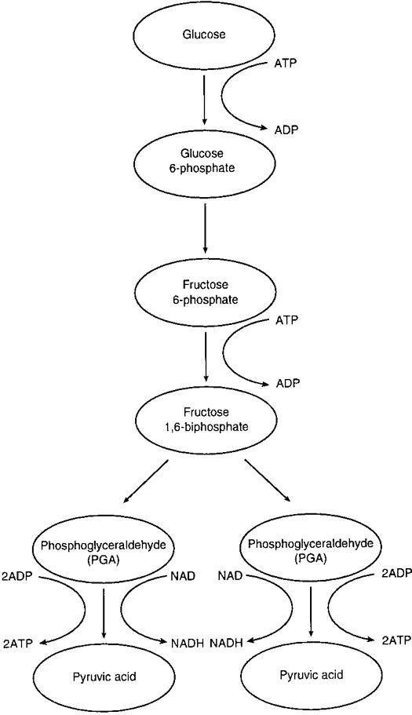
Cell Respiration: Glycolysis
Glycolysis is a series of chemical reactions that occurs in the cytoplasm.
The purpose of glycolysis is to break down a 6-carbon sugar into 2 3-carbon molecules called pyruvic acid
This process makes a gross of 4 ATP but it uses 2 ATP so you only make 2 net ATP
Other than ATP 2 molecules of NADH are made (electron carriers)
IF IF IF oxygen is present then the pyruvic acid moves into the mitochondria

Slide 4
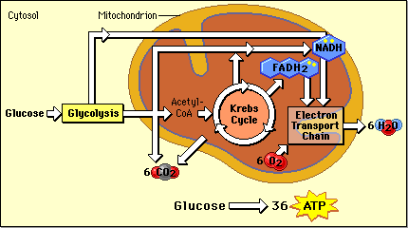
Cell Respiration: Steps between Glycolysis and Citric Acid Cycle
Pyruvic acid moves from the cytoplasm into the mitochondria
CO2 is released from the pyruvic acid leaving only 2 carbons. This also creates another NADH
A molecule called Coenzyme A is added to make a molecule called Acetyl-CoA
This molecule then goes through the Citric Acid Cycle

Slide 5
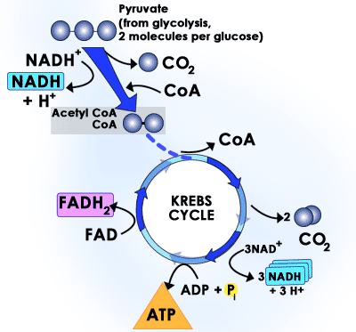
Cell Respiration: Citric Acid Cycle
The Citric Acid Cycle aka Kreb Cycle is similar to the Calvin cycle in photosynthesis
This Acetyl-CoA goes through several chemical reactions.
With each complete turn of the Kreb Cycle there are 3 NADH, 1 FADH2, 1 ATP, and 2 CO2 produced.
For 1 molecule of sugar there are 2 turns of the Kreb cycle

Slide 6
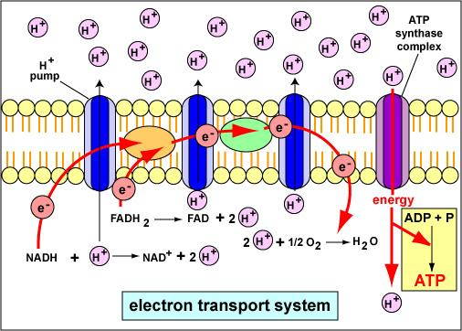
Cell Respiration: Chemiosmosis and ETC
The electron carriers made in the other steps transport electrons to the inner membrane where there is an ETC
The electrons are released into the ETC and the energy is used to make ATP and to pump hydrogen ions into the space between the 2 membranes of the mitochondria
At the end of the ETC the electrons are used to combine oxygen and hydrogen to make water.

Slide 7
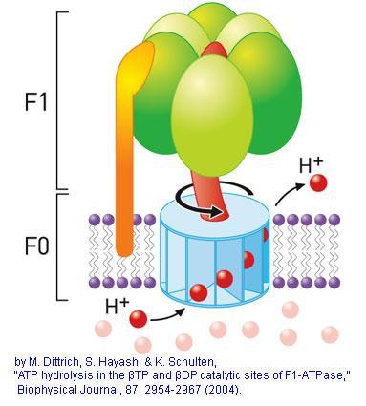
Cell Respiration: Chemiosmosis
The process of pumping H+ into the inner membrane space creates a concentration gradient.
When the H+ move with the gradient through a protein in the membrane the movement is used to drive ATP synthesis similar to the way water is used to produce energy using a water wheel.
Overall this step adds 32 ATP to the 4 made in previous steps

Slide 8
Cell Respiration: Recap
Glycolysis takes in one molecule of sugar and using 2 ATP breaks it into 2 pyruvic acids creating 2 ATP and 2 NADH
Step between: each pyruvic acid releases a CO2 creating another NADH each and a molecule of Acetyl-Coa each
Kreb Cycle: chemical reactions that take Acetyl-CoA and release 2 CO2, 3 NADH, 1 FADH2, and 1 ATP
Chemiosmosis/ETC: electron carriers release electrons which travel down the ETC creating 2 ATP and pumping H+ across the membrane. H+ ions come back across the membrane and drive the synthesis of 32 ATP

Slide 9
Fermentation
The processes of cell respiration is called an aerobic process because it uses oxygen as the final electron acceptor
If there is no oxygen available after glycolysis the cells will perform fermentation to make ATP. This process is an anaerobic process
Ex: When you run sprints you do not take in oxygen, your cells have to perform fermentation to continue making ATP

Slide 10
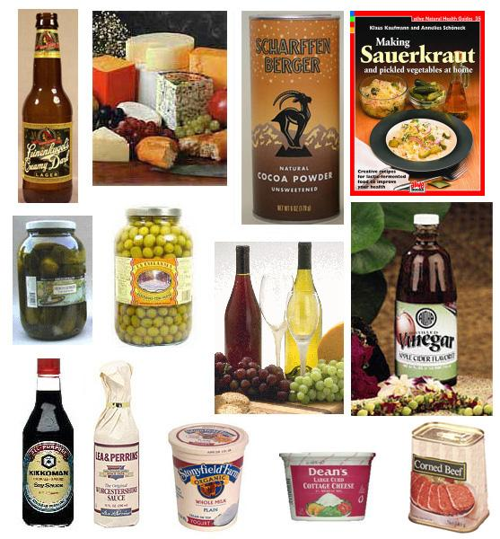
Fermentation
When there is no oxygen the electron carriers NADH and FADH2 can not release the electrons into the ETC.
If the cell cannot break down these molecules the processes of glysolysis and citric acid cycle cannot continue. You need NAD+ for these reactions.
The cell does not have another method of using FADH2 but it can use NADH.

Slide 11
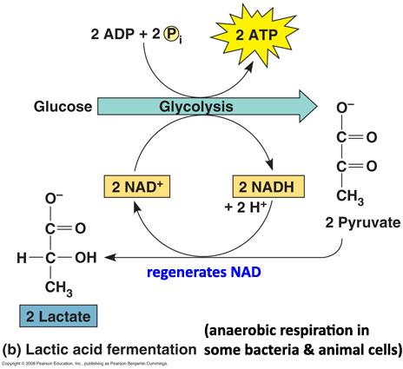
Lactic Acid Fermentation
In lactic acid fermentation pyruvic acid is broken down into lactic acid using the energy stored in NADH. Once the NADH is broken down it is free to be used in glycolysis again.
The lactic acid that builds up in the muscle is eventually transported to the liver to be converted back into pyruvic acid.
Lactic acid build up is responsible for muscle fatigue.

Slide 12
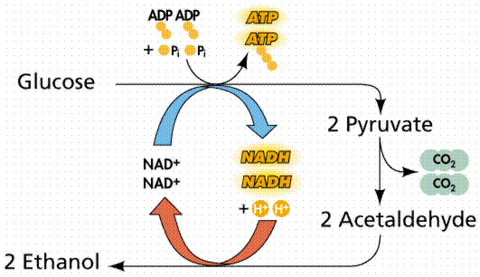
Alcoholic Fermentation
This is a process used by yeast and some bacteria to make CO2 and ethyl alcohol. In this process NADH is used to break pyruvic acid into ethyl alcohol and CO2
Ex: the yeast in bread dough produces CO2 causing the bread to rise. Cooking the dough kills the yeast and the CO2 pockets created create a light fluffy bread.

