Slide 1
The Plasma Membrane
Maintaining Balance

Slide 2
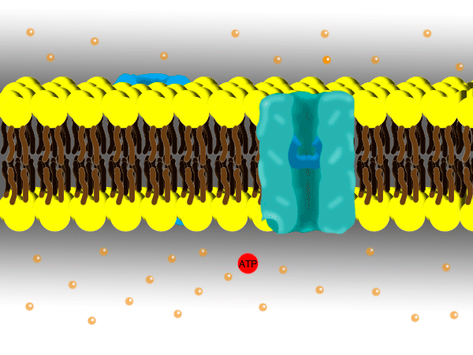
Why cells must control materials
Cells need glucose, amino acids and lipids to function. It is the responsibility of the plasma membrane to allow a supply of these nutrients into the cell.
Excessive amounts of nutrients and waste are also removed from the cell via the cell membrane.

Slide 3
Homeostasis in the cell
The plasma membrane is selectively permeable. It allows some substances to pass through while blocking others.
Water enters freely while sodium and calcium ions can only enter at certain time, in certain amounts and through certain channels.

Slide 4
Structure of the plasma membrane
The plasma membrane is made up of a phospholipid by-layer The phosphate group is important for the formation of the plasma membrane.
The phosphate group allows the cell to interact with the water in its environment. The lipids form a water hating barrier inside, making it impossible for water to pass through the membrane.

Slide 6
Cholesterol
Cholesterol is often seen as an unhealthy substance found in our bodies. Cholesterol is a very important substance needed to support the cell membrane.

Slide 7
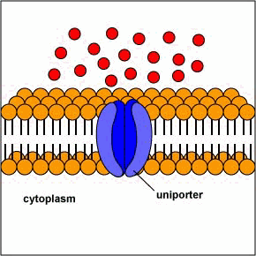
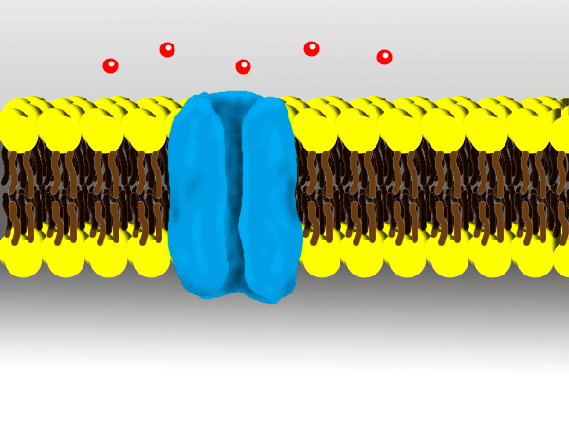
Transport Protein
Transport protein are needed to move substances through the plasma membrane. They are also used as markers to identify foreign cells.

