Slide 1
Cell Transport

Slide 2
Diffusion
Diffusion - the natural movement of molecules from high
concentration to lower
concentration (with the
concentration gradient).

Slide 3
Facilitated Diffusion
Facilitated Diffusion - passive transport across the membrane using transport (carrier) proteins

Slide 4
Passive transport
Passive Transport - movement of substances across the membrane without the use of energy.

Slide 5
Active Transport
Active Transport - movement of materials through a membrane against the concentration
gradient which requires energy (ATP)

Slide 6
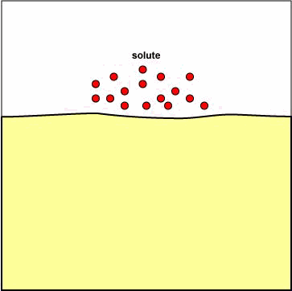
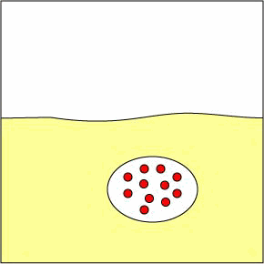
Endocytosis and Exocytosis
Endocytosis - process by which a cell surrounds and takes in materials.
Exocytosis - the expulsion of secretion of materials from a cell.

Slide 7
Selectively permeable membrane
Selectively Permeable - only lets certain things in & out.

Slide 8
Osmosis
Osmosis - movement of water across a membrane. Water is polar so needs a protein channel
(aquaporin).

Slide 9
Isotonic Solutions
Isotonic
the concentration of dissolved substance in the fluid surrounding the cell is the same as cell. No net movement.

Slide 11
Hypotonic Solutions
Hypotonic - concentration of dissolved substances is lower than the cell so more water outside the cell. Cell swells and becomes turgid or lysed

Slide 13
Hypertonic
concentration of dissolved substances is greater outside than inside the cell so more water inside and it moves out. Cell shrinks and become
flaccid.

Slide 15
Active Transport -movement of materials through a membrane against the concentration gradient (low to high) which requires energy (ATP)
Types:
Endocytosis
Phagocytosis (solids)
Pinocytosis (liquids)
- Receptor-mediated
Exocytosis - secretion, excretion

