Slide 1
Specialize Cells

Slide 2
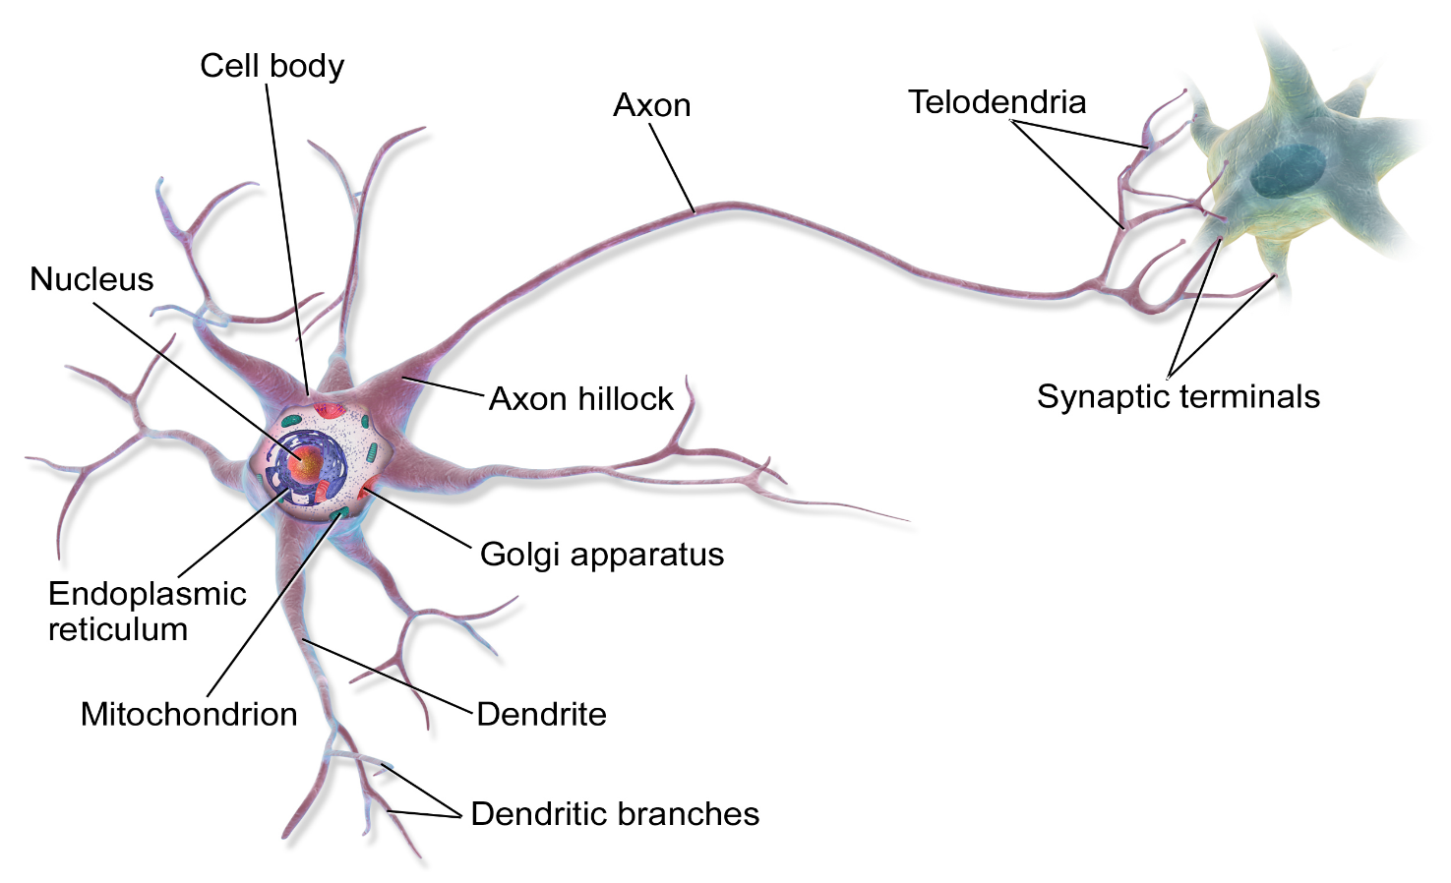
Multicellular Organisms
Multicellular organisms are made up of more than one cell.
The cells in multicellular organisms are designed to perform certain functions.
Nerve Cells are thing and long, they send information from one part of the organism to another.

Slide 3
Nerve transporting messages from the brain to the body organs.

Slide 4
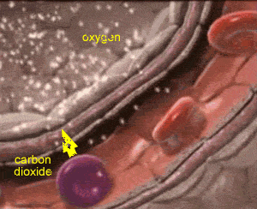
Red Blood cells
Red blood cells are flattened disc that carry oxygen through out the body. The red pigment hemoglobin stores the oxygen that the cells carry. They are flat so that they float through the blood vessels.

Slide 5
Blood cells floating through blood vessels

Slide 6
Sperm cells
Sperm cells travel to the ovary in search of an egg to fertilize. It has a strong tail that allow it to swim from the womb to the ovary.

Slide 7
Sperm Cells fertilizing an Egg cell

Slide 8
Levels of Organization of Organisms

Slide 9
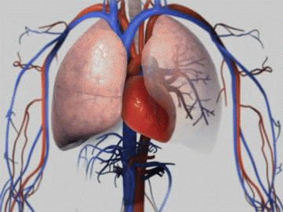
Complex organisms
Cell growth results in group of cells called tissues. These cells work together to perform a specific function, e.g. muscle cells form muscle tissues.
Tissues organize to form organs that perform more complex roles within the organism, .e.g the stomach is made up of muscles tissues that help to digest food.

Slide 10
Organs at work – The heart pumps blood around the body.

Slide 11
The lungs take air in and pushes it out of the body.

Slide 12
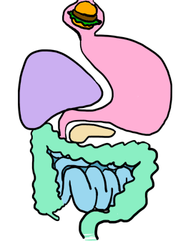
Organs make systems
Organs come together to make body systems, e.g. bones are a part of the skeletal system.
These body systems work together to ensure that the organism functions properly.

