Slide 1
Macro Molecules

Slide 2
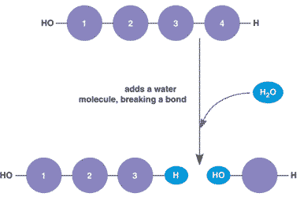
When polysaccharides are split apart to form monosaccharides, water is added. This is the reverse of dehydration synthesis and is called hydrolysis.

Slide 3
Glucose

Slide 4
Dehydration synthesis

Slide 5
DNA & RNA
The 2 major types of nucleic acid
DNA ­
Deoxyribonucleic acid
RNA ­ ribonucleic
acid

Slide 6
Nucleic Acids are made up of monomers called nucleotides.
Each nucleotide is composed of:
a phosphate group
a 5 carbon sugar
a nitrogen containing base

Slide 8
Lipids
Diverse group of compounds. Characteristics:
– Insoluble in water
– made of carbon, hydrogen, oxygen and
sometimes phosphorous.
Far fewer oxygen than carbon and hydrogen, but there is no set ratio, e.g. : C32H50O6

Slide 10
Fatty acids can be.
Saturated ­
made up of all single bonds. They are solid at room temperature, e.g. butter.
Unsaturated ­
at least one non­ single bond. They are liquid at room temperature, e.g. coconut oil.

Slide 11
4 main types of Lipids
triglycerides ­
consists of 3 fatty acids joined to a glycerol. If a liquid at room temperature it forms oil
If a solid at room temperature it forms fat

Slide 12
Wax
long fatty acid
chain with an ­OH
group at the end.
• Highly
waterproof.

Slide 13
Steroids
Steroids are lipids with 4 carbon rings
cholesterol is an important steroid and is a precursor of many other steroids, including sex hormones, (testosterone and estrogen)

Slide 14
Phospholipids
Similar to triglycerides, but has a phosphate group instead of one of the fatty acid chains.
• Very important in the cell membrane.

Slide 15
Protein
Contain nitrogen as well as carbon, hydrogen and oxygen.
Made up of monomers called amino acids. Amino acids are compounds made up of an amino group (­NH2) and a carboxyl group (­COOH).

Slide 16
Monomers to Polymers

Slide 17
Amino Acids
There are 20 different kinds of amino acids. The order in which they are arranged (dictated by DNA) determines the particular protein made.

Slide 19
Protein and their roles
Proteins dictate almost every function within any organism.
They control the rates of reactions and cellular processes. Some are used to make bone and muscle.
Other proteins are used to transport materials in the body and fight off infections.

Slide 20
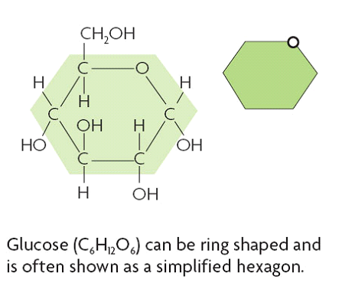
B. Four main types of carbon-based molecules are found in living things.
1. Carbohydrates are made of carbon, hydrogen, and oxygen
a. Carbohydrates include sugars and starches
b.Monosaccharides are simple sugars

Slide 21
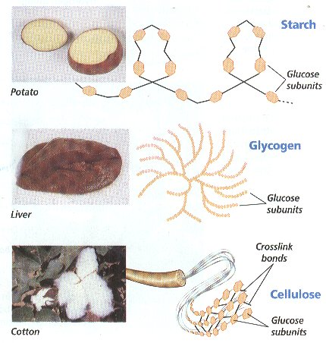
c. Polysaccharides include starches, cellulose, and glycogen
d. Carbohydrates can be broken down to provide energy for cells
e. Some carbohydrates are part of cell structure

Slide 22
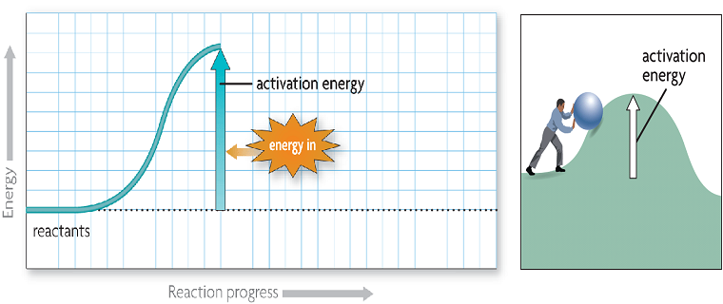
D. Chemical reactions release or absorb energy
1. Activation energy is the amount of energy that needs to be absorbed to start a chemical reaction.

Slide 23
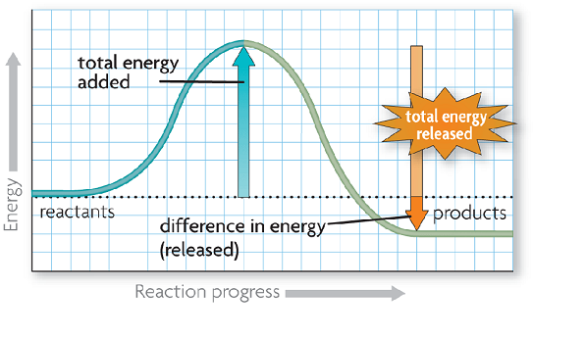
2. Exothermic reactions release more energy than they absorb.
a. Reactants have higher bond energy than products
b. Excess energy is released by the reaction

Slide 24
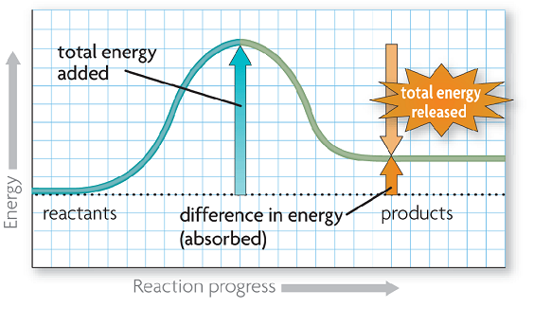
3. Endothermic reactions absorb more energy than they release.
a. Reactants have lower bond energy than products
a. Energy is absorbed by the reaction to make up the difference.

Slide 25
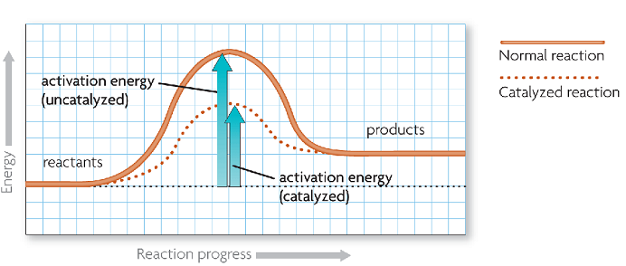
V. Enzymes (2.5)
A. A catalysts lowers activation energy
1. Catalysts are substances that speed up chemical reactions
a. Decrease activation energy
b. Increase reaction rate

Slide 26
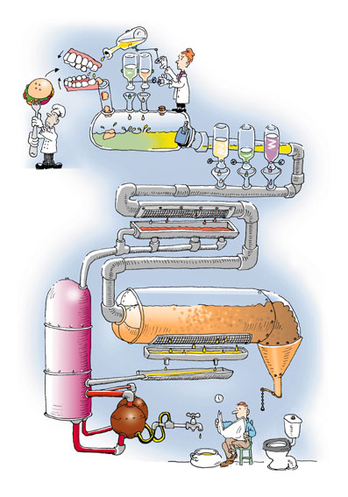
B. Enzymes allow chemical reactions to occur under tightly controlled conditions.
1. Enzymes are catalysts in living things
a. Enzymes are needed for almost all processes
b. Most enzymes are proteins

Slide 27
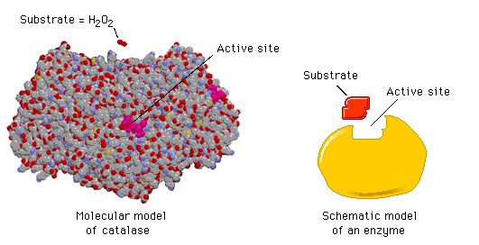
C. Disruptions in homeostasis can prevent enzymes from functioning.
1. Enzymes function best in a small range of conditions
2. Changes in temperature and pH can break hydrogen bonds.
3. An enzyme’s function depends on its structure

Slide 28
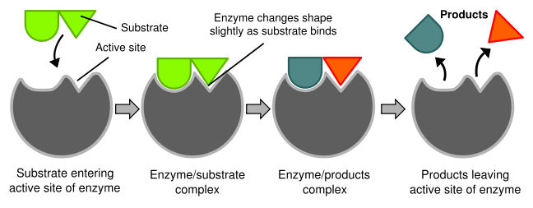
D. An enzyme’s structure allows only certain reactants to bind to the enzyme
1. Substrates
2. Active Site

Slide 29
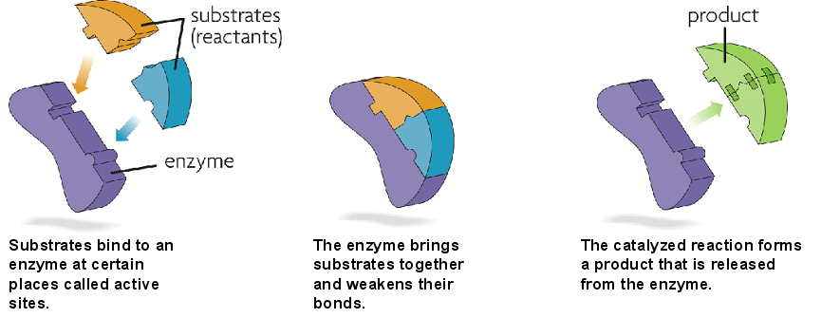
E. The lock-and-key model helps illustrate how enzymes function
1. Substrates brought together
2. bonds in substrates weakened

