Slide 1
Classification
The Kingdoms.

Slide 2
Evolutionary relationships and classification.
Evolutionary relationships are determined by similarities in
body structure
breeding behavior
Geographic distribution.
Chromosomes.
These keys provide the evidence that these organisms are related.

Slide 3
Structural similarities.
Shared structural similarities indicates that these species are closely related and descend from a common ancestry. The lynx and the bob cat share similar structures and that suggest that they descended from a common ancestry, e.g.
Ear tufts
Spotting on their coat.
Short tail
Back legs longer than the front legs.

Slide 5
Breeding behavior
Organisms that live in the same area and have similar breeding habits are normally related.
The Hyla versicolor and the Hyla chrysoscelis are two species of frogs that look similar but their mating calls are different.

Slide 6
Geographic distribution
The location of species on earth helps biologists determine their relationships with other species.
The finches that live on the Galapagos islands are similar to the finches that lived on the south American mainland.

Slide 7
Genetic comparisons
The chromosomal number and structure during mitosis and meiosis are similar in cabbage, kale, broccoli and cauliflower. Biologists suggests that they all came from a common ancestry.

Slide 8
Phylogenic classification models.
Species that descend from a common ancestry also share a common evolutionary history. The evolutionary history of an organism is called its Phylogeny.

Slide 9
cladistics
Scientists believe that organisms evolved from one common ancestry. Taxonomist use these traits that they inherited to make a cladogram.
Branches on these cladograms show similar ancestry. On a cladogram, diverging branches share a more recent ancestor than branches farther away.

Slide 10
The Six Kingdoms of Organisms
The six kingdoms of life are,
Archaebacteria
Eubacteria
Protists
Fungi
Plants
Animals.
The difference in cell structure and methods of obtaining energy are the two main characteristics that separate these kingdoms.

Slide 12
Prokaryotes
Prokaryotes are small organisms that lack have membrane bound organelles, e.g. nucleus or mitochondria. The two kingdoms of prokaryotes are,
Archaebacteria
Eubacteria

Slide 13
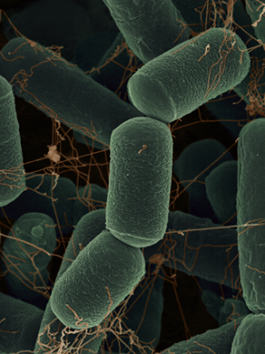
Archaebacteria
There are hundreds of species of archaebacteria and most are found in swamps, deep oceans and hydrothermal vents. These environments lack oxygen which suits the archaebacteria.

Slide 14
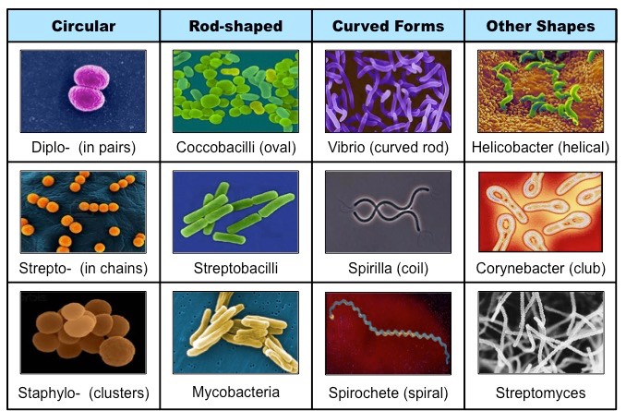
Eubacteria.
This kingdom consists of about 500 species of bacteria. Their less genetic makeup is less complex and they have a strong cell wall. They can also be found is most habitats and may cause diseases such as pneumonia and strep throat.

Slide 15
Diseases caused by bacteria

Slide 16
Protista
A protest lacks a complex organ system and lives in moist habitats. Some protista are made up of one cell, while others are multicellular.
Some protista are plant like and make their own food while others depend on others for food.

Slide 17
Types of Protists

Slide 18
Fungi
Organisms in the Fungi kingdom depend on other organisms for food (heterotrophs) and do not move from place to place. A fungus absorbs nutrients from dead or decaying organisms in the environment. There are over 500 species of fungi known today.

Slide 19
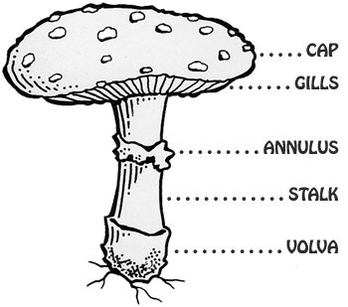
Fungal Structures

Slide 20
Plants
Plants are made up of more than one cell ( multicellular), make their own food and do not move from place to place.
A plant cell contains chloroplast and cell wall. Plants first existed 400 million years ago. We can classify plants as mosses, ferns, evergreen, flowering and non-flowering.

Slide 22
Animals
Animals are multicellular heterotrophs that move from place to place. Animal cells do not have cell walls; however they are organized into tissues that form complex organ systems. These systems include, digestive, skeletal, muscular, reproductive etc.

