Slide 1
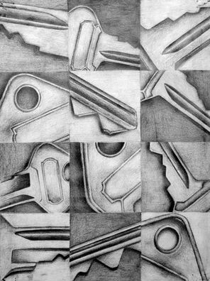
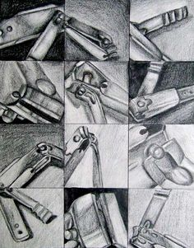
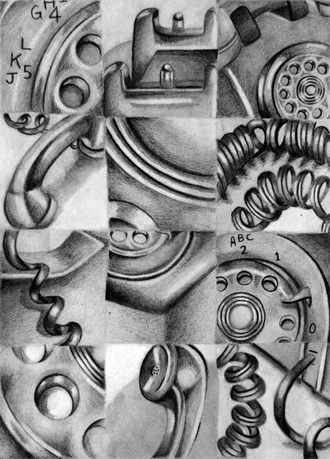

Slide 2
Art I 2-16
Working within a 9x12 inch drawing paper, create different compositions using a single small object. Using a ruler, separate your 9x12 paper into 3 inch squares.
Draw a different view of the object each time. Isolate just enough of the object to hint at its identity.
Do not forget to add value and add detail to your small object. You are going to create 12 different compositions that come together to show one object.

Slide 3
Art I 2-17
Project Due:
Tuesday 2-21
**Progress Reports** I will hand out progress reports at the beginning of class. If you have a zero for an assignment make sure to turn it in as soon as possible. I will reprint your progress reports if you show me missing work today.
***Get your parents to sign your progress report if you made below a 65***
Working within a 9x12 inch drawing paper, create different compositions using a single small object. Using a ruler, separate your 9x12 paper into 3 inch squares.
Draw a different view of the object each time. Isolate just enough of the object to hint at its identity.
Do not forget to add value and add detail to your small object. You are going to create 12 different compositions that come together to show one object.
Friday Flex Schedule “A”
1st: 7:75 – 9:10
FLEX: 9:15 – 9:45
2nd: 9:50 – 11:15
3rd:11:45 – 12:45
Lunch: 11:15 – 11:45
4th: 1:20 – 2:45

Slide 4
Art I 2-20
Project Due:
Tuesday 2-21
**Reminder** Use cell phones only for listening to music. Many students did not follow this on last Friday.
Working within a 9x12 inch drawing paper, create different compositions using a single small object. Using a ruler, separate your 9x12 paper into 3 inch squares.
Draw a different view of the object each time. Isolate just enough of the object to hint at its identity.
Do not forget to add value and add detail to your small object. You are going to create 12 different compositions that come together to show one object.
Repeated Object Grading
Creativity & Originality | Different views Of the Object
Composition | Value
Skill/Craftsmanship | Fine detail Used
Directions | Correct use of Grid
Time Usage/Effort | Object Magnified/Fits Each Square

Slide 5
Art I 2-21
Project Due:
Today!!
I will be coming around the first part of class to grade your Elements and Principals Worksheet. Make sure to have it on your desk so I can grade it.
Working within a 9x12 inch drawing paper, create different compositions using a single small object. Using a ruler, separate your 9x12 paper into 3 inch squares.
Draw a different view of the object each time. Isolate just enough of the object to hint at its identity.
Do not forget to add value and add detail to your small object. You are going to create 12 different compositions that come together to show one object.
Repeated Object Grading
Creativity & Originality | Different views Of the Object
Composition | Value
Skill/Craftsmanship | Fine detail Used
Directions | Correct use of Grid
Time Usage/Effort | Object Magnified/Fits Each Square

