Slide 1
Doodle Landscape
A lesson in line, color and rhythm.

Slide 2
Objective
To learn about the elements of line, color, value and space and how to apply them to create the principles of rhythm, repetition, pattern in a work of art.
.

Slide 3
Before we start
Lets talk about the Elements of Art
The Elements of Art are the building blocks that we use in a piece of art to create Principles of Art.
The Elements of Art can be compared to letters of the alphabet. We use these elements to create Principles of Art
Watch this movie, it may seem a little rudimentary, but has great information.

Slide 4
Elements and Principles of Art Video
http://safeshare.tv/w/fnCUZCbyme
Notes:
http://safeshare.tv/w/fnCUZCbyme

Slide 5
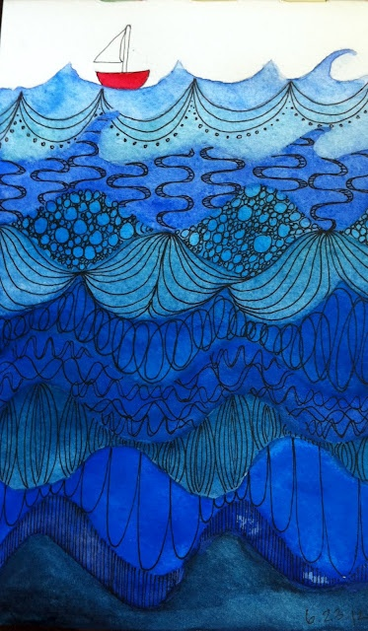
In your thumbnails, make at least 6 patterns to use in your landscape.
Then experiment with different landscapes until you find one you would like to use in your final work of art.

Slide 6
Step One
Create thumbnail designs using the worksheet provided.
Use the doodle starter idea sheets to help you get started.
Create your own doodles by using simple lines and adding detail to create visual interest.

Slide 7
Notes:
Provide the students with the Doodle Starter Idea sheets and then have them use the Doodle Thumbnails Worksheet to re-create designs, or make up their own. Remind them that we are creating not just doodle, but structured doodles that create rhythm like in the examples provided.

Slide 8
Step Two
Using the Landscape Thumbnail sheets create at least
3 thumbnail landscapes to choose from.
Create as many landscapes as you need until you get one that you like.
Remember as shapes recede into the distance they should get smaller and overlap
Notes:
Have students use reference photos of landscapes and simplify shapes if needed.

Slide 10
Step Three
Using watercolor paper and pencil re-create your make believe landscape using one of your thumbnails.
Then outline your landscape in Sharpie Marker.

Slide 11
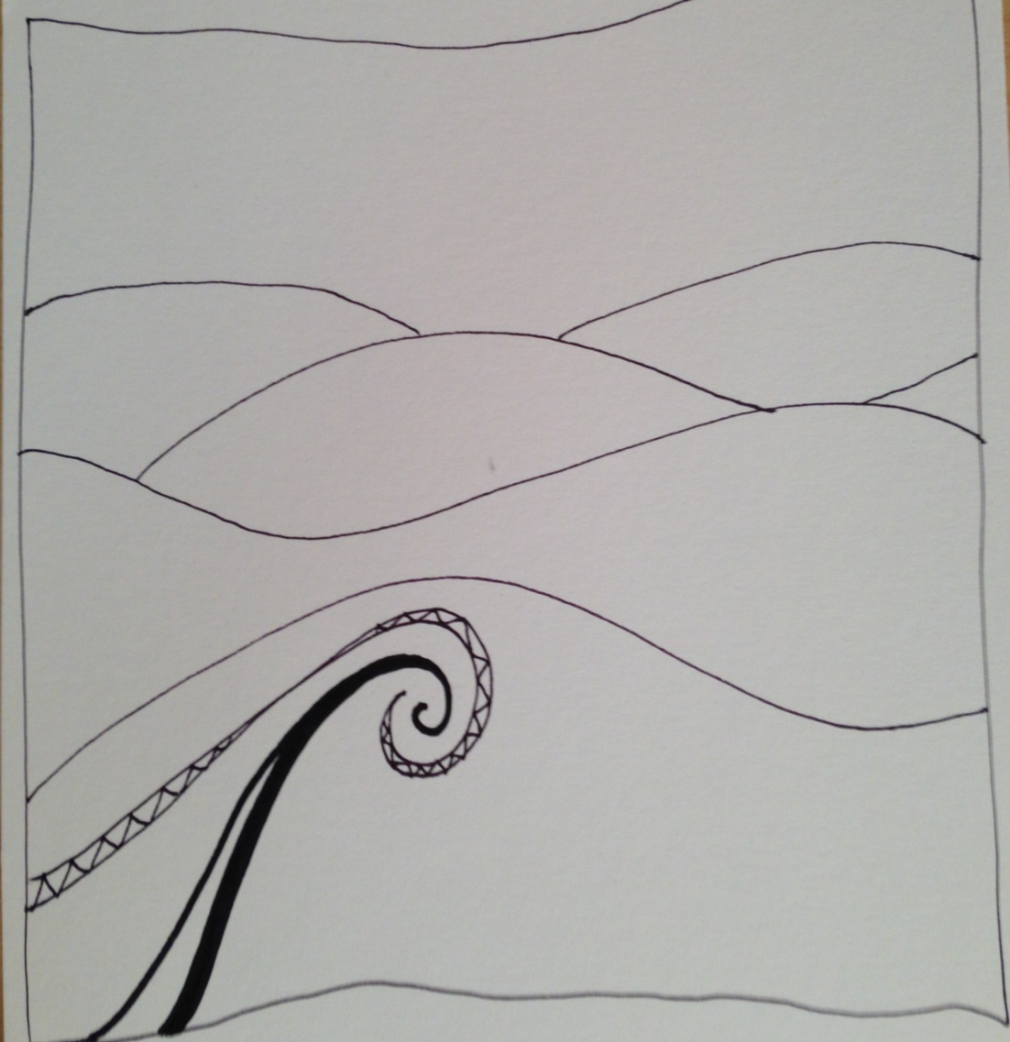

Slide 12
Step Four – Lines & Rhythm
Using a Sharpie marker, or other waterproof marker, begin to fill in your hills with different doodle patterns.
Change the pattern on each hill. Use your thumbnails for ideas.
Line is an element of art, using them in this piece will create rhythm which is a principle of art.

Slide 13
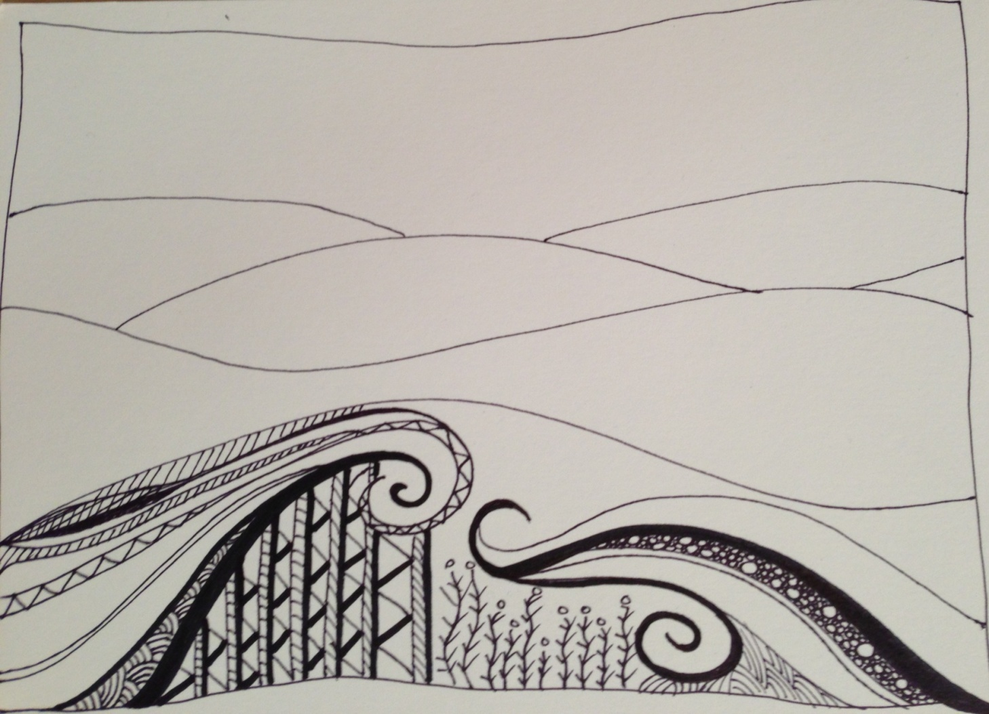

Slide 15
Step Five - Color
Using watercolor paint, or colored pencils we will color in the doodles.
The foreground will be warm colors, (reds, oranges, and yellows)
The background should get cooler
(blues and greens) as the hills recede into the distance.
This adds to the illusion of depth to your Doodle landscape, and to any piece you may work on in the future. This is called atmospheric perspective.
Notes:
This is called atmospheric perspective.

Slide 16
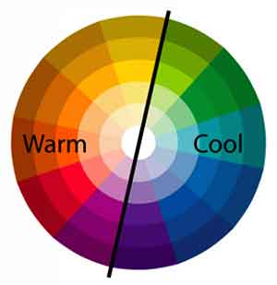
More about Warm and Cool Colors
An easy way to remember warm colors are to think of the colors of the sun and fire like yellow and reds and some violets.
When you think of cool colors think of cool water and grass, blues and greens.

Slide 17
So the hill in the foreground I fill with warm colors, reds and yellows.

Slide 18
Step Six – Color Mixing/Glazing
You can glaze your colors, whether you are using colored pencil, or watercolor paint, by going over one color with another color.
If you mix complementary colors, (red/green, yellow/violet, blue/orange) you will get some version of brown, so if you want to keep your landscape bright, avoid mixing those colors. Mixing yellow and red though will create a beautiful orange.

Slide 19
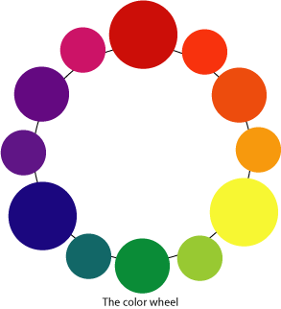
More about Color Mixing
Primary Colors are
RED, BLUE, YELLOW
Mixing these creates the Secondary Colors:
VIOLET, GREEN, ORANGE
Intermediate Colors are created by mixing Primary with Secondary Colors to create:
RED-VIOLET, BLUE VIOLET, BLUE-GREEN, YELLOW GREEN, YELLOW-ORANGE, RED-ORANGE,
Notes:
This is a great interactive color wheel that you can use if you’d like:
http://juliannakunstler.com/art1_colorwheel.html#.UxdnNoJHZuU

Slide 20
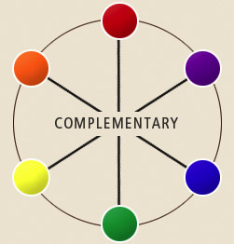
Complementary Colors
Are across from each other on the color wheel, for example:
Red – Green
Blue – Orange
Violet – Yellow
When mixed together they create a neutral color, like brown or gray.
When used next to each other they vibrate and can create a focal point in a piece of art, because the eye tends to go to those areas first.
Sports teams combine complementary colors for this reason.

Slide 21
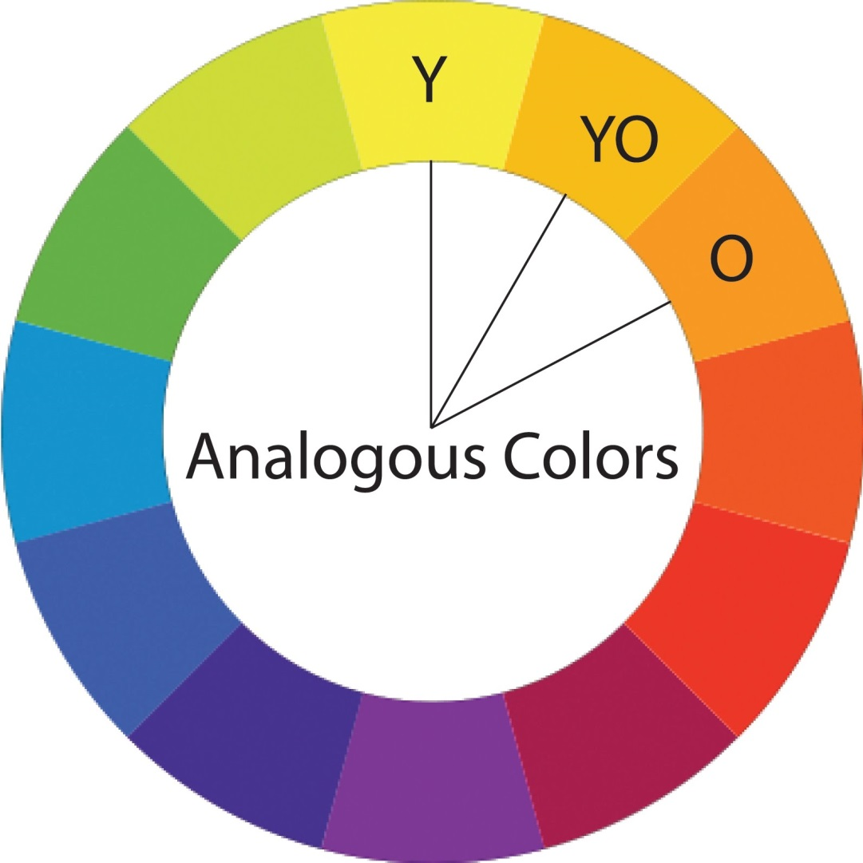
Analogous Colors
Are next to each other on the color wheel, for example:
Red-Violet, Red, Red-Orange
When used together they create a sense of harmony or unity.

Slide 22
Step Seven – Value
Create interest in your doodle landscape by using values (the dark and light shades) of your color.
If you are using watercolor, add water to get lighter values of the same color.
If you are using colored pencils color more lightly in some areas and darker in others.

Slide 23
More about Value
In this color wheel you can see all the colors dark to light. As the colors go toward the center you can see they get lighter.
So if you look at the green you can see all the different values of that color from dark to light.

Slide 24
Putting it all together
When you are finished you should have something that looks a little like this, but completely different because it will be your own doodle landscape.

Slide 26
More Examples

Slide 28
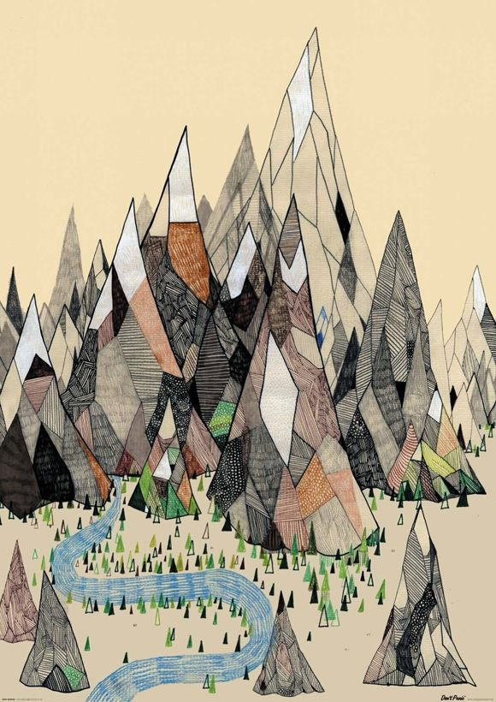
Detailed view

Slide 29
Zentangle Movies
http://safeshare.tv/w/oWxvvQYGUL
http://safeshare.tv/w/uxwqaYUZpj
http://safeshare.tv/w/AAjzrhXmYo
Notes:
Hand out Doodle Thumbnail Sheet and doodle starter sheets and play the first movie to get them started. I then go through and play a different movie every consecutive day to keep them engaged.

Slide 30
Vocabulary
Rhythm: Rhythm is a principle of art, it is created through the repeated use of lines, shapes or colors. It lends movement to a piece of art.
Unity: Unity is achieved in a piece of art when a composition looks or feels complete, balanced and like it’s done.
Complementary Colors: Colors across from each other on the color wheel. Red/Green, Yellow/Violet, Blue/Orange.
Primary Colors: The colors from which all other colors are created, in pigment they are Red, Yellow and Blue.
Secondary Colors: Are the colors that are achieved by mixing the primary colors. Green, Orange and Violet
Intermediate Colors: Are the colors that are achieved by mixing Secondary Colors.
Line: An Element of Art. It is literally the extension of a dot. However, when the line intersects itself, it becomes a shape.
Warm & Cool Colors: Warm colors are the colors of the sun, Yellow, Orange and Red. Cool colors are the colors of water and grass, Blues and Greens.
Notes:
Rhythm: Rhythm is a principle of art, it is created through the repeated use of lines, shapes or colors. It lends movement to a piece of art.
Unity: Unity is achieved in a piece of art when a composition looks or feels complete, balanced and like it’s done.
Complementary Colors: Colors across from each other on the color wheel. Red/Green, Yellow/Violet, Blue/Orange.
Primary Colors: The colors from which all other colors are created, in pigment they are Red, Yellow and Blue.
Secondary Colors: Are the colors that are achieved by mixing the primary colors. Green, Orange and Violet
Intermediate Colors: Are the colors that are achieved by mixing Secondary Colors.
Line: An Element of Art. It is literally the extension of a dot. However, when the line intersects itself, it becomes a shape.
Warm & Cool Colors: Warm colors are the colors of the sun, Yellow, Orange and Red. Cool colors are the colors of water and grass, Blues and Greens.

Slide 31
Vocabulary
Space: The area between or around objects. The space around objects is often called negative space; negative space has shape. Space can also refer to the feeling of depth. Real space is three-dimensional; in visual art when we can create the feeling or illusion of depth we call it space.
Texture: The surface quality that can be seen or felt. Actual texture can be felt, implied texture is seen.
Value: The relationship between light and dark. Change of value can be seen in high, low and medium contrast areas.
Shape: A closed line. Shapes can be geometric, like squares and rectangles, or organic, like free-formed shapes or natural shapes. Shapes are flat and can express length and width.
Form: Three-dimensional shapes, expressing length, width, depth. Balls, Cylinders and Boxes are examples of forms.
Notes:
Space: The area between or around objects. The space around objects is often called negative space; negative space has shape. Space can also refer to the feeling of depth. Real space is three-dimensional; in visual art when we can create the feeling or illusion of depth we call it space.
Texture: The surface quality that can be seen or felt. Actual texture can be felt, implied texture is seen.
Value: The relationship between light and dark. Change of value can be seen in high, low and medium contrast areas.
Shape: A closed line. Shapes can be geometric, like squares and rectangles, or organic, like free-formed shapes or natural shapes. Shapes are flat and can express length and width.
Form: Three-dimensional shapes, expressing length, width, depth. Balls, Cylinders and Boxes are examples of forms.

Slide 32
Notes:
I usually display the different steps and stages for the students on a big board at the front of the room. This helps when students are absent to be able to pick up where they left off.

Slide 33
Grading Guidelines:
Different patterns in each section of your landscape. (25 points)
Used color pencils to help emphasize the colors of your landscape. (25 points)
Uses watercolors to add color and not cover up your design. (25 points)
Clear use of craftsmanship (it looks neat and tidy and it is obvious you spent plenty of time on it). (25 points)

