Slide 1
Color Pencil Blending
Art I

Slide 2
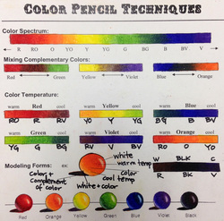

Slide 4
Color Pencil Video
https://www.youtube.com/watch?v=R2T3b9o7ea8

Slide 5
Grading Guidelines:
Color Pencil Blended Smoothly (33 points)
Color Pencil lines go in one direction (33 points)
Colors are a 5 or 6 on color pencil quality chart (33 points)

