Slide 1
Intro to Value
Art I
** Please get out your sketchbook**

Slide 2
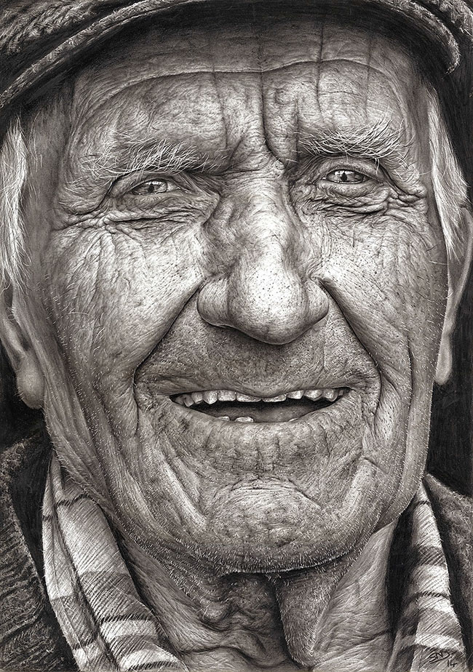
Portrait by Shaina MacDonagh
VALUE: the lightness or darkness of a color.
Value Scale: a range of values from dark to light.
Notes:
Value, day 1

Slide 3
. Draw a value scale with at least 6 values
Notes:
have students draw value scales in sketchbooks, while they work look for 6 levels of value and help those who need it. 5 - 10 min

Slide 4
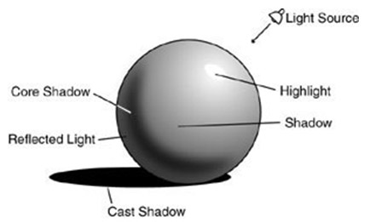
Notice all of the parts shown on this sphere. Each part has a different value.
Notes:
Play video, then demo with document camera or play video again while they start to draw in sketchbooks. Check drawings as they work. 10 - 15 min

Slide 5
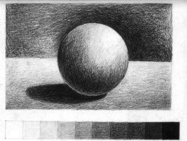

Slide 6
What is a composition?
Composition is the placement or arrangement of visual elements or ingredients in a work of art, as distinct from the subject of a work.

Slide 7
The Four Basic Shapes

Slide 8
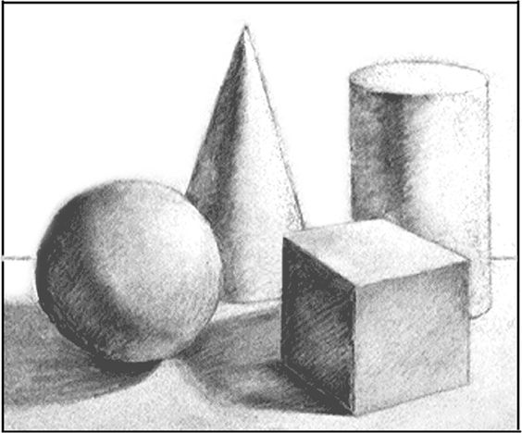
The Four Basic Shapes in a Composition

Slide 9
Draw the four basic shapes in a composition.
Show the different values in each shape.
Include: Highlights
Cast Shadows
Core Shadows
and

Slide 10
Grading Guidelines (Value Study):
Vocabulary in Sketchbook (10 points)
6 point value scale showed a gradual change from dark to light (20 points)
4 basic shapes:
Showed different levels of value (25 points)
Used composition (25 points)
Craftsmanship (took your time on your drawings and completed assignment neatly and effectively)
(20 points)

Slide 11
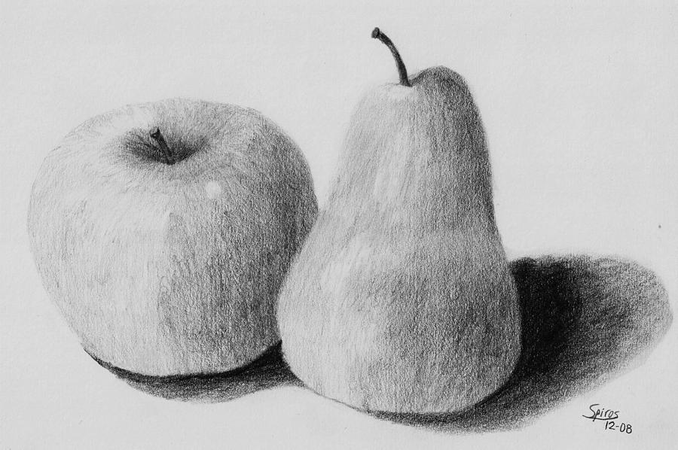
Value Drawing
Now draw the 2 pieces of fruit in full value. You should use all 6 levels of value in your work. Remember to think about composition.
Notes:
Talk about why drawing example has an effective composition. Have students use cell phones or view-finders to plan composition (take 3 photos), then start drawing in sketchbook (full page). Students should spend the rest for class time drawing.

Slide 12
Grading Guidelines (Fruit Still Life):
Highlights (10 points)
Cast Shadows (10 points)
Middle Tones (10 points)
Overlapping (10 points)
Life sized Fruit (10 points)
Smooth Transitions
(10 points)
Background (10 points)
Middle Ground (10 points)
Foreground (10 points)
Drawing Neatly (10 points)

