Slide 1
Elements of Visual Art **Please get out your sketchbook and write the following definition.** Texture: The way an object feels or looks like it feels.

Slide 2
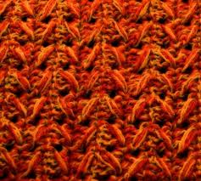
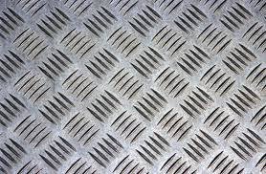
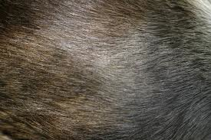
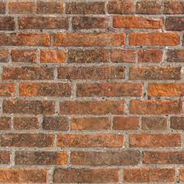
Texture
Real
How would it feel to the touch?

Slide 4
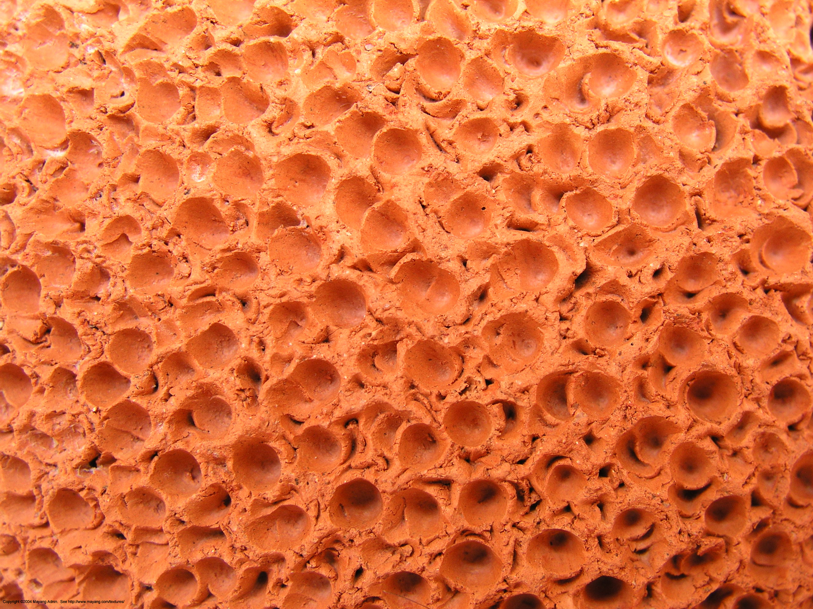

Slide 5
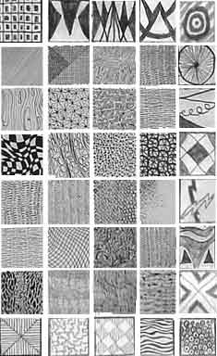
Texture
Notes:
http://www.mmwindowtoart.com/foundations/foundationstexture2.html

Slide 6
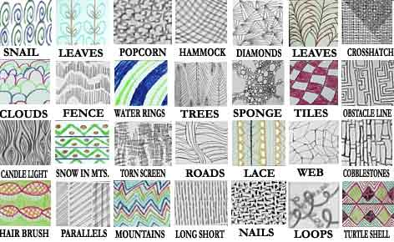
Implied Texture Visual Illusion

Slide 7
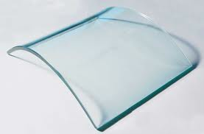
Real Texture
Brainstorm words that describe the texture.

Slide 8
Brainstorm Texture
Draw 6 examples of implied texture in your sketchbook.
They must resemble to a texture you see everyday.
10 min

Slide 9
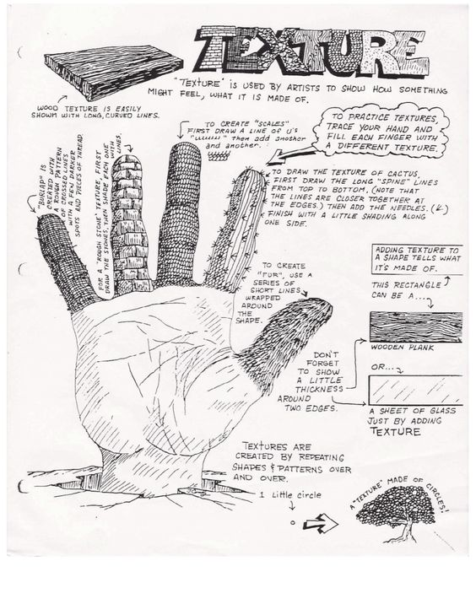
In your sketchbook draw your hand.
Create five different implied textures on your fingers.

Slide 10
Hands Grading Guidelines:

Slide 11
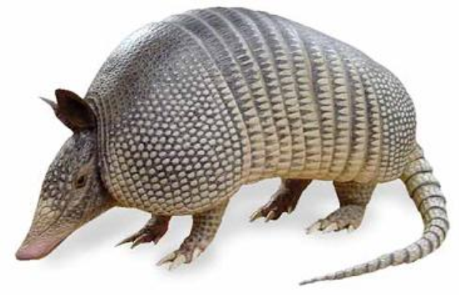
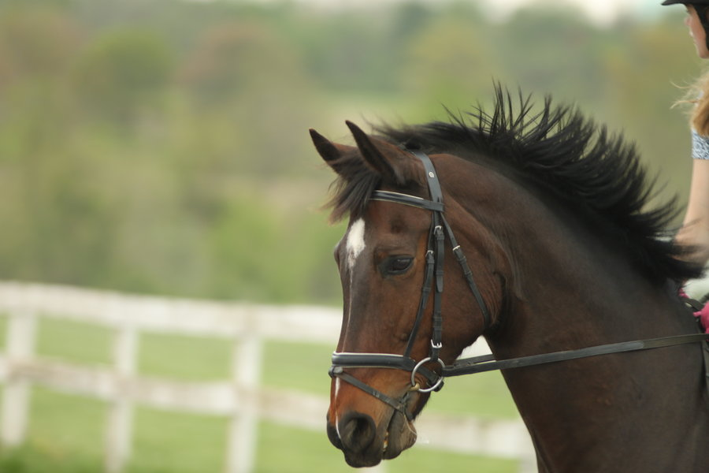
Draw one of the four animals showing implied texture.

Slide 12
Animal Grading Guidelines:
Value
Texture (fur, scales, feathers)

