Slide 1
Welcome to Kindergarten!
Mrs. Carter
&
Mrs. Williamson’s
Class

Slide 2
School/Daily Procedures

Slide 3
Checking-In
Any time you come into the school, you MUST wear a badge. Always check into the office to get one.
-This is for the safety of our students and staff.
Tardy bell rings at 8:05am. If your child is tardy, you must come inside the office to sign them in.

Slide 4
Checking-Out
If you need to check your child out early, you must sign your child out in the office.
Your child will then be called to the office

Slide 5
Breakfast
Everyone receives FREE breakfast.
Students must go directly to cafeteria prior to coming to class to receive breakfast .

Slide 6
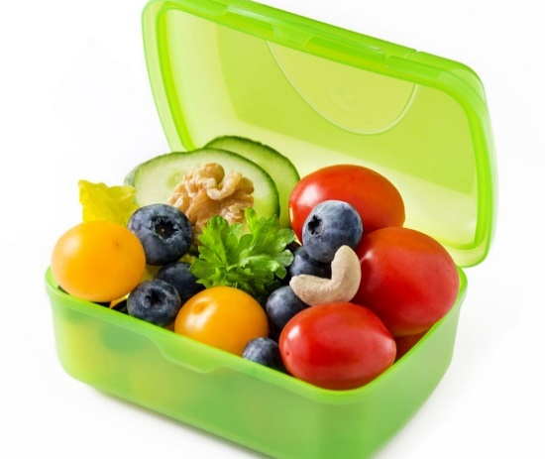
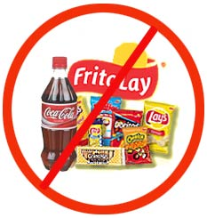
Snack Time
Send 1 Snack Each Day.
1. Please make it a healthy choice.
(fruit, veggies, dry cereal, crackers, etc.)
-Make it small…we don’t have much time
-No way of keeping your snack cold
2. You may send a bottle of water.
-Yes, it can be a reusable bottle.
-Write name on bottle (if reusing)
-We will not be going to the water fountain during snack.

Slide 7
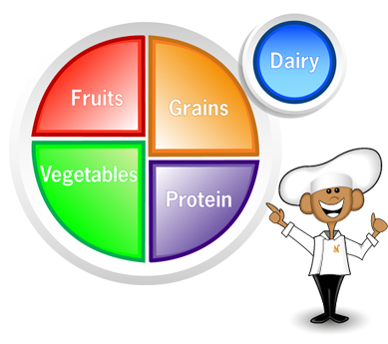
Lunch
All lunches are also FREE
Lunch Time Snack- You may send money ($) in a sealed envelope, labeled with first and last name, how much money is included, and what money is for. Student will take money to the cafeteria during breakfast, or during morning routine.
Shana Smith
Snack Money
$1.00

Slide 8
Transportation
Please make sure you see me to check your child’s transportation information.
All changes to transportation must be in writing by noon.
-Notes in the daily folder are preferred, e-mails are also accepted by 11:15pm.
-Absolutely NO phone calls (for safety reasons--We don’t actually know who is calling.)

Slide 9
In the Classroom…

Slide 10
Behavior System
(Blue) Great Day
(Green) Ready to Learn
(Yellow) Stop & Think
(Orange) Teacher Choice
(Red) Parent Contact
Clip Chart →
Students always begin day on “Green”
Students clip up for good choices and educational triumphs.
Students clip down to “Yellow” as a warning.
If students get to “Orange,” they will have a consequence, usually linked to offense, and may include a Lunch Detention.
If student gets to red, students will receive a Lunch Detention, note or phone call home, and may receive an office referral.

Slide 11
Green Daily Folder
Green Daily Folder will come home daily.
It contains a Behavior Calendar that will include the color he/she earned, as well as homework instructions, some worksheets, notes, and reminders.
----------------------
Behavior Calendars & Homework Instructions need to be signed daily.

Slide 12
Yellow Progress Folder
A Progress Folder will be sent home on Thursday with notes, reminders or tips about your child’s progress.
Please sign the folder each Thursday evening and return.

Slide 13
Homework
Homework Journal:
Monday – Thursday students will have homework.
Every week, a homework page will come home in your child’s Green Folder. It will have instructions for the week.

Slide 14
Homework
Homework Journal:
Students will have a Homework Journal that will be sent home on Mondays, and is due back on Fridays. It will be utilized for many homework activities.
Sometimes worksheets will be sent home, as well. This will also be listed on the Homework Instruction’s Page.

Slide 15
Sight Words
Aside from knowing all letters and sounds, recognizing sight words is essential to reading in Kindergarten.
There are 9 sets (about 16 words each) of words. Your child may learn one set a month, or he/she will have the opportunity to go on if motivated and able.
Students will be rewarded for learning each set! More information to come!

Slide 16
Reading Folder
When your child is ready, a Reading Folder will also be sent home weekly as homework. It will include several books at your child’s reading level.
More information on that to come!
(Get Excited!!)

Slide 17
Newsletter
I will e-mail a Newsletter every week or so with additional information/ reminders.
-If you have no e-mail, I will send a paper copy.

Slide 18
General Information

Slide 19
Medication
No medication should be brought to school, unless we have doctor’s orders.
No chap stick or cough drops.
----------------------
If your child needs to take medication at school, please bring in medical documentation ASAP! -This includes inhalers for asthma
Please contact the school nurse with any questions.

Slide 20
Kindergarten Physical
Your child must have a current Physical (within the last year) on file within the first 30 days of school. It is due no later than September 24th.
If no is Physical submitted, a suspension will result until paperwork is submitted.

Slide 21
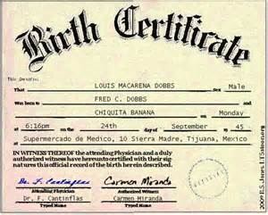
Birth Certificate
It is required by law that a Birth Certificate is on file at the school. If you have not submitted one, please do that as soon as possible.

Slide 22
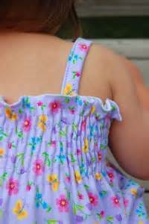
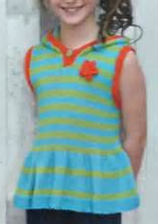
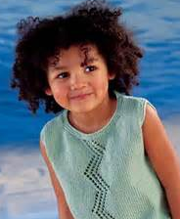
Dress Code
Students at Bunn Elementary must follow the student dress code. The most frequent violations include:
Any sort of tank top or spaghetti straps (sleeveless is acceptable.)

Slide 23
Dress Code
Shorts may be no higher than mid-thigh.
Skirts and dresses must be no higher than three inches above the top of the knee.
Clothing is not to be sheer or mesh and cannot have excessive holes
An extra set of seasonal appropriate clothing is required to stay at school for Kindergarteners
If the dress code is violated, or your child has an accident and he/she does not have clothes at school, parents will be contacted to bring in clothes.

Slide 24
Volunteers/Field Trip
All parents are highly encouraged to get Volunteer Status online through the Franklin County Schools Website!!
If you would like to go on our field trip, or help out in the classroom, you must need clearance! You can not go on a fieldtrip without clearance.

Slide 25
$20.00 Kindergarten Fee
Fee covers:
-Field Trip
-Other themed activities during the year
Due by the end of September 16th
-Make checks payable to Bunn Elementary School
-Receipt sent to verify payment.

Slide 26
Thank You!
Mrs. Carter &
Mrs. Williamson’s
Class

